Slide 1
BIOACOUSTICS IN THE URBAN NATURE PROJECT
Ed Baker
ACOUSTIC BIOLOGY RESEARCHER, NHM

Slide 2
BIOACOUSTICS: BRIEF INTRODUCTION

Slide 3
Why do animals make sounds?
To communicate
Navigation
As a form of defence
Incidental noises

Slide 4
Why study sounds?
Relatively cheap way of monitoring biodiversity 24/7
For some groups (e.g. birds) can give clues to behaviour
Non-disruptive
Noise

Slide 5
The Challenges
We don’t know what everything sounds like
Volume of data to analyse and store
Cost
Water and electronics

Slide 6
NHM BIOACOUSTICS

Slide 7
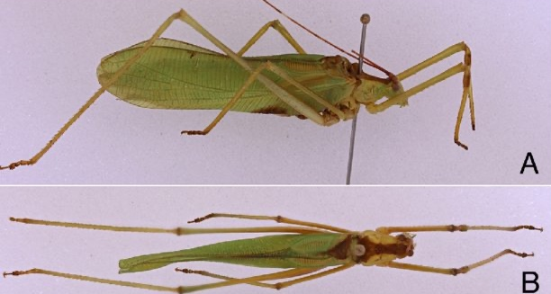
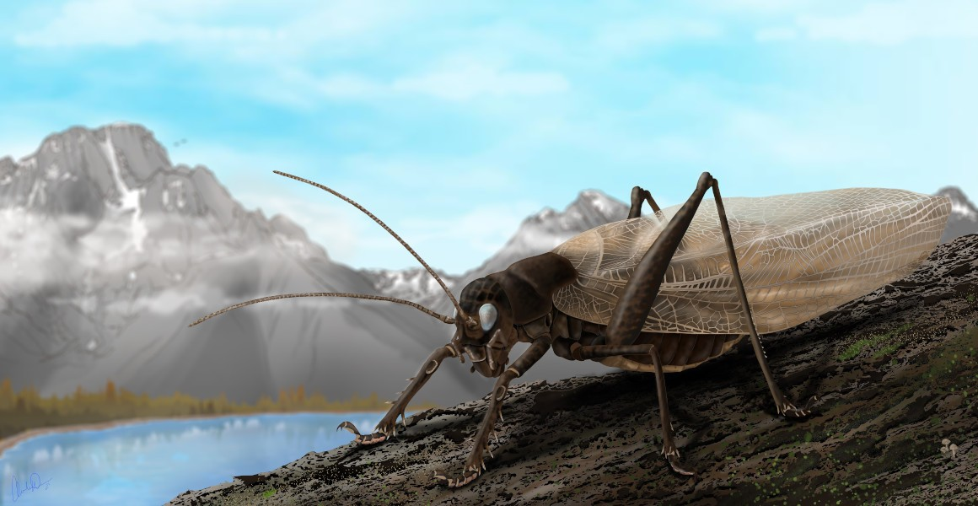
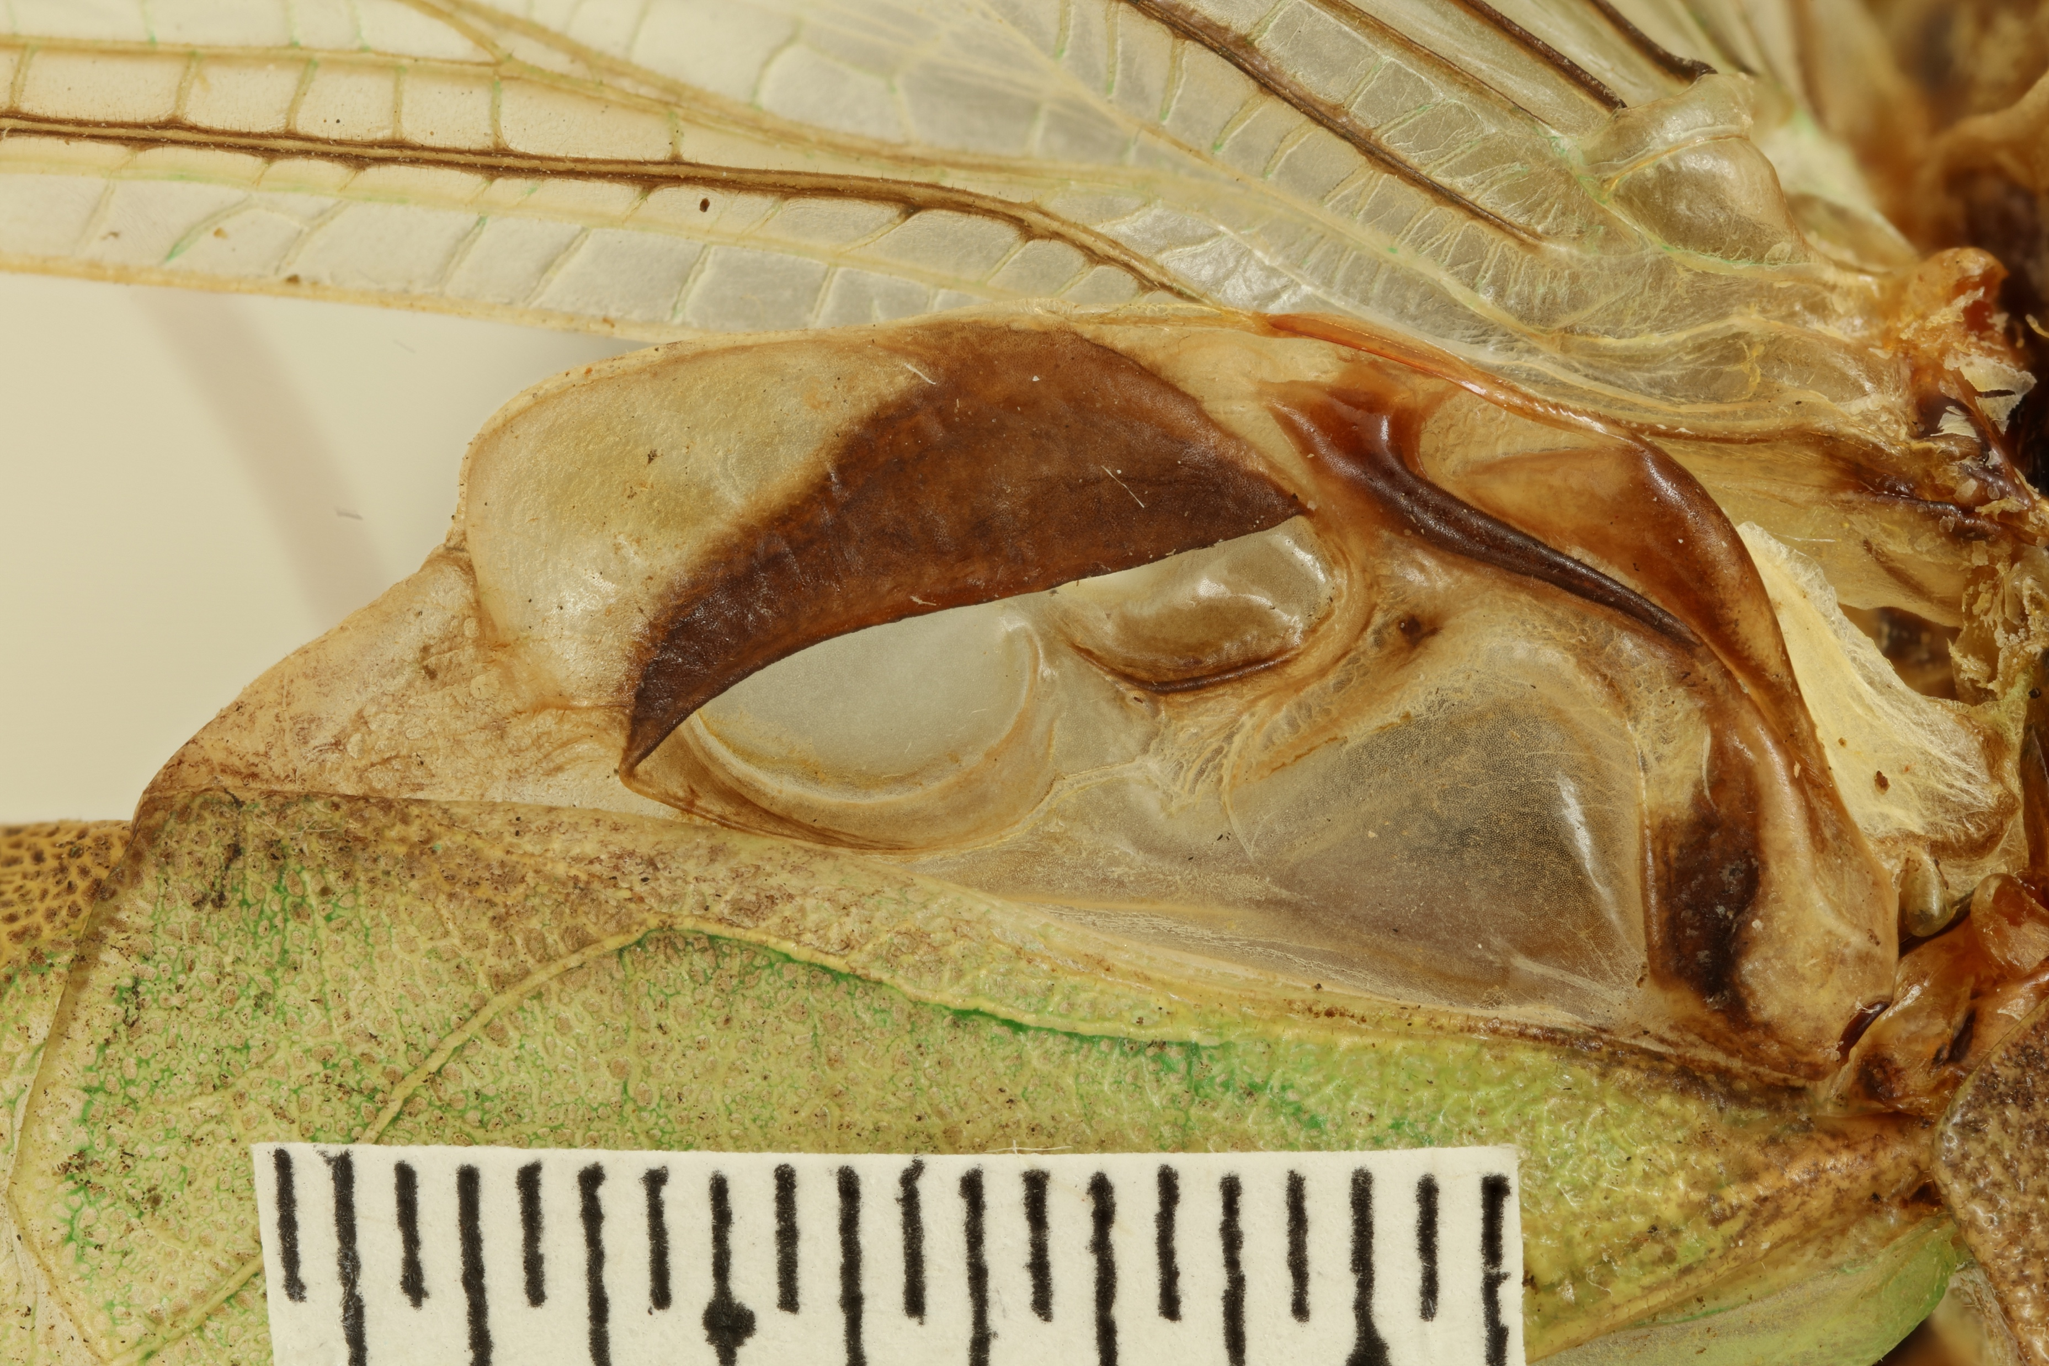
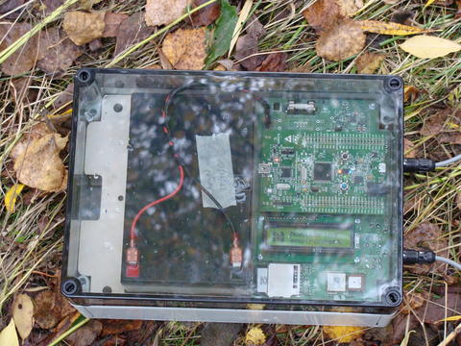
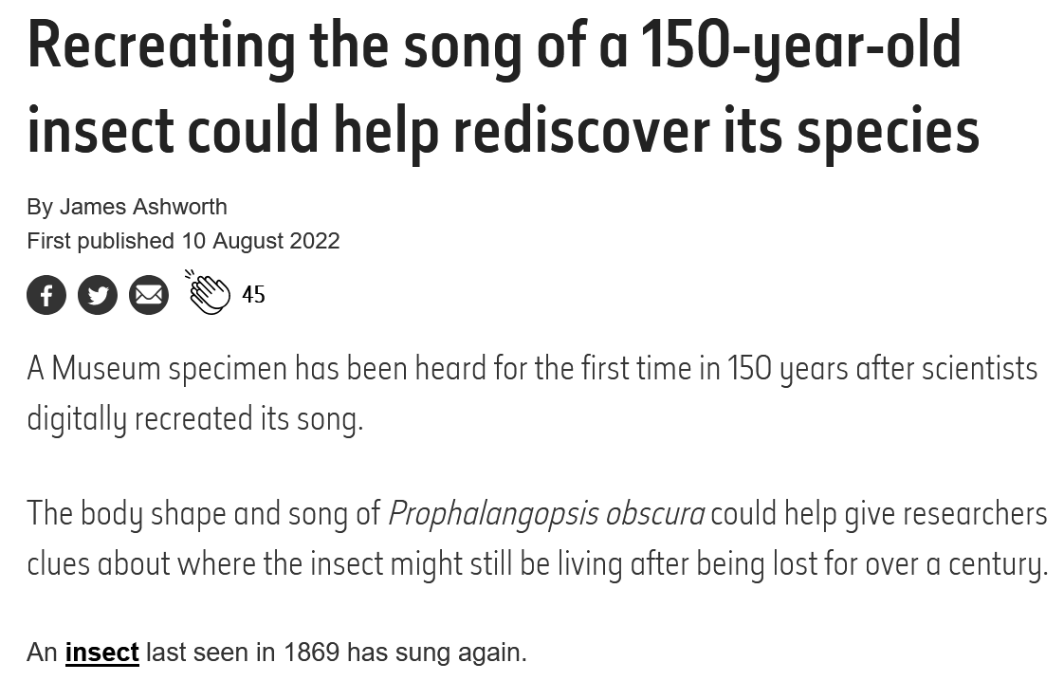
Previous ACOUSTICS WORK AT NHM

Slide 8
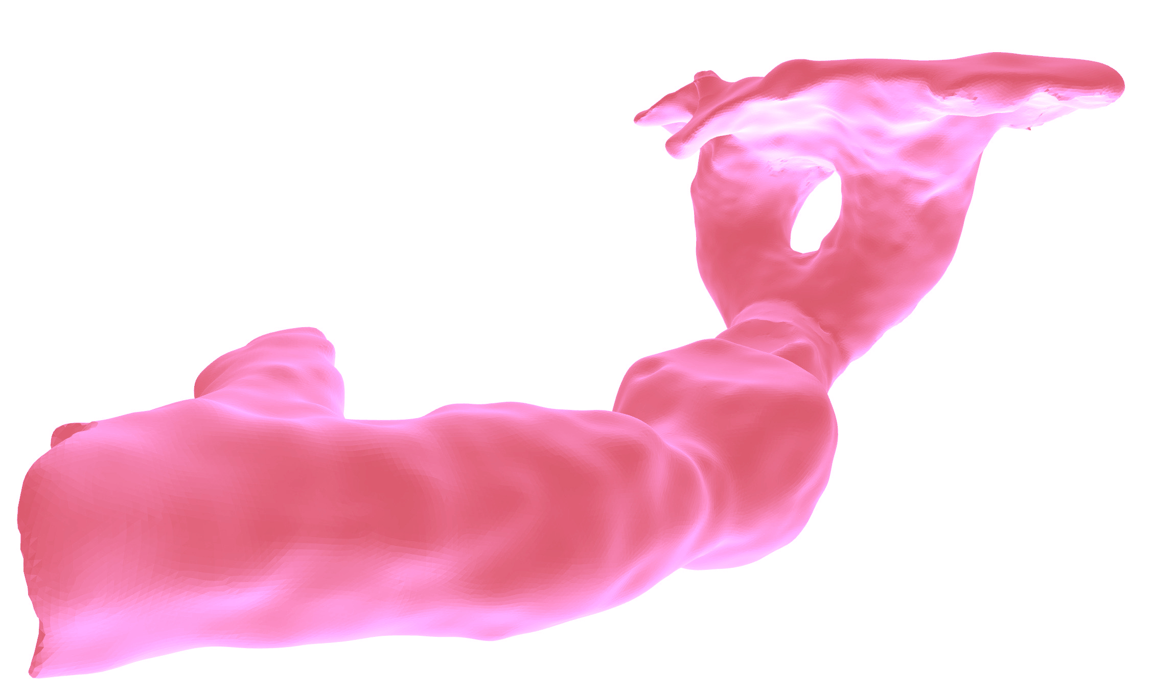
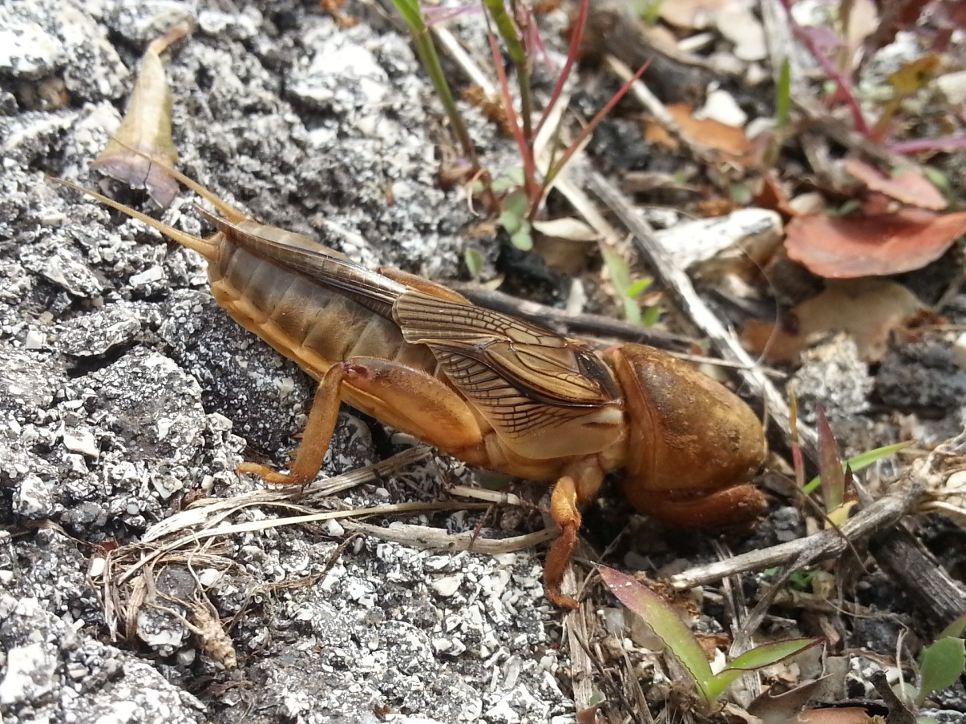
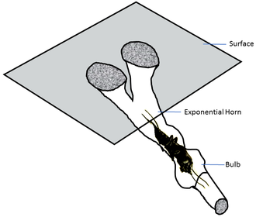
Previous ACOUSTICS WORK AT NHM

Slide 9
WHAT’s DRIVING CHANGE?

Slide 10
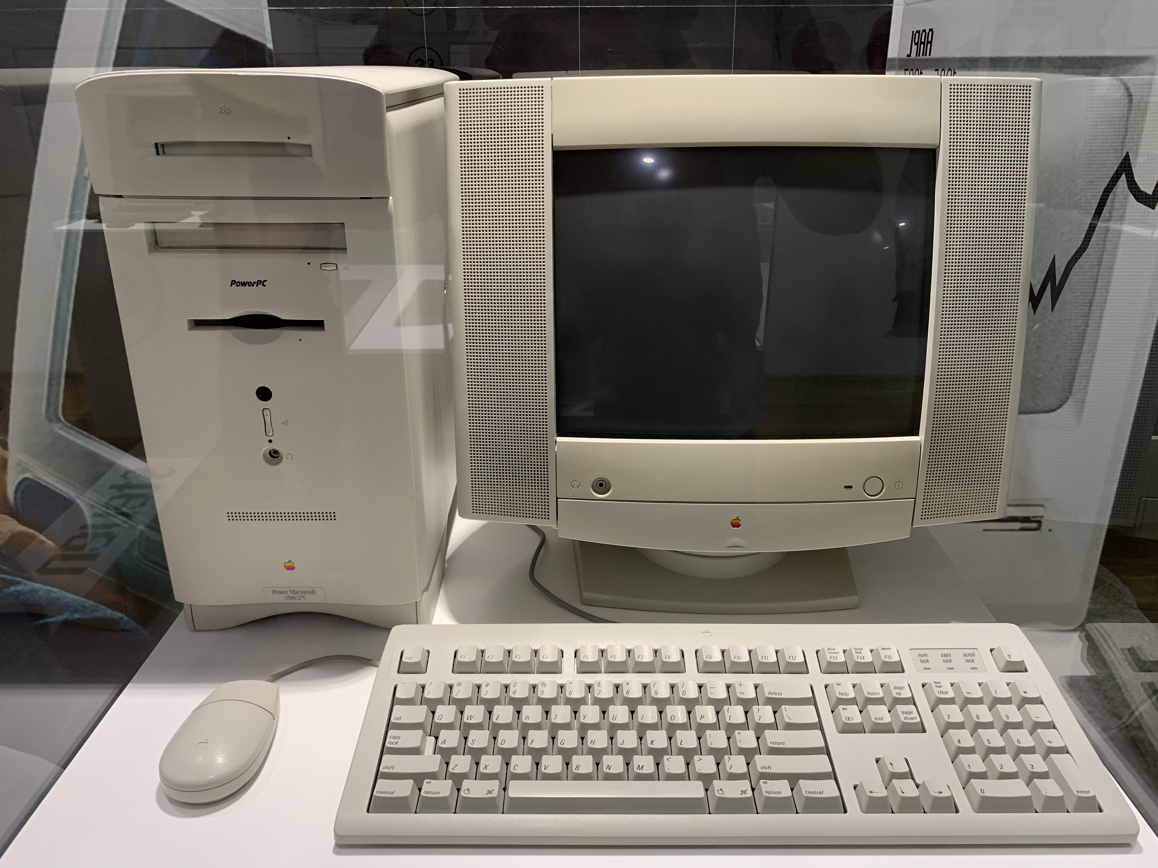
WHAT’s DRIVING CHANGE?

Slide 11
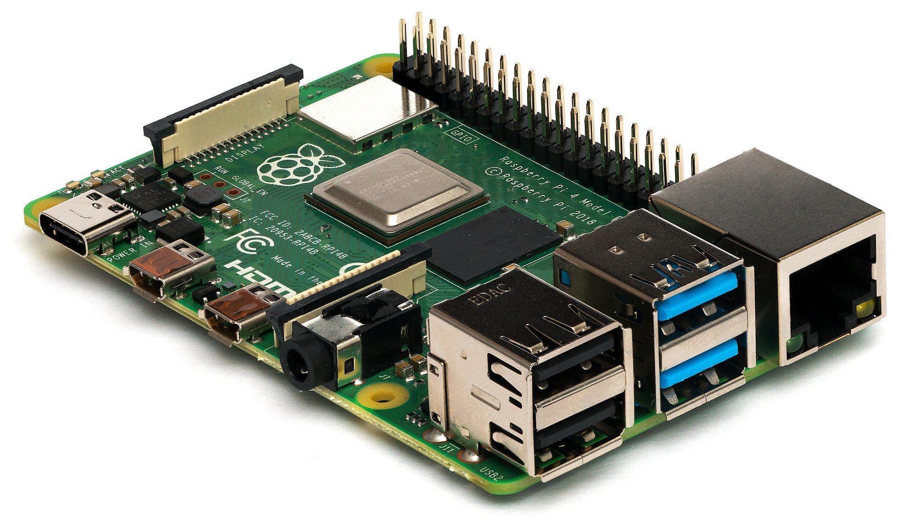
WHAT’s DRIVING CHANGE?

Slide 12
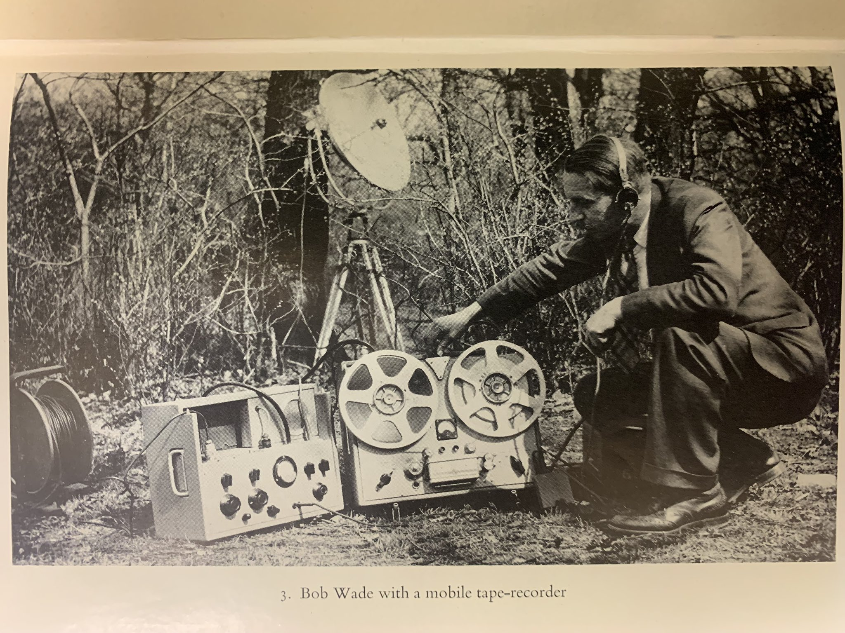
WHAT’s DRIVING CHANGE?

Slide 13
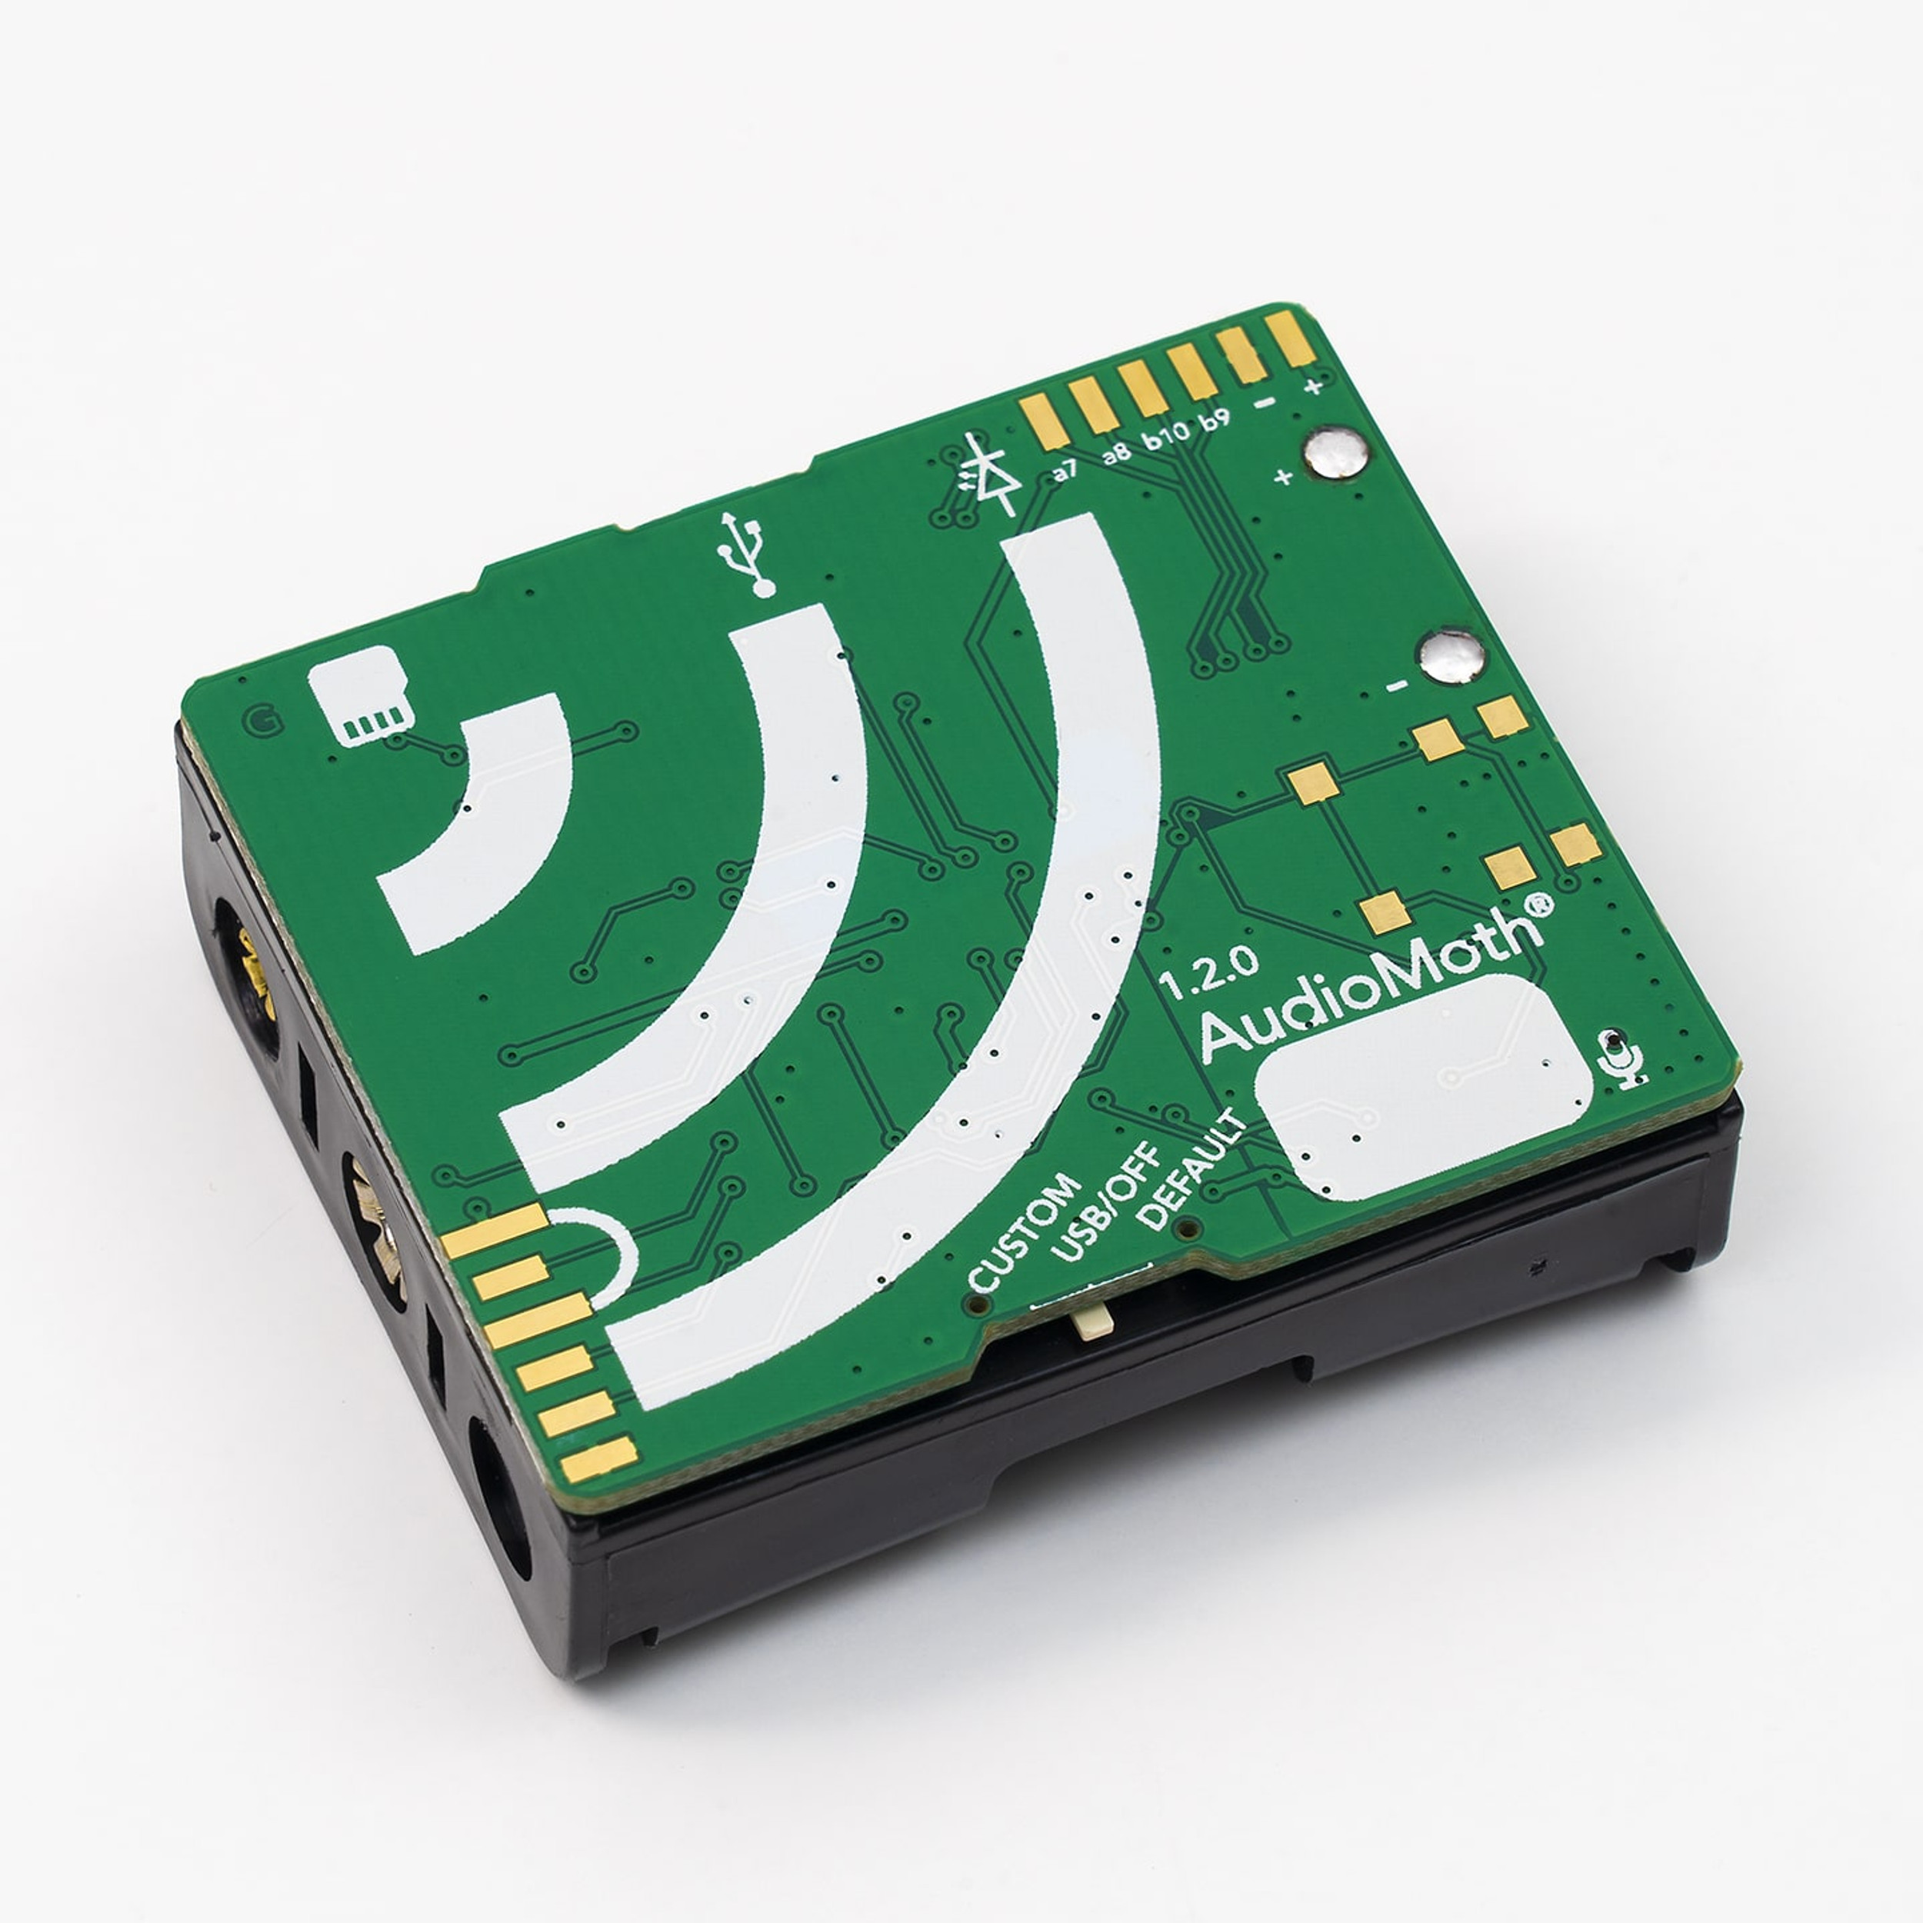
WHAT’s DRIVING CHANGE?

Slide 14
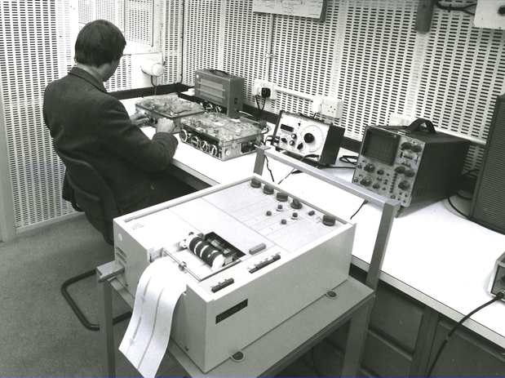
WHAT’s DRIVING CHANGE?

Slide 15
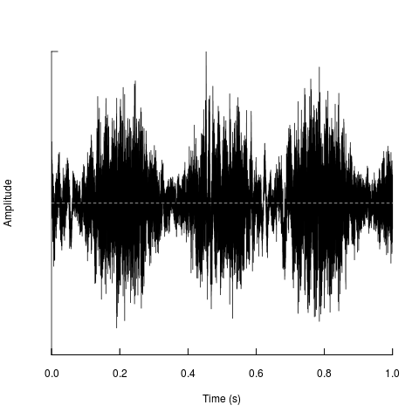
WHAT’s DRIVING CHANGE?

Slide 16
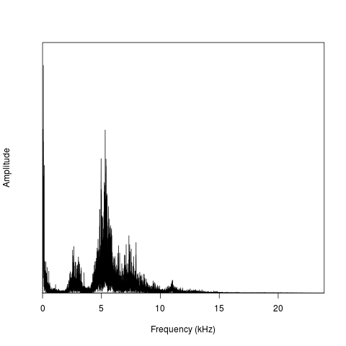
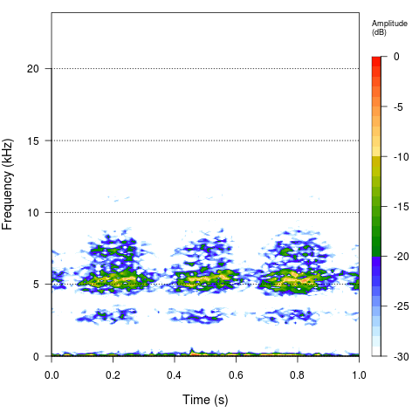
WHAT’s DRIVING CHANGE?

Slide 17
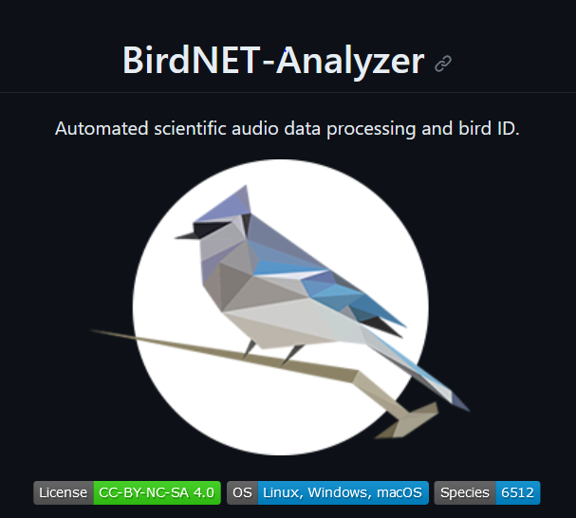
WHAT’s DRIVING CHANGE?

Slide 18
NHM Approach: From The Lab to The Field
BIOACOUSTICS
ECOACOUSTICS
Single species
Ecosystems
Single microphones
Microphone arrays
Sensor networks
Species descriptions
Behavioural studies
Sound collections
(https://bio.acoustic.ca)
Statistical analyses
Machine Learning

Slide 19
Urban Nature Project
Changing the scope, scale and speed of acoustic monitoring
Bringing technology to environmental challenges
Integrating bioacoustics with other methods

Slide 20
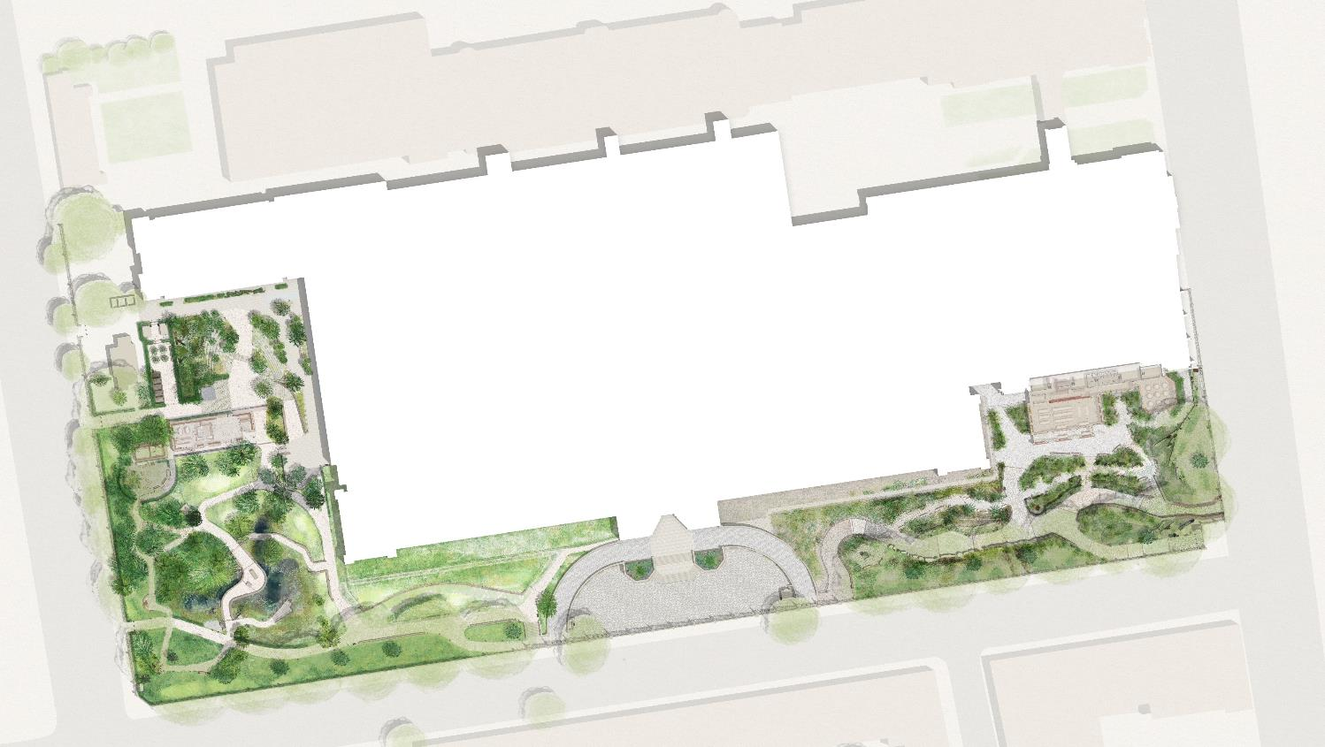
We currently monitor ‘our’ biodiversity using visual and eDNA methods
2024 onwards will also include bioacoustic and environmental parameters across a 25 point IoT sensor array
Long-term monitoring plus detailed case studies of how habitat translocation, creation and restoration actions impact biodiversity
Data infrastructure to capture, share and support co-analysis and visualisation of these multiple data types

Slide 21
LOTS OF DATA
25 hours of audio per hour
+ partner sites

Slide 22
Data Ecosystem and high-throughput computing allow for real-time analysis

Slide 23
Overview Analyses
24 hours recorded from a tropical rainforest in Sabah, Borneo.

Slide 24
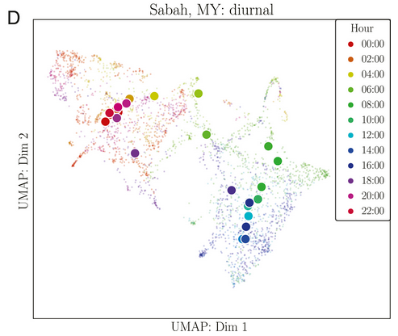
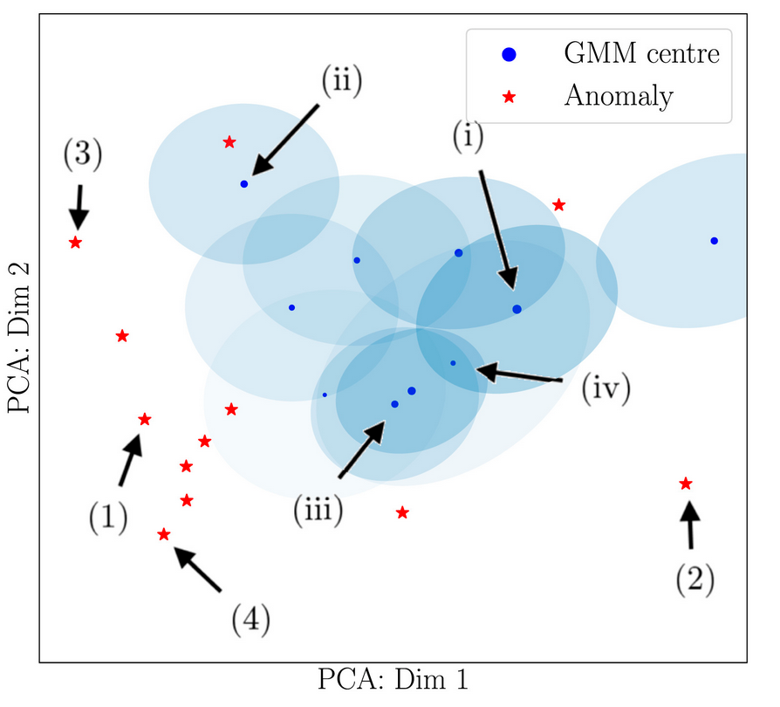
Overview Analyses
10.1073/pnas.2004702117

Slide 25
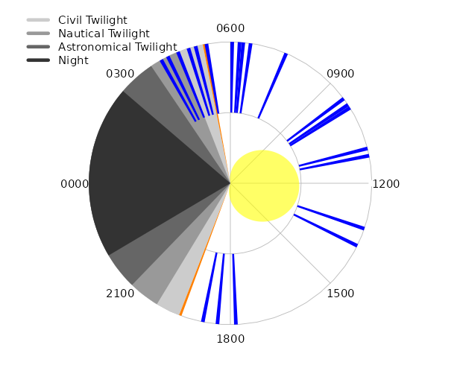
SPECIES Analyses
UNP partner site Glasgow

Slide 26
Integrated analysis
Comparing acoustic complexity measures with eDNA diversity
Refining acoustic identifications with distribution and niche models
Noise transfer between environments (e.g. airborne and freshwater)
… and?

Slide 27
Questions?

