Slide 1
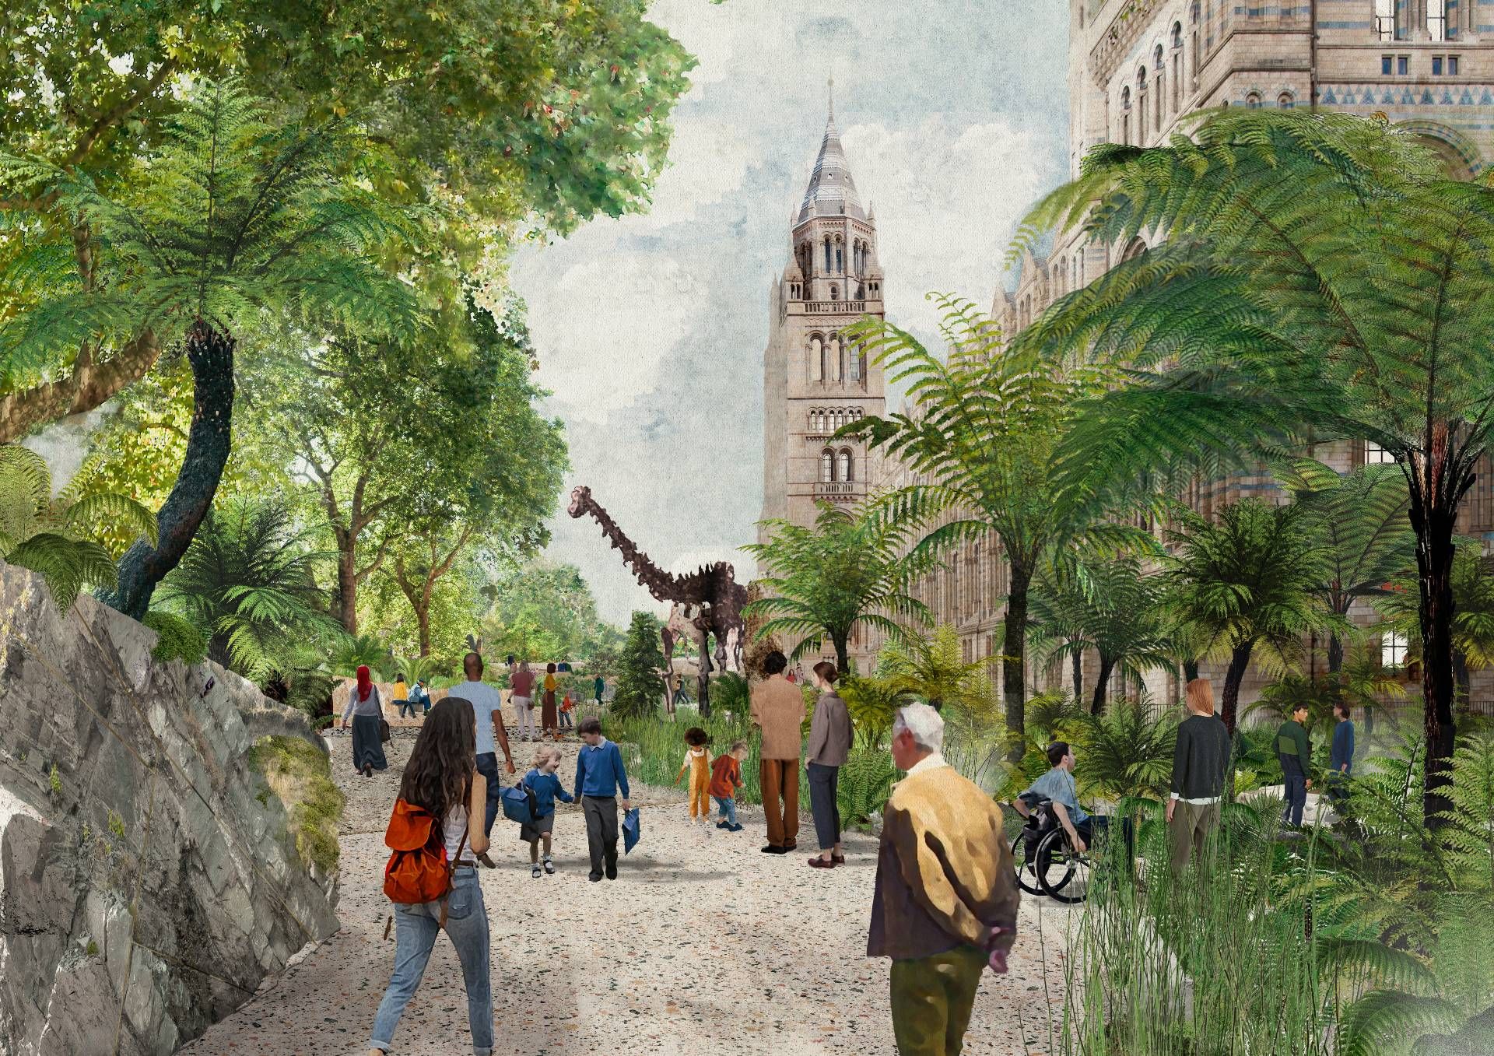
Bioacoustic and ecoacoustic data in AudiovisualCore
Ed Baker
Acoustic Biology Researcher, Natural History Museum, London
Convenor, AudiovisualCore MG
Notes:
Good afternoon and thank you for joining us for this session in which we’ll introduce some of the ways that we’re developing and employing digital technologies to monitor and support recovery of the UK’s urban nature

Slide 2
Bioacoustics

Slide 3
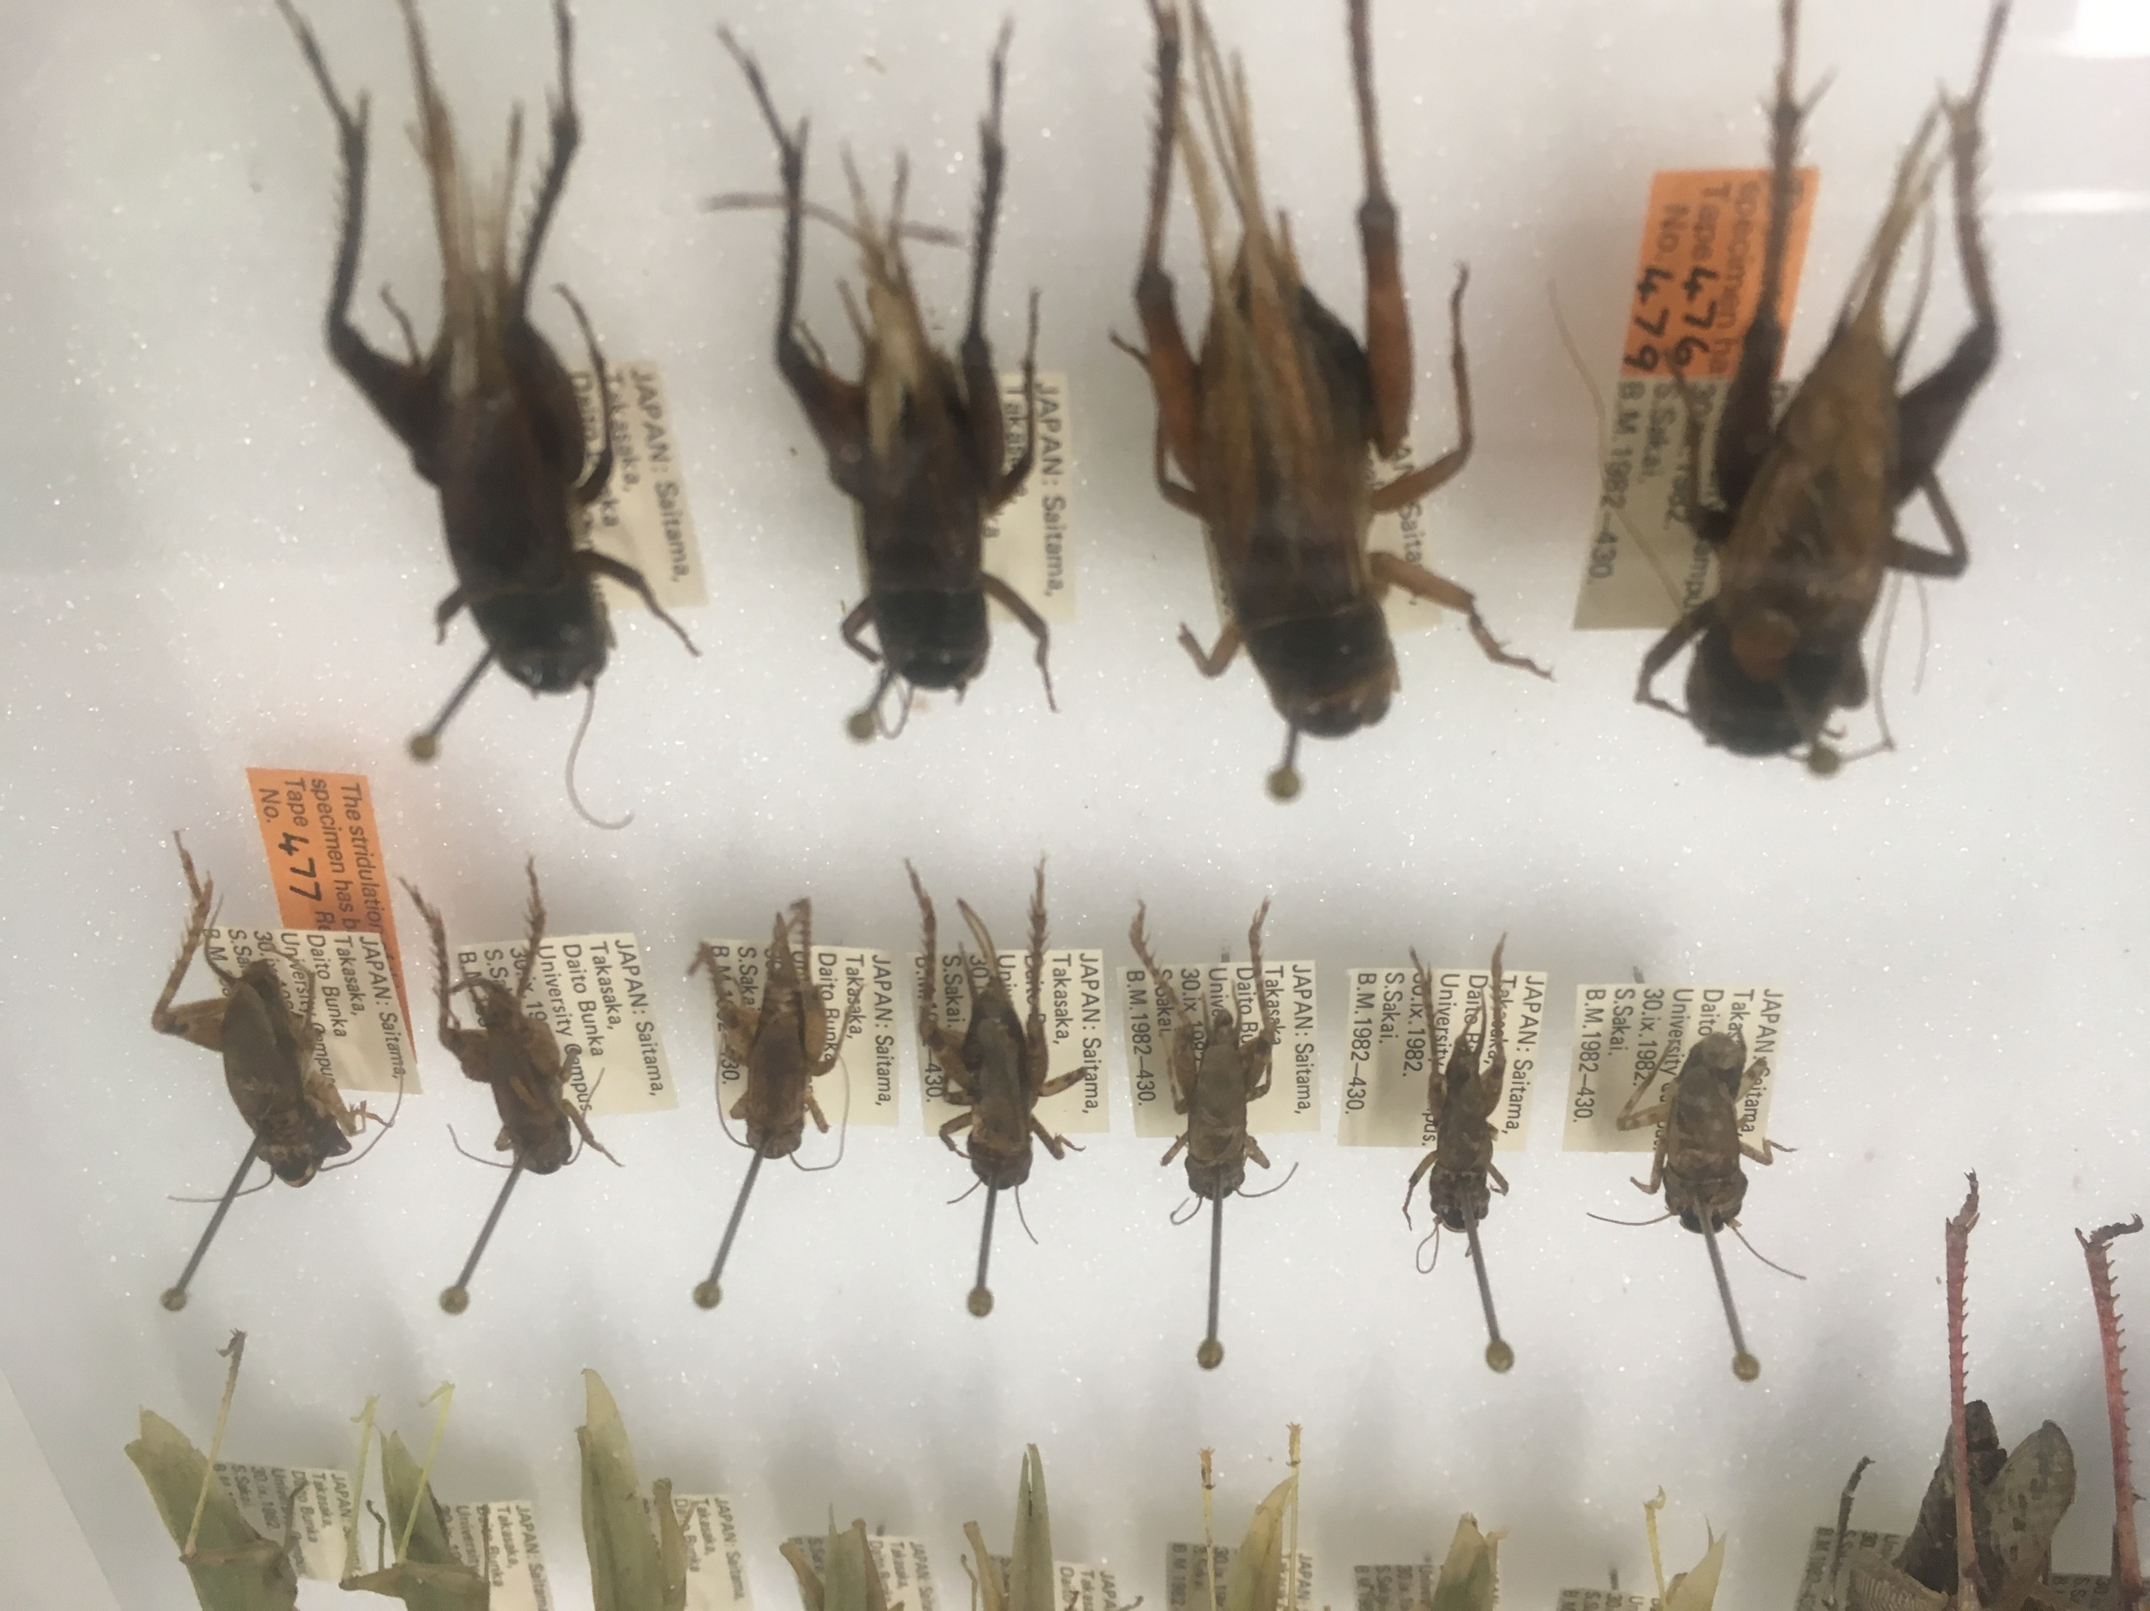

Slide 4
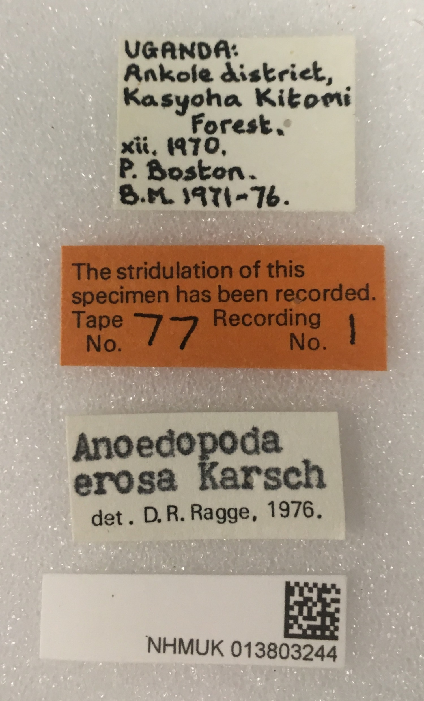

Slide 5
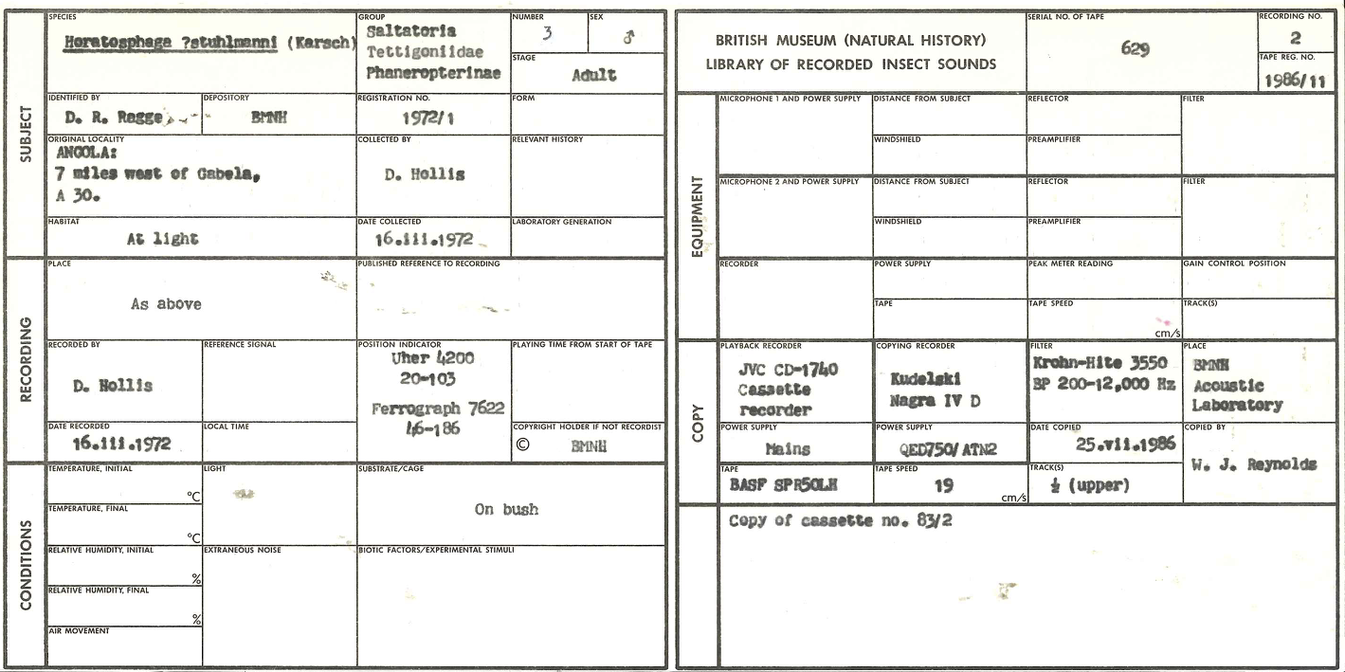

Slide 7
Blue: voice introductions
Red: extraneous noise
Green: calls

Slide 8
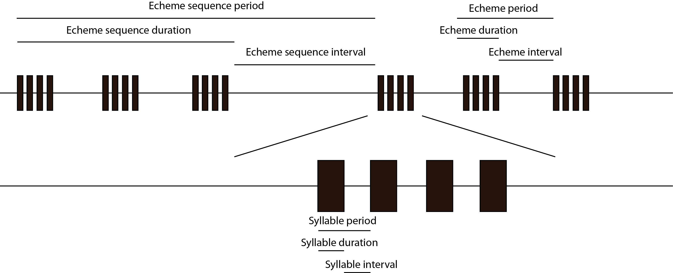
doi: 10.3897/BDJ.8.e54222

Slide 9
doi: 10.3897/BDJ.8.e54222

Slide 10
doi: 10.3897/BDJ.8.e54222

Slide 11
doi: 10.3897/BDJ.8.e54222

Slide 12
https://🦗.fm

Slide 13
Ecoacoustics

Slide 14
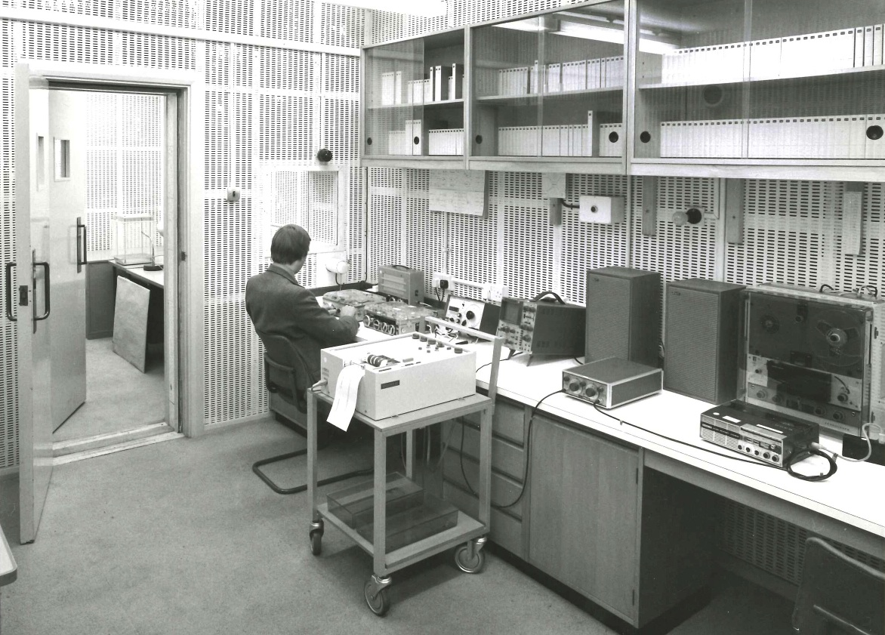
Ecoacoustics

Slide 15
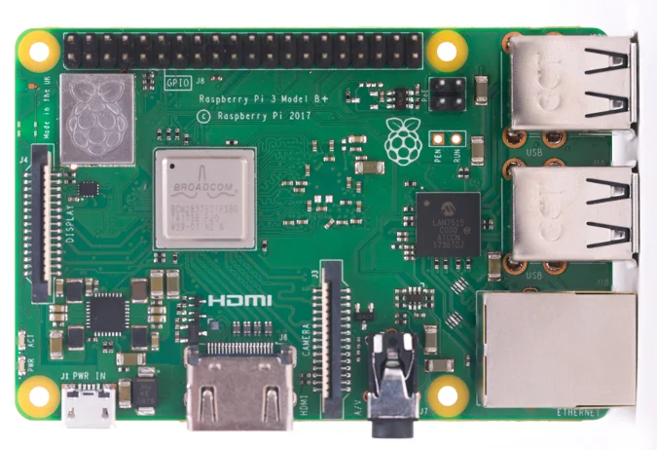
Ecoacoustics
Individuals
Landscapes

Slide 16
https://www.nps.gov/mora/learn/nature/soundscapes.htm

Slide 17
Notes:
Another example of how we’re building on our on-site research is community or participative science
Here where we’re actively using digital tech to connect people with their local urban nature and engage audiences in scientific research using a familiar device – their mobile phone.
Open to all, but aims to empower young people by focusing on their interests, curiosity and concerns – co-designed with school pupils “How can we make roads better for nature?”
Human-made noise can cause behavioural and physiological changes in animals
First study to look at impact of road noise on insects - at scale - in the UK
56,000 participants in activities in 2023

Slide 18
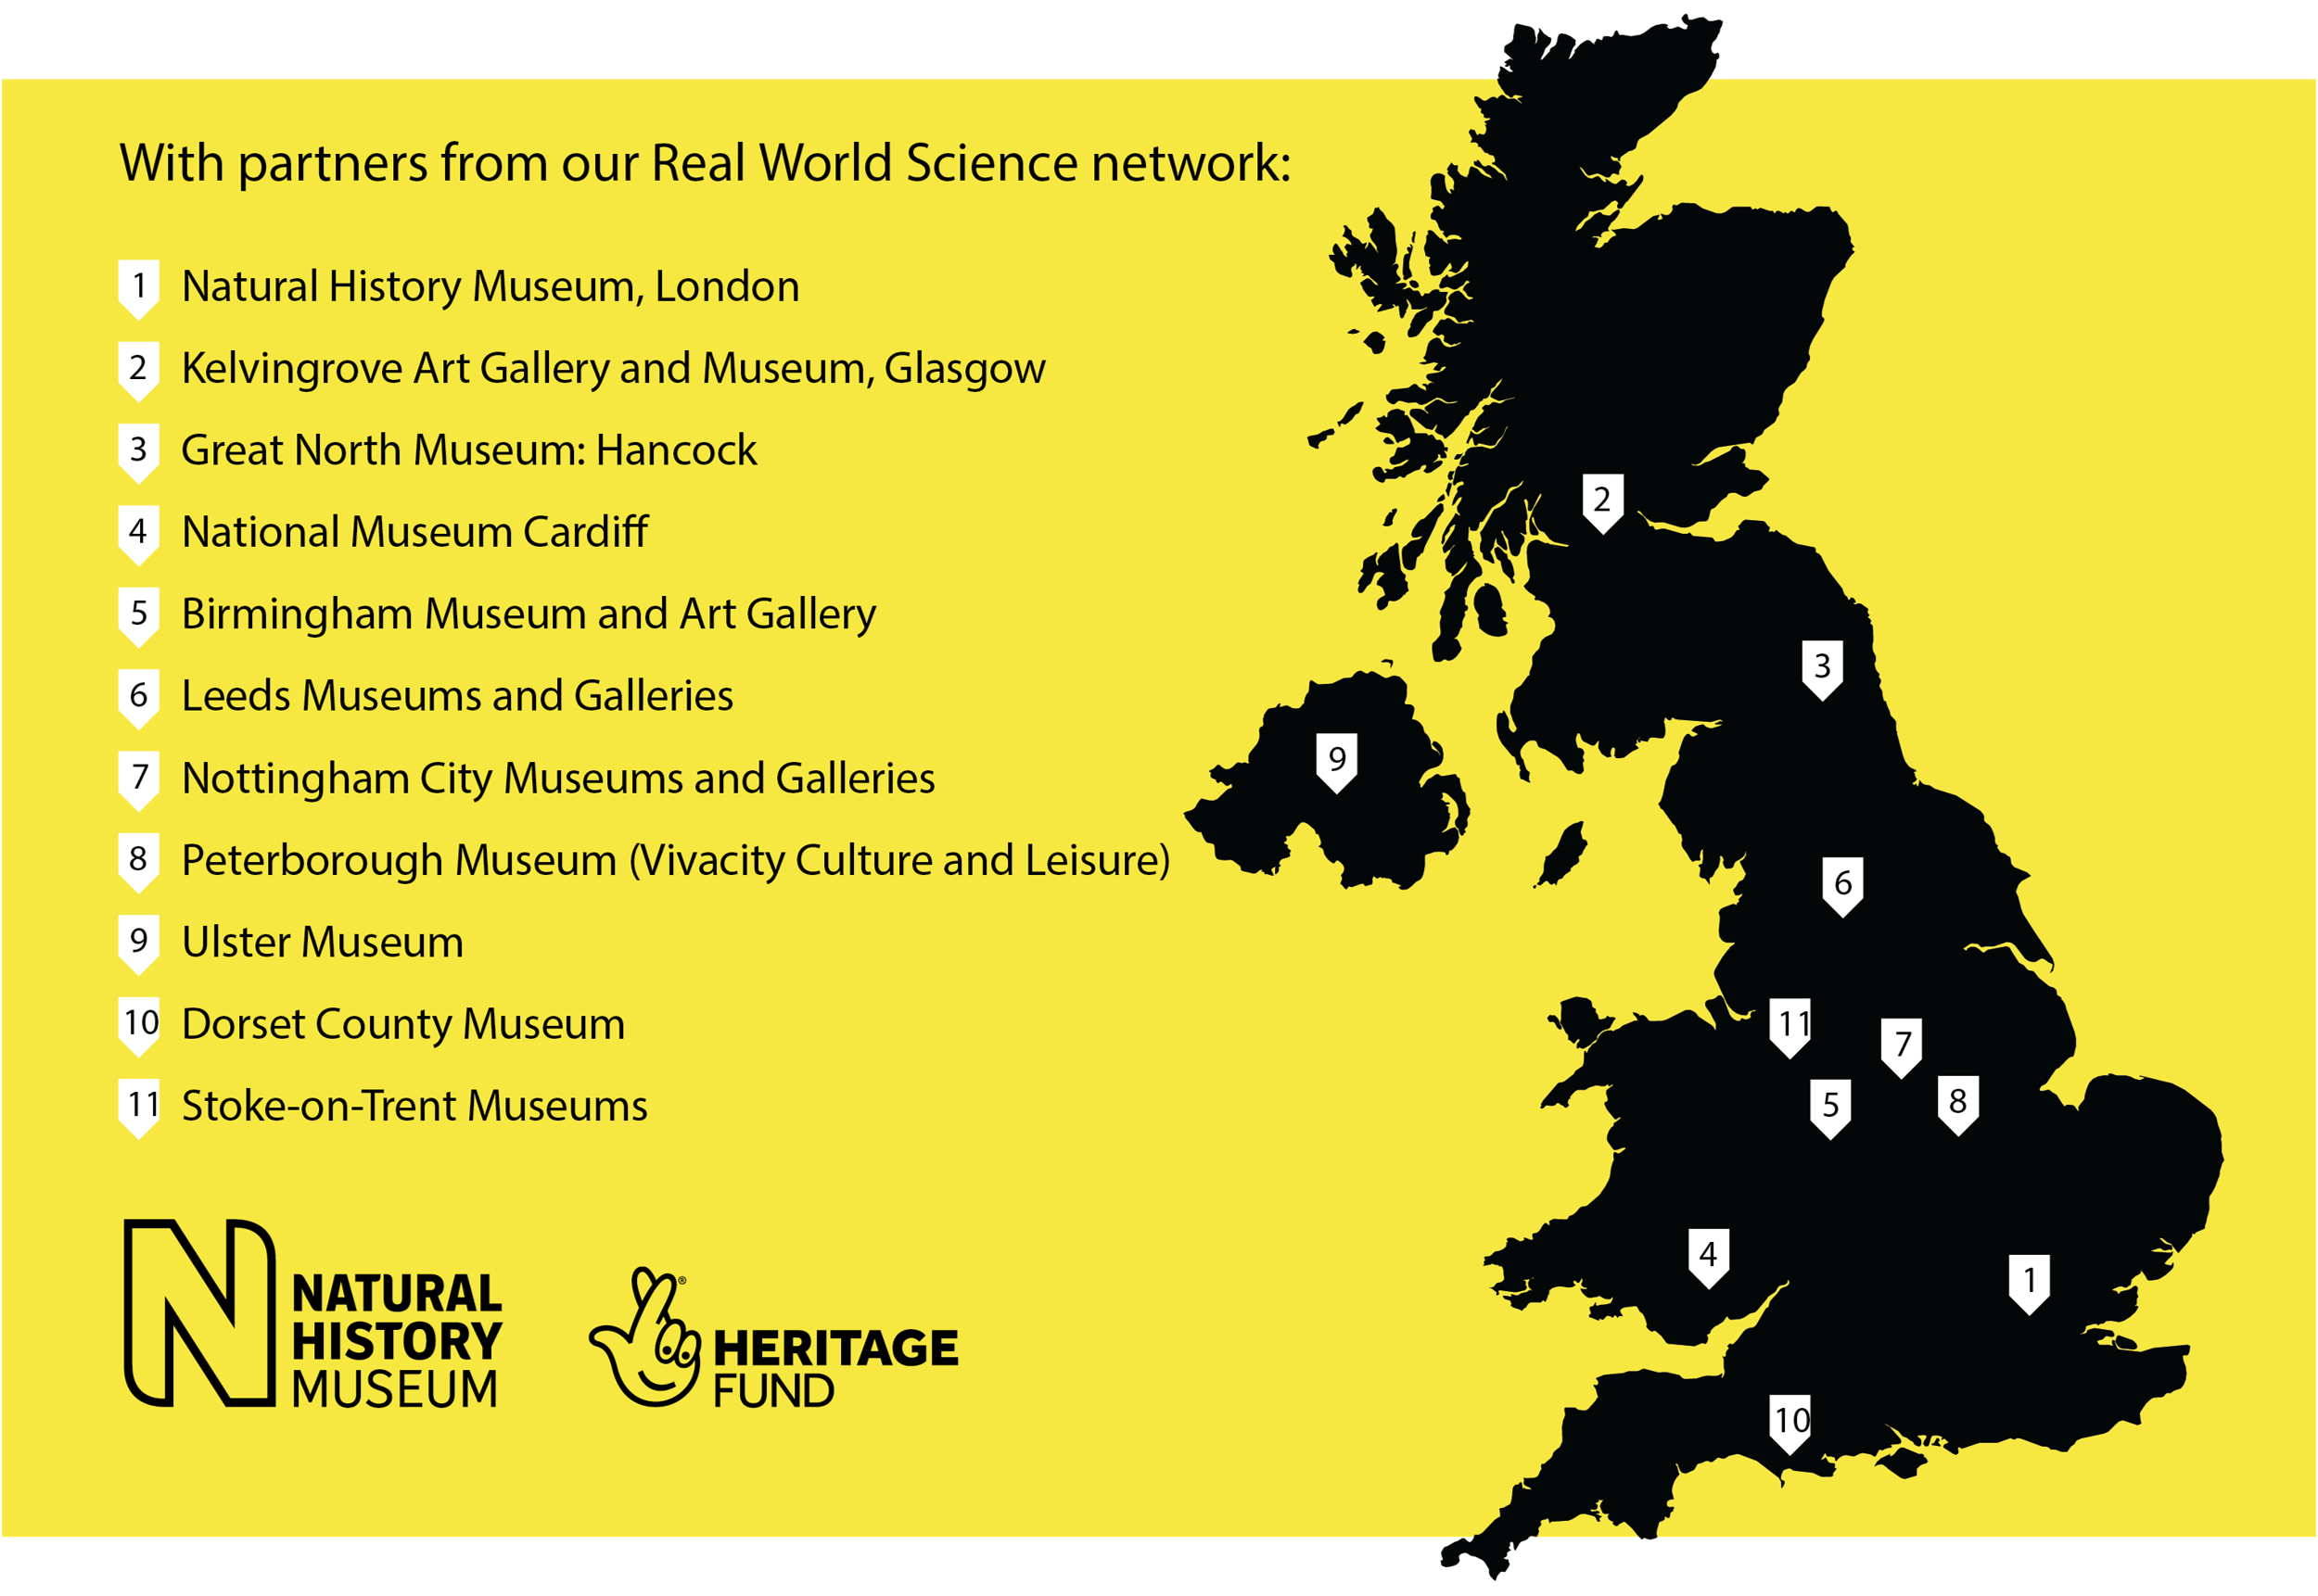
Urban Nature Project
Partner Network

Slide 19
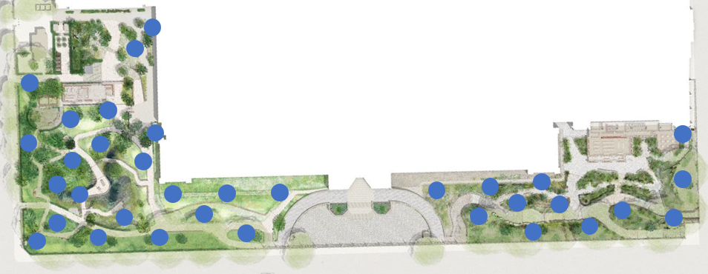
Acoustic sensor network
Permanent, integrated digital infrastructure
Acoustics
Air
Water
Soil
Timber
Ultrasound
Spatial
Notes:
Talk through sensor network and how it can be used by others, plus how it is a model that can be extended at other locations

Slide 20
Both

Slide 21
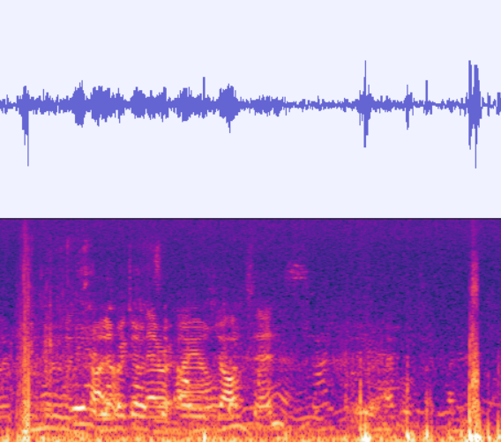
Both

Slide 22
Both

Slide 23
Both

Slide 24
Both

Slide 25
Both

Slide 26
Audio files…
May contain multiple occurrence records
May contain multiple “things”
Different parts can be used for different purposes (regions input and output to models)
Need to identify regions within files.

Slide 27
Other uses cases
Specimen digitisation (labels / scales / colour refs) – more later
Video

Slide 28
RegionOfInterest
hasROI, isROIof
startTime, startTimestamp, endTime, endTimestamp
freqLow, freqHigh
xFrac, yFrac, (heightFrac, widthFrac), radius

Slide 29
Prototype aggregator
audioblast.org
Annotations/ROI (BirdNET, etc)
Traits

Slide 30
ac: coming soon (and thanks)
Content Description Controlled Vocabulary https://github.com/tdwg/ac/milestone/7
3D Task Group https://github.com/tdwg/ac/milestone/8
Third Wednesday MG meetings: GitHub

Slide 31
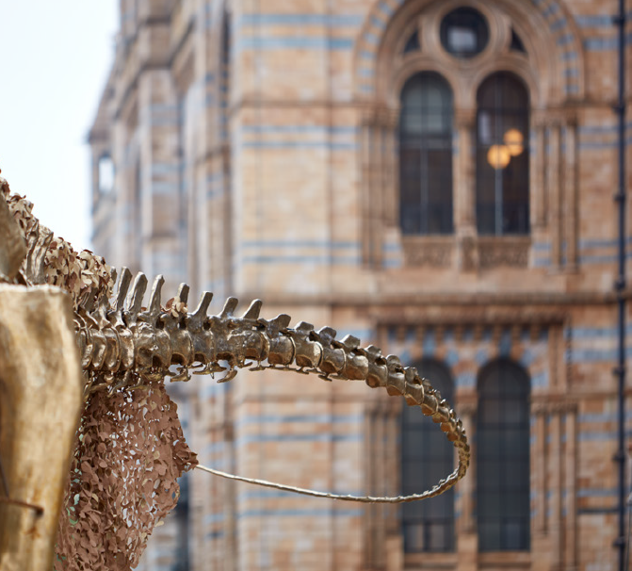
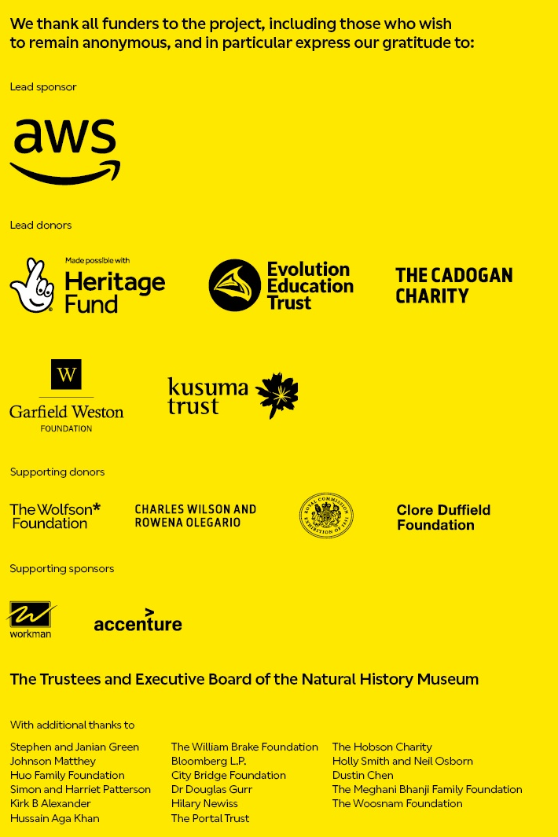
Questions?
edward.baker@nhm.ac.uk

