Slide 1
Garden science Sounds, sensors, and network
Ed Baker
Acoustic Biology Researcher Natural History Museum, London

Slide 2
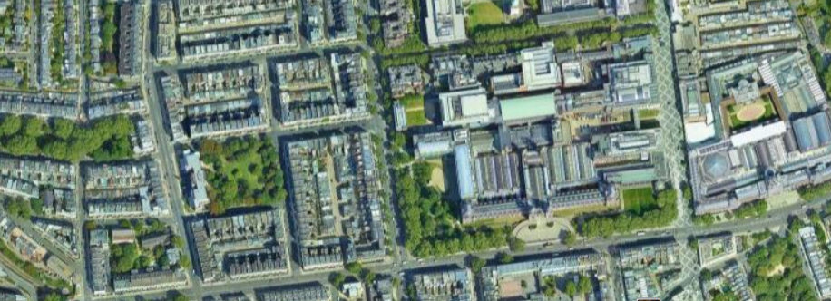
Urban Nature Project
The Urban Nature Project is developing new scientific tools and skills urgently needed to monitor, understand and protect urban nature.
nhm.ac.uk/urbannature

Slide 3
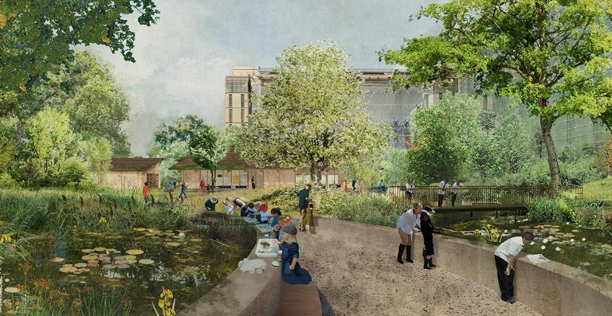
A Living Laboratory
Our gardens are a hub for urban nature identification and field survey skills

Slide 4
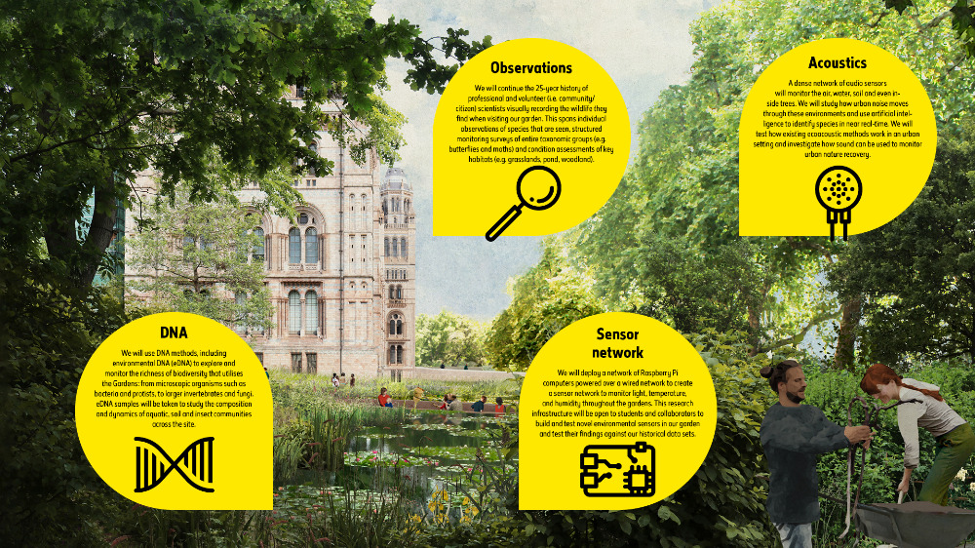

Slide 5
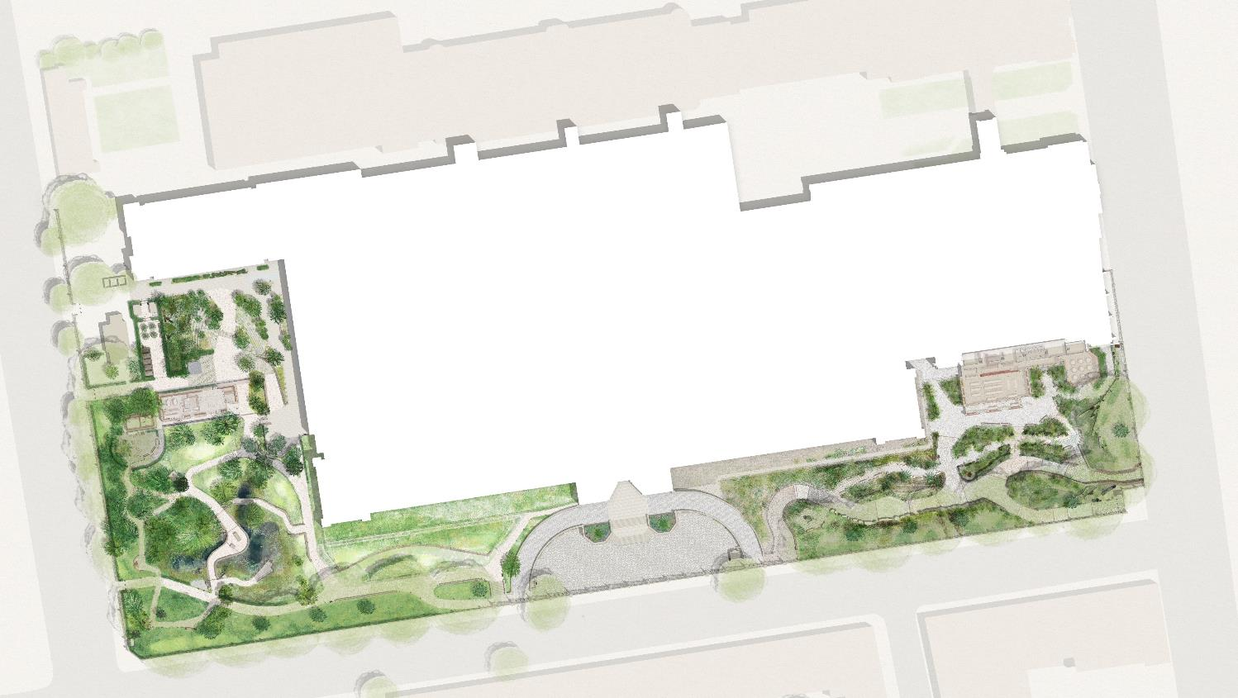
A Living Laboratory
Power-over-Ethernet locations
Long-term (intense, untargeted) monitoring plus detailed case studies of how habitat translocation, creation and restoration actions impact biodiversity
Over-specified (plenty of excess compute, transfer) – capacity to double number of devices. Testing arena for more targeted, less power-hungry devices.
Background data:
One of the most intensively studied urban sites for 25 years

Slide 6
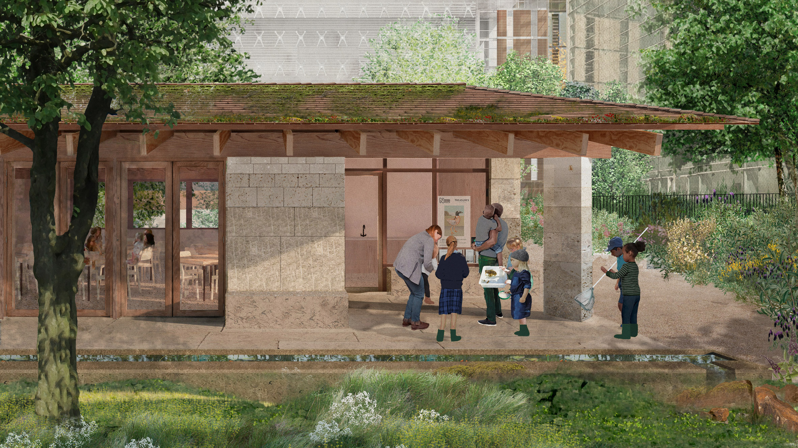
Education and engagement
Nature Activity Centre supported by AWS
Listening funnels (curated soundscapes from grounds) with interpretation panels
Digital panel with real-time identifications and interpretation

