Slide 1

Latest additions to Audiovisual Core
Ed Baker
Bioacoustics Researcher, Centre for UK Nature, Natural History Museum
Convenor, TDWG Audiovisual Core Maintenance Group

Slide 2
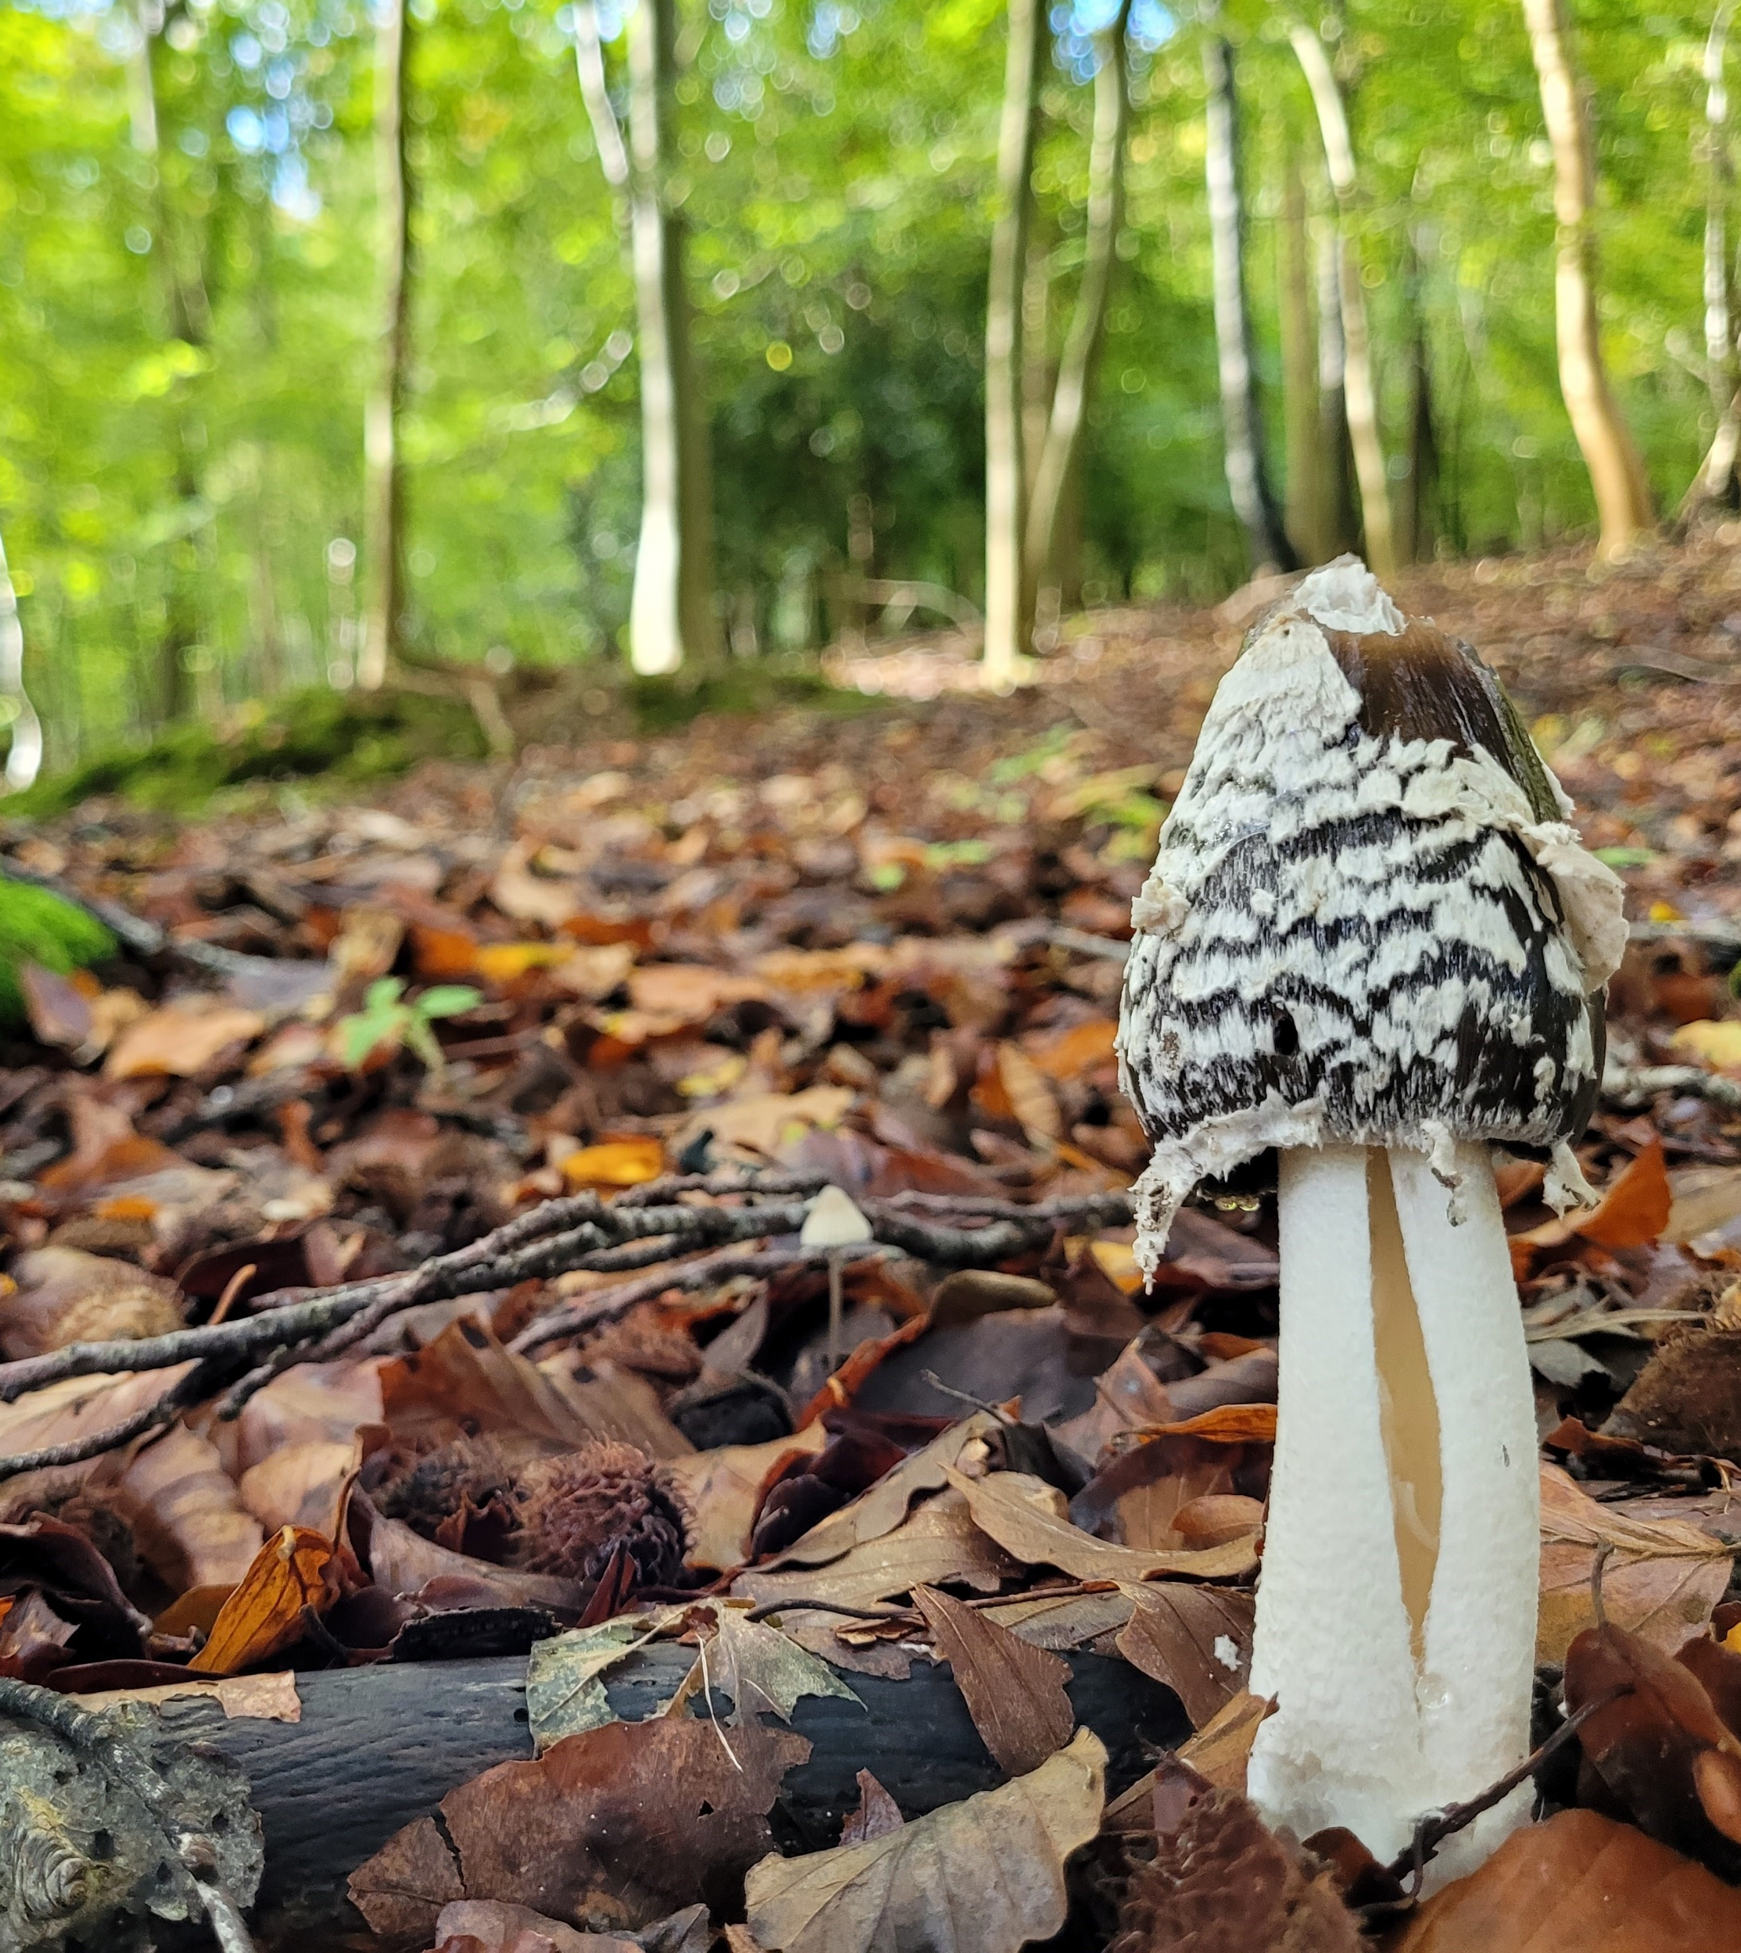
What is Audiovisual Core?
The purpose of Audiovisual Core is to represent metadata for biodiversity multimedia resources and collections, and to make it possible for users to determine whether those resources would be fit for some biodiversity science application before acquiring the media.

Slide 3

3D Task Group
Coming soon; Forthcoming public comment period
New term name: ac:Digital3DResource
  Value for dc:type, dcterms:type
  Public comment period for other additions to the standard will start soon

Slide 4
Content Description
Coming soon
A term to describe the content of media (or region of interest) by a value from a Controlled Vocabulary
https://github.com/tdwg/ac/issues/246
e.g. Label, Color Bar, Scale Bar, Spoken Description

Slide 5
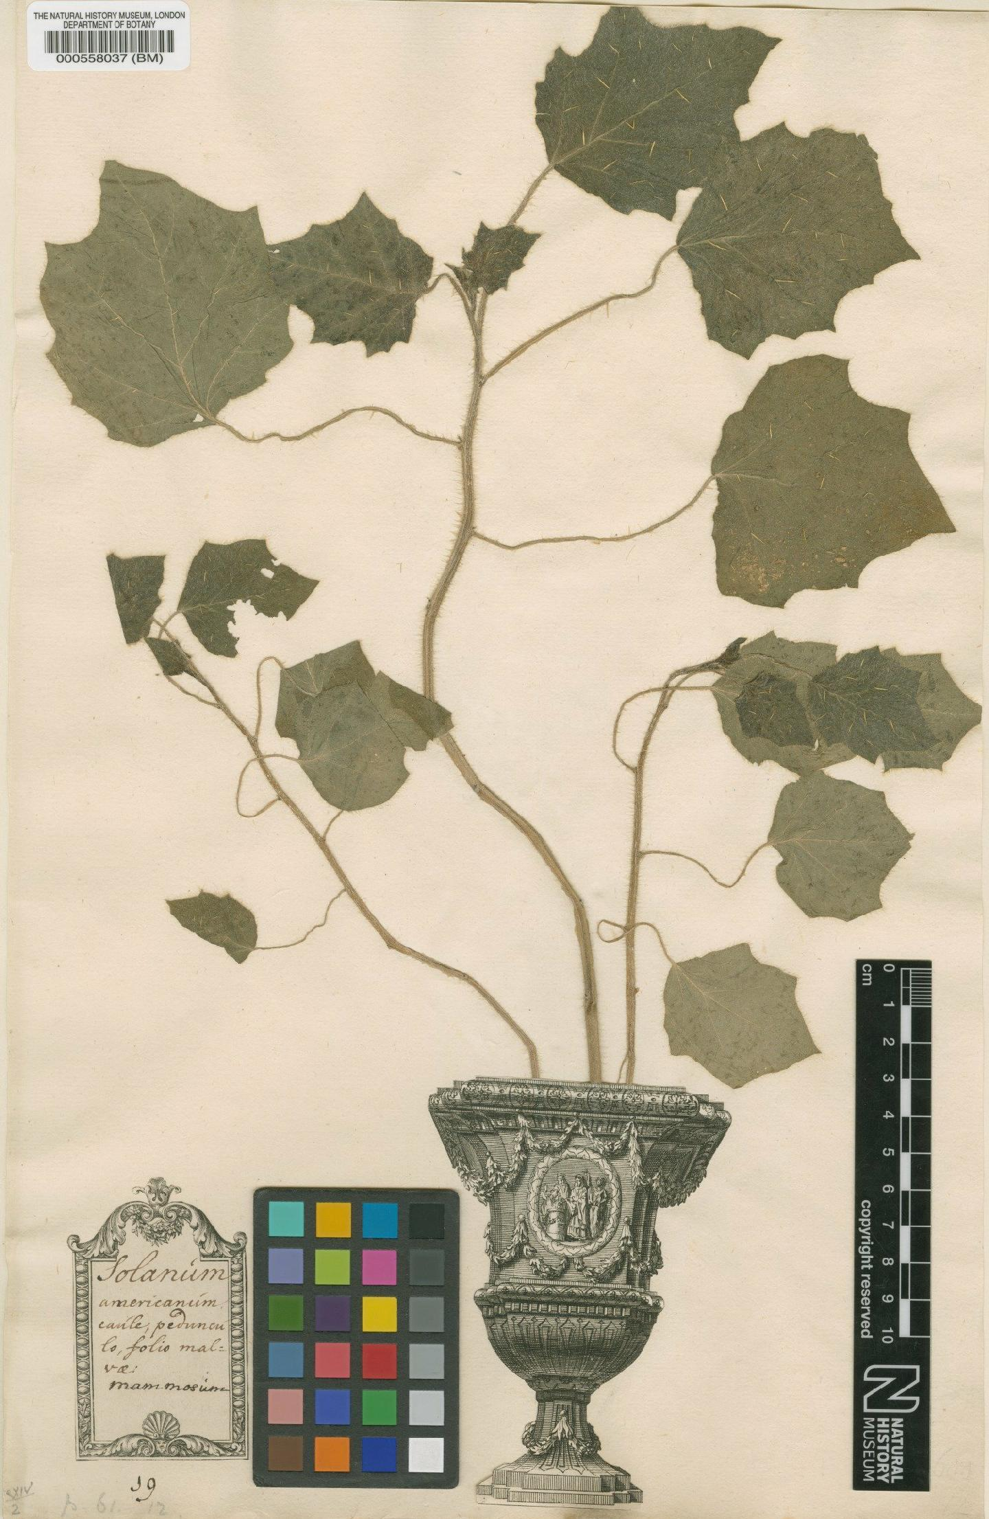
Content Description
Coming soon

Slide 6
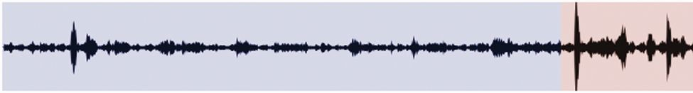
Content Description
Coming soon

Slide 7
ac:Media
Comment period imminent
The Darwin Core Data Package (DwC-DP) proposal, currently under review, includes addition of the new term dwc:Media. The DwC-DP working group feels that this term would be more appropriate in the Audiovisual Core ac: namespace than in dwc:.
ACMG have considered minting class term for media items previously, but were waiting for a confirmed use case.
Going to public comment imminently after this conference.

Slide 8
What’s next?
The year ahead
Rights/licence recipes
Audio recipes
© The Trustees of the Natural History Museum, London

Slide 9
Joining in
https://github.com/tdwg/ac
  Upcoming comment periods
  General questions
Third Wednesday of the month
  Details on GitHub
© The Trustees of the Natural History Museum, London

Slide 10
Thanks
  All members of the Maintenance Group (listed on GitHub)
Contributors to task groups
Everyone who has contributed to Audiovisual Core so far
© The Trustees of the Natural History Museum, London

