Slide 1
Acoustic research at the Natural History Museum, London
Ed Baker
Acoustic Biology Researcher Natural History Museum, London

Slide 2
21st Century museums 21st Century methods

Slide 3
21st Century museums 21st Century methods
Still think in decades and centuries as well as projects

Slide 4
Some History…

Slide 5
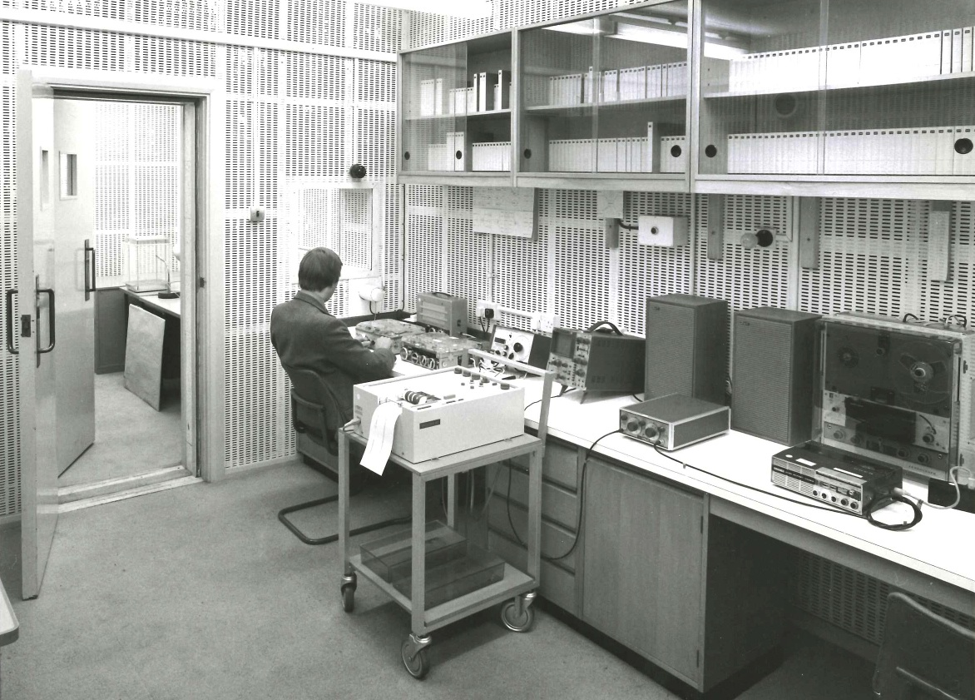
British Museum (Natural History) recording studio
1973-1998
bio.acousti.ca

Slide 6
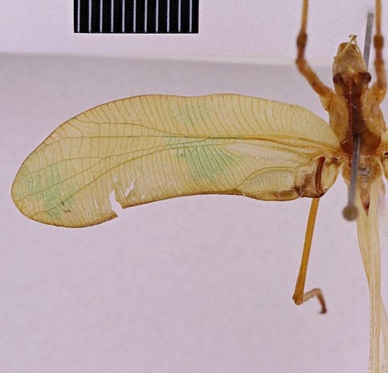
Horatosphaga raggei (Heller & Baker, 2017)
Discovered as new species from a sound recording
Heller, K-G., & Baker, E. (2017). From an old sound recording to a new species in the genus Horatosphaga (Orthoptera: Tettigonioidea: Phaneropterinae: Acrometopini). Zootaxa, 4323(3), 430-434.

Slide 7
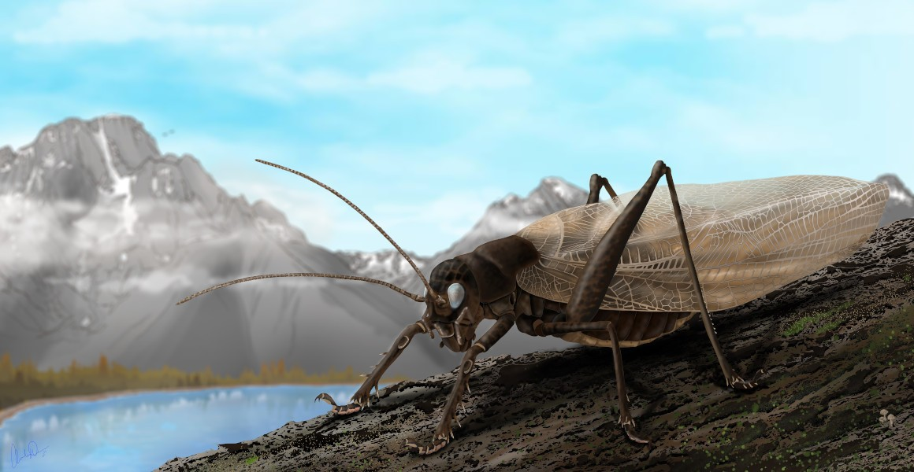
Prophalangopsis obscura
Sound reconstructed of species only known from male holotype
Woodrow, C., Baker, E., Jonsson, T., & Montealegre-Z, F. (2022). Reviving the sound of a 150-year-old insect: The bioacoustics of Prophalangopsis obscura (Ensifera: Hagloidea). Plos one, 17(8), e0270498.

Slide 8
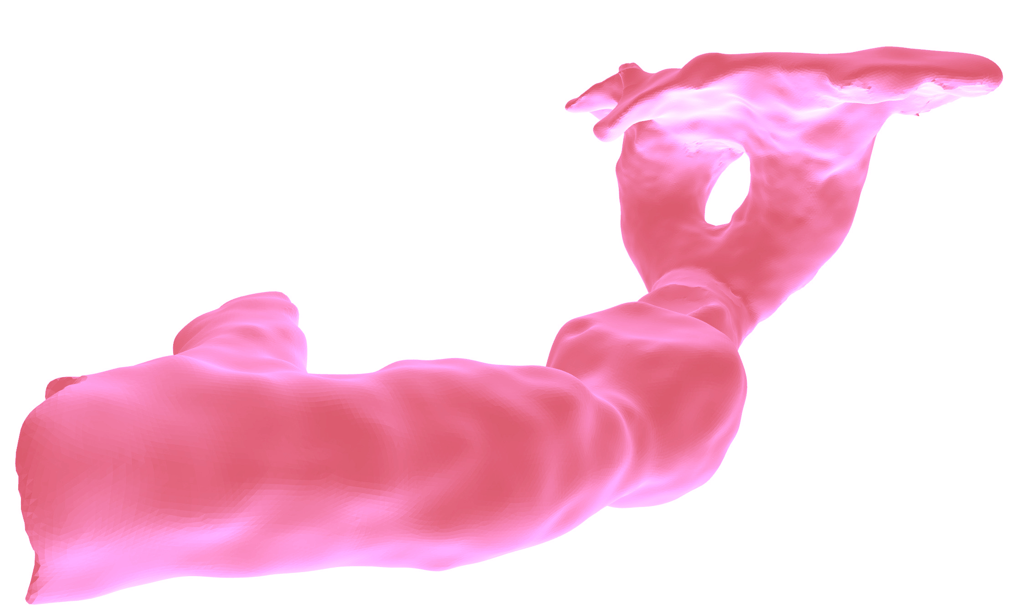
Acoustic burrow scan of mole cricket
Baker, E., & Broom, Y. S. (2015). Natural History Museum sound archive I: Orthoptera: Gryllotalpidae Leach, 1815, including 3D scans of burrow casts of Gryllotalpa gryllotalpa (Linnaeus, 1758) and Gryllotalpa vineae Bennet-Clark, 1970. Biodiversity Data Journal, (3).

Slide 9
The story so far: 🦗.fm

Slide 10
Sudden need to scale

Slide 11
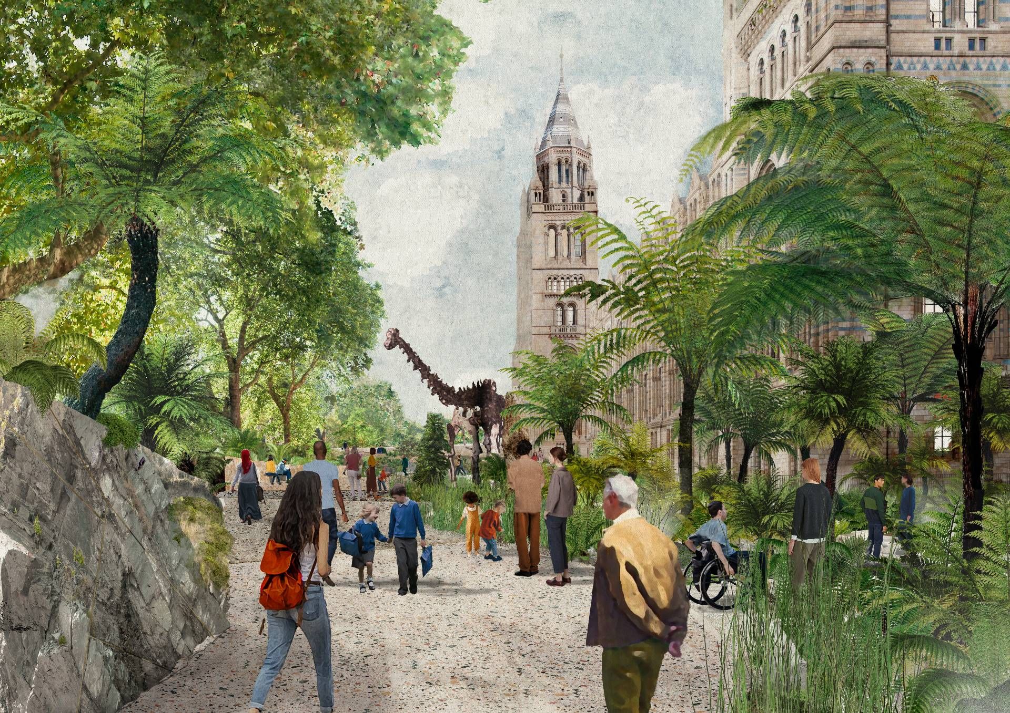
How we got here Commitments to bioacoustics
1 UK Nature Recovery (Research Theme)
2 Urban Nature Project

Slide 12
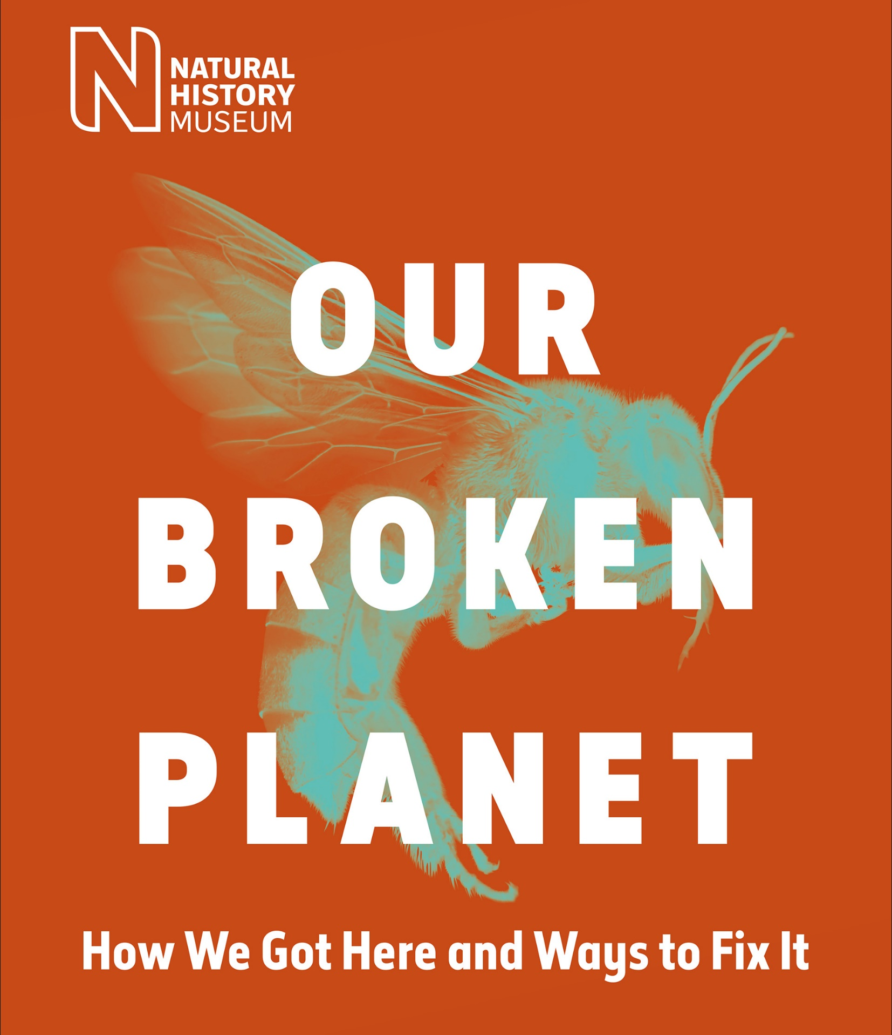
UK Nature Recovery
Research Theme
… develop and share scientific understanding of the composition and dynamics of the natural world, generating data, knowledge and tools that accelerate nature recovery in the UK and UK Overseas Territories
nhm.ac.uk/our-broken-planet

Slide 13
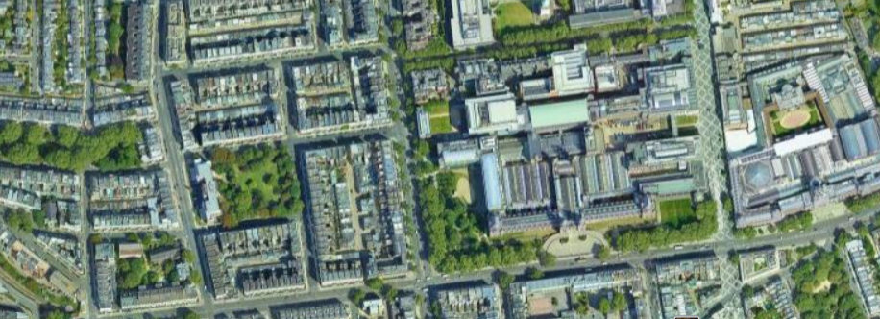
Urban Nature Project
The Urban Nature Project is developing new scientific tools and skills urgently needed to monitor, understand and protect urban nature.
nhm.ac.uk/urbannature

Slide 14
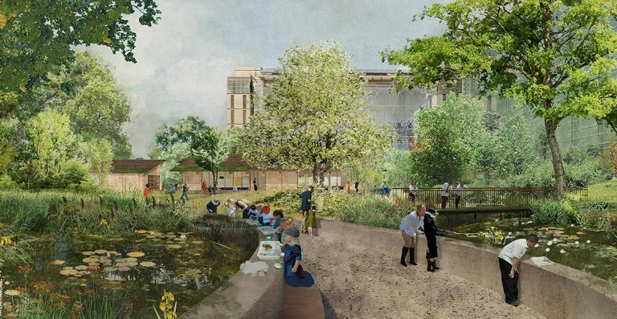
A Living Laboratory
Our gardens are a hub for urban nature identification and field survey skills

Slide 15
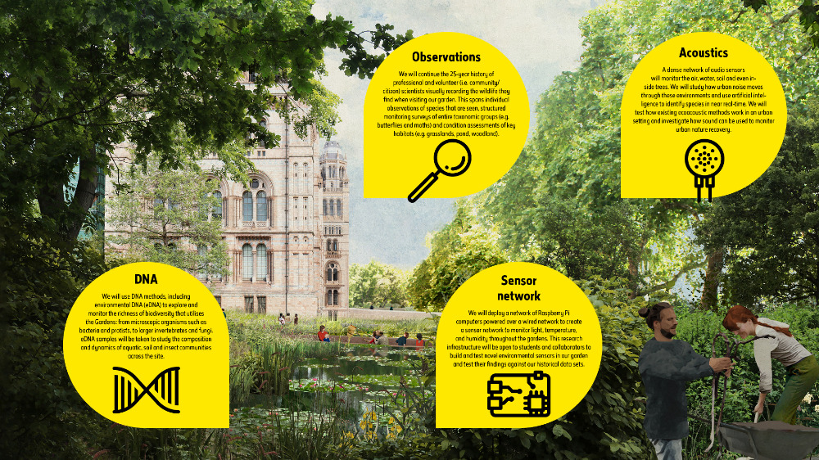

Slide 16
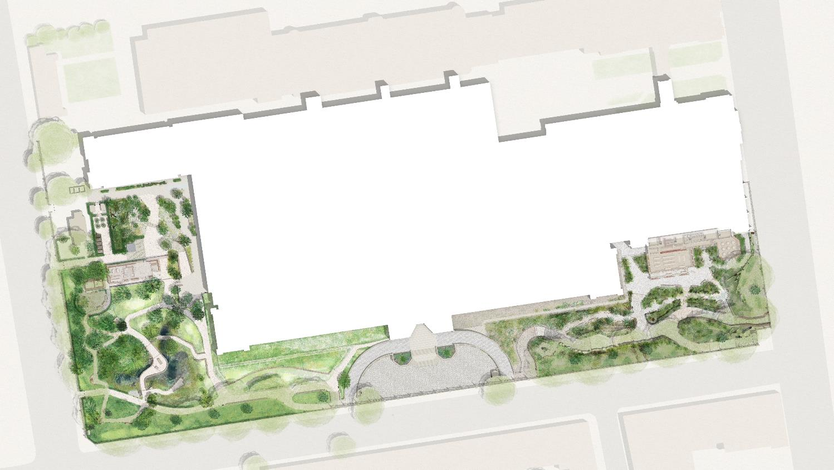
A Living Laboratory
Power-over-Ethernet locations
Long-term (intense, untargeted) monitoring plus detailed case studies of how habitat translocation, creation and restoration actions impact biodiversity
Over-specified (plenty of excess compute, transfer) – capacity to double number of devices. Testing arena for more targeted, less power hungry devices.
Background data:
One of the most intensively studied urban sites for 25 years

Slide 17
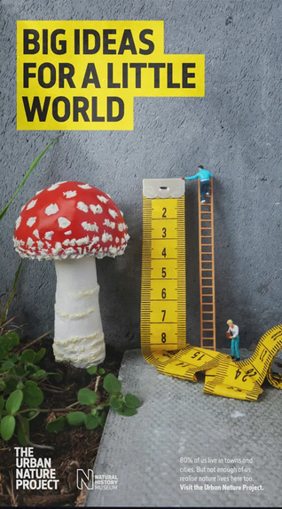
Acoustics in Urban Nature Project
Comprehensive survey of acoustic environments of the site
Airborne; freshwater; soil; timber
First year: complete dataset
Look at sampling in some subsequent years (museums like to keep stuff)
Some ultrasound, some arrays
Raspberry Pi devices
Familiar environment for researchers
Generic Linux fits with IT maintenance and security practices
Extensible with new sensors/capabilities
Cheap to replace

Slide 18
Research Agenda
Comprehensive baseline at the opening of grounds
Prior work before and during lockdowns
Sound in urban environments
Effects on wildlife
Effects on methods
Noise transfer between environments
Noise mitigation vs biodiversity gain
Some species-related work (with NHM Innovation Lab)
Focus on collection strengths (e.g. European Orthoptera)
Focus on hard groups with institutional knowledge (e.g. pollinators; mosquitoes) – from library creation

Slide 19
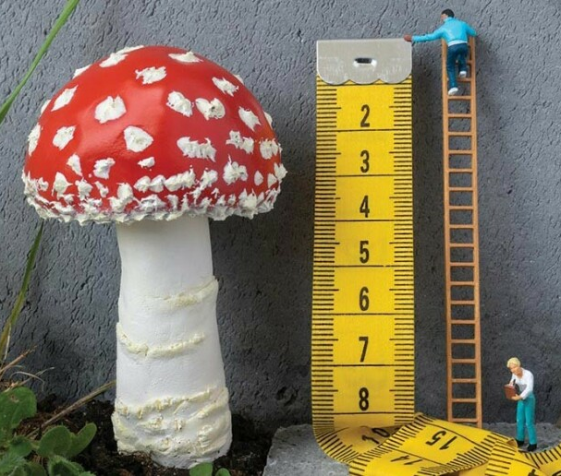
Continuous audio data High environmental sensor density Regular traditional surveys eDNA (water, soil, malaise)

Slide 20
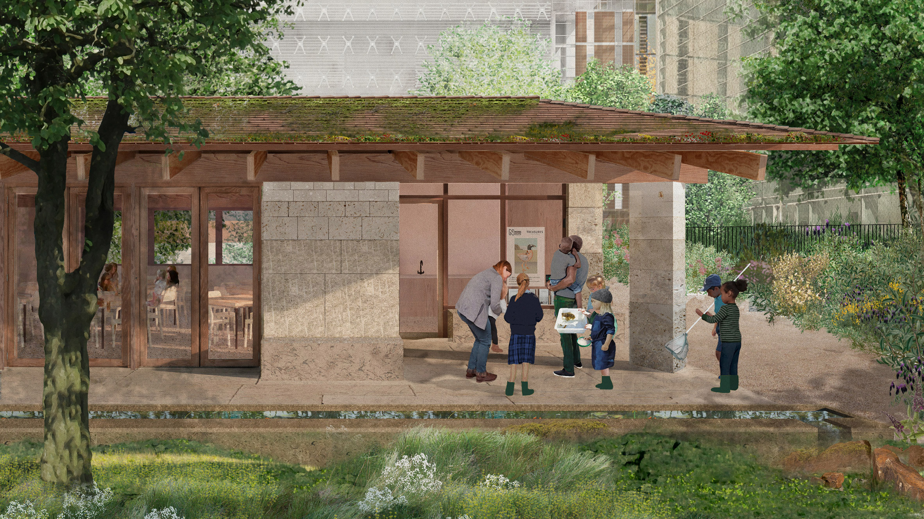
Education and engagement
Nature Activity Centre supported by AWS
Listening funnels (curated soundscapes from grounds) with interpretation panels
Digital panel with real-time identifications and interpretation

Slide 21
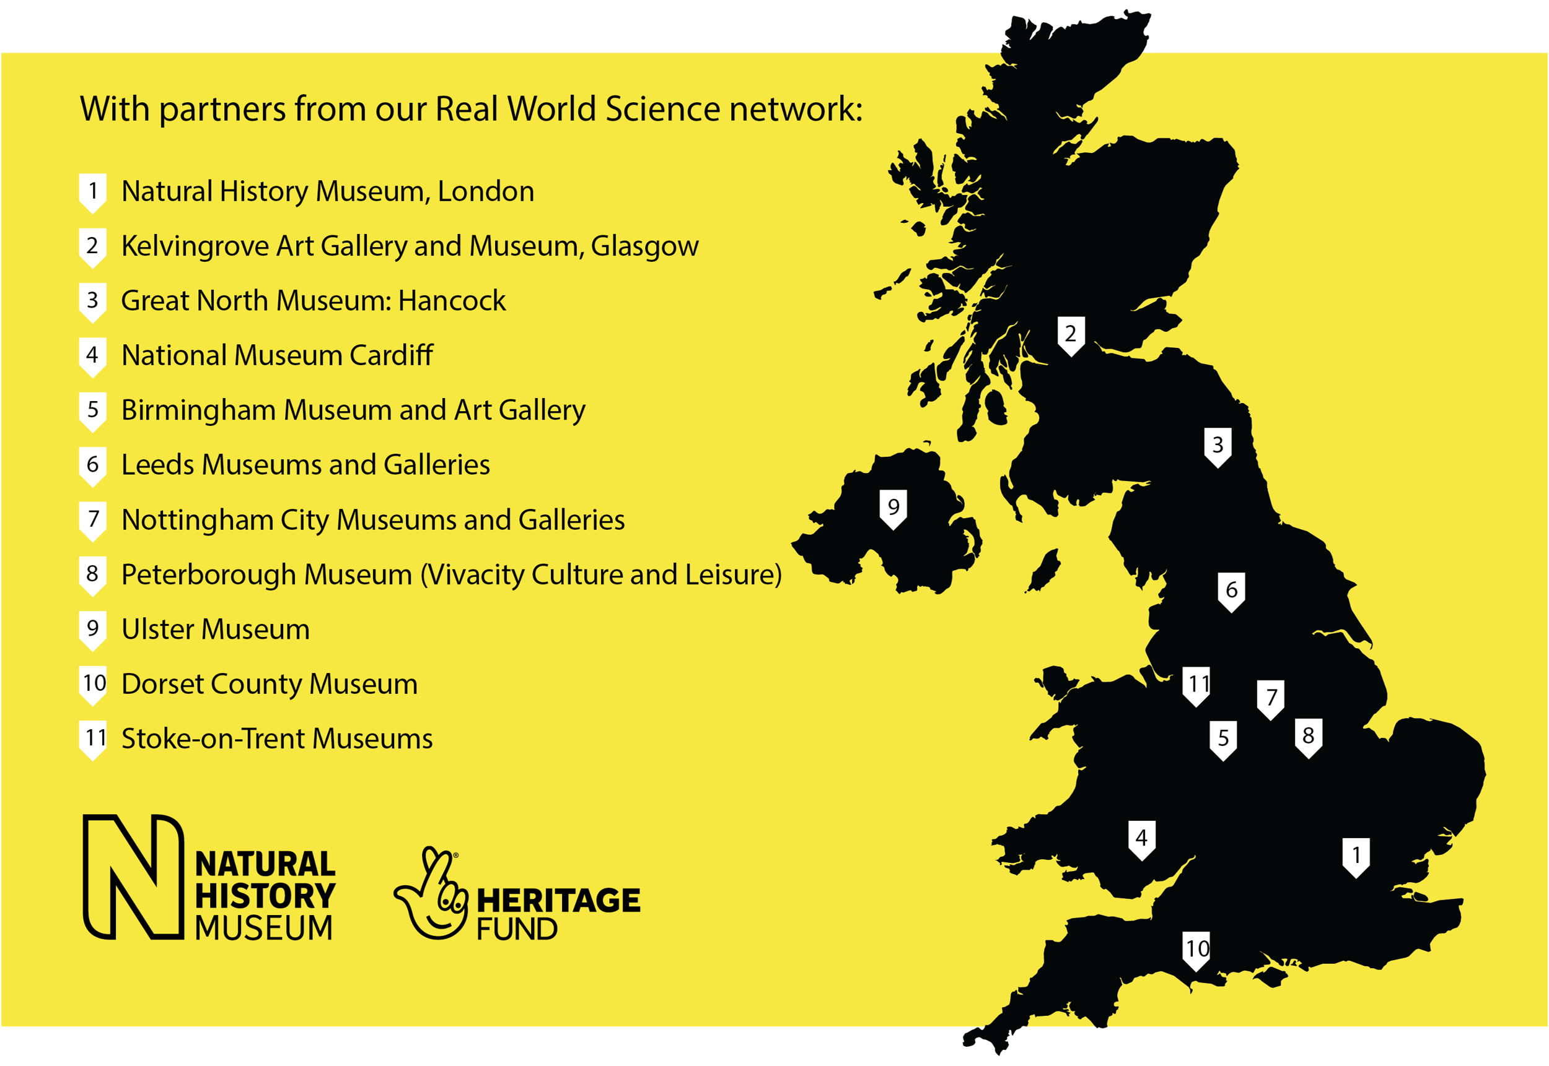
Urban Nature Project
Partner Network

Slide 22
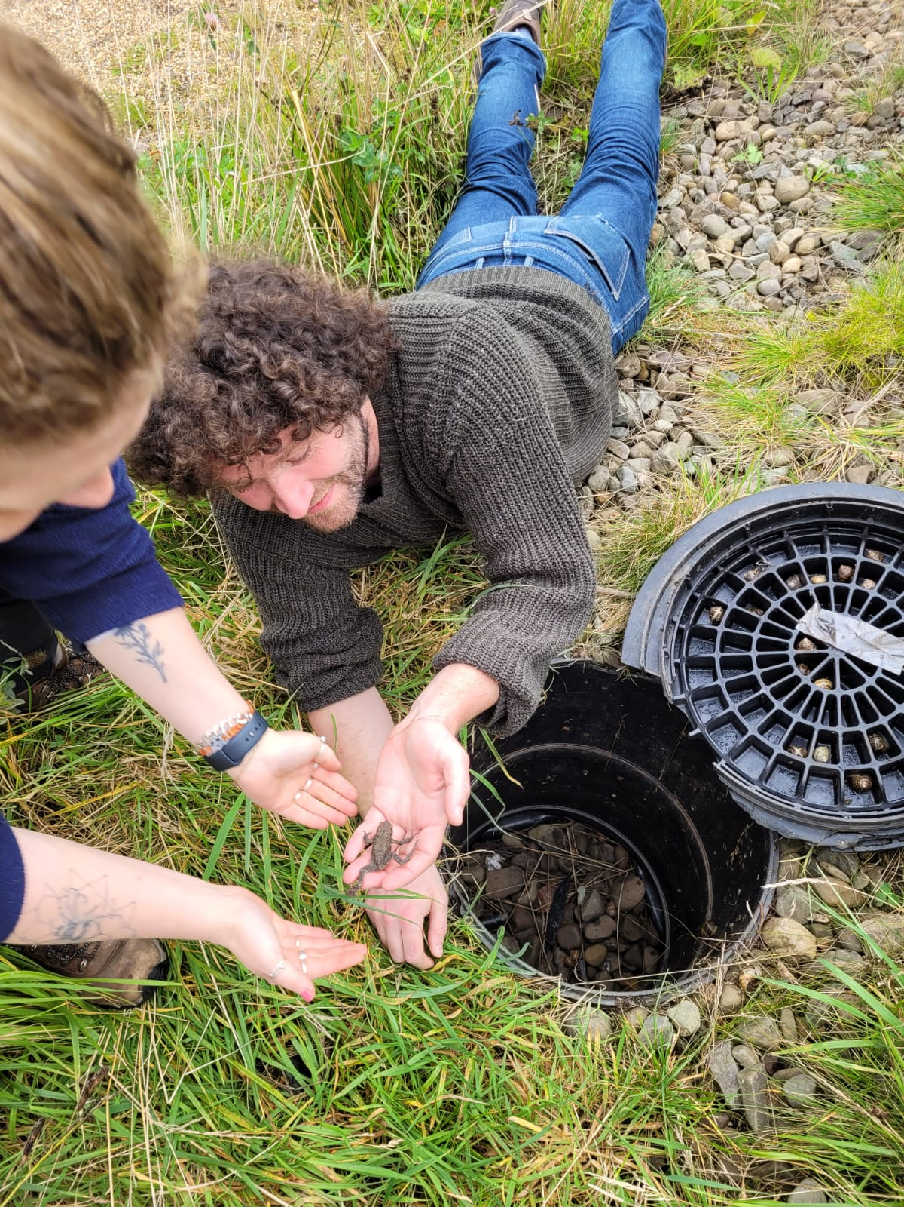
Acoustics with Partner Sites
Audiomoth surveys
Soil/water/malaise eDNA
Research focus:
Latitudinal changes across UK
Correlation of ecoacoustic metrics with eDNA (over seasons and latitude)
CONFIDENTIAL
© The Trustees of the Natural History Museum, London

Slide 23
Sampled data Single audiomoth eDNA

Slide 24
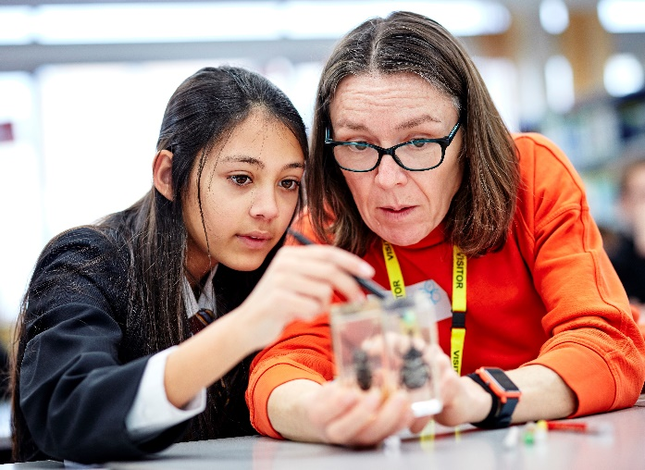
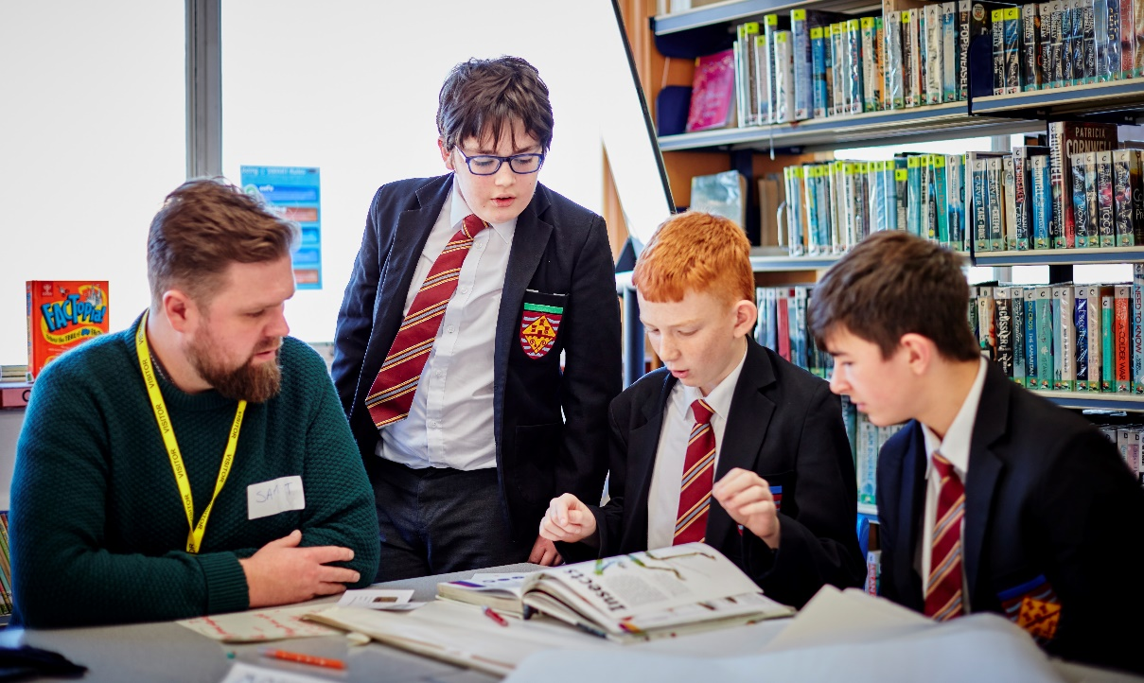
Nature Overheard
Co-design workshops with students and Museum scientists to produce a scientific question​
Nature Overheard investigates how road noise affects wildlife
Recordings from mobile devices and short online survey
nhm.ac.uk/natureoverheard

Slide 25
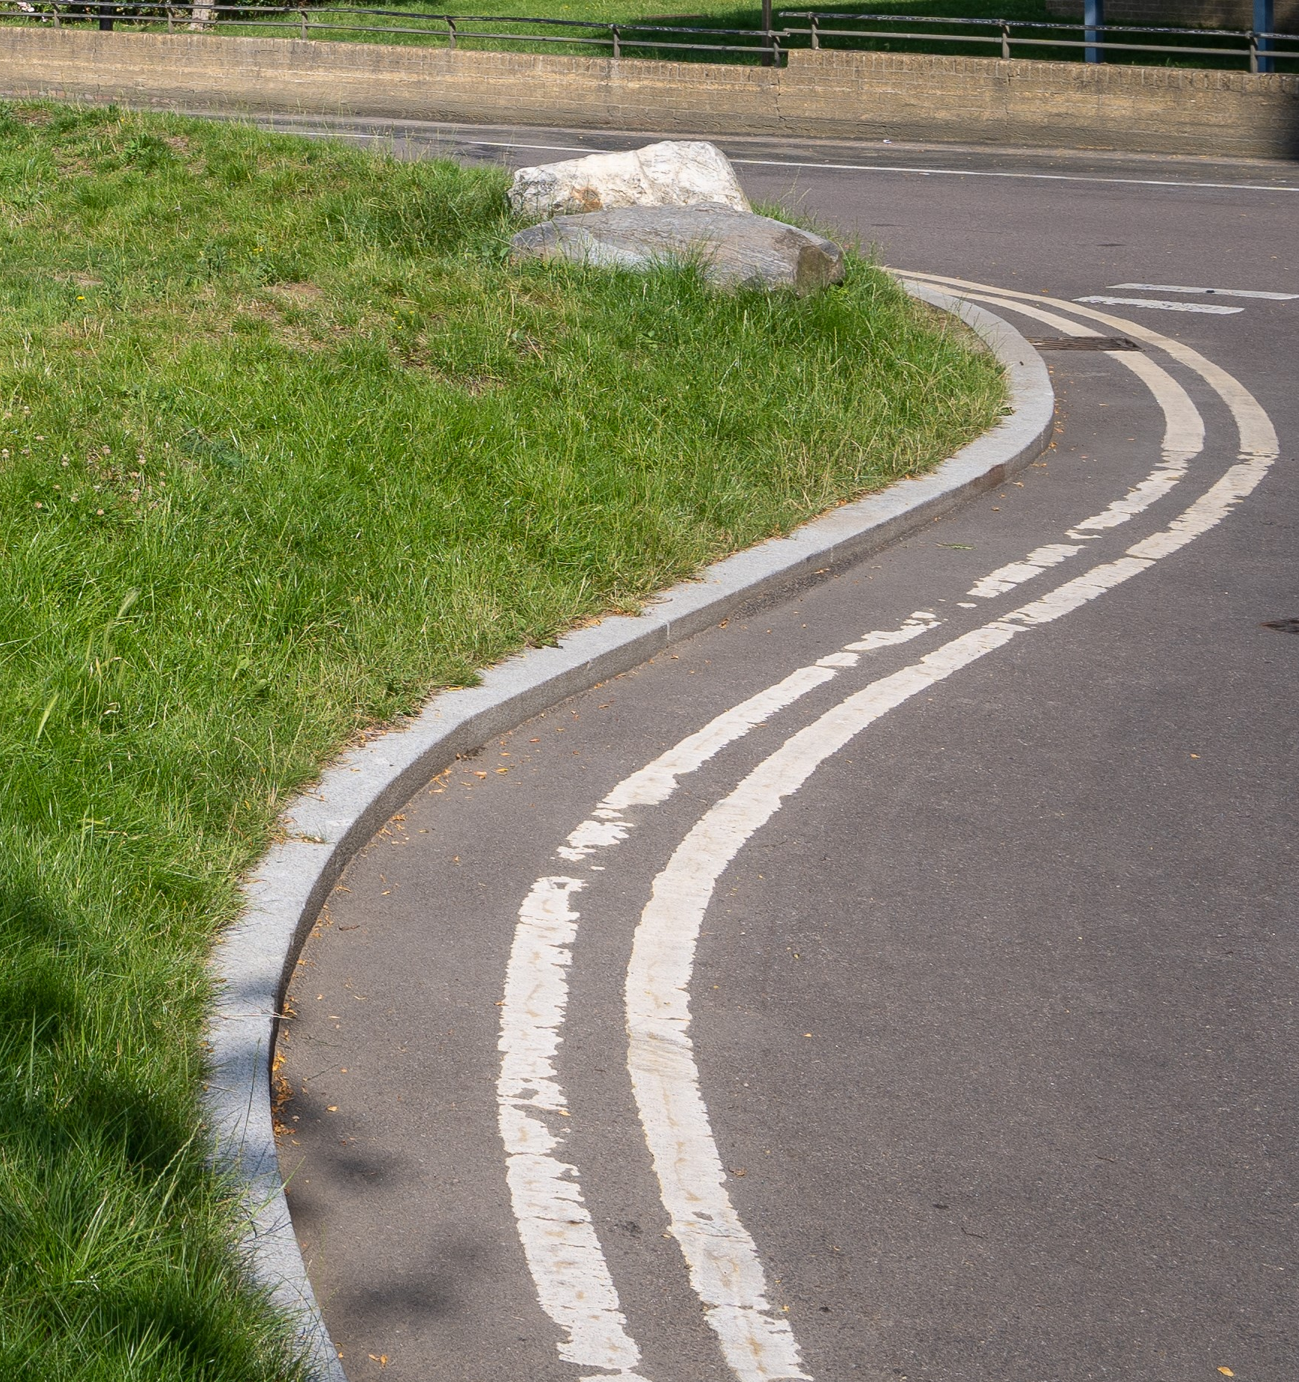
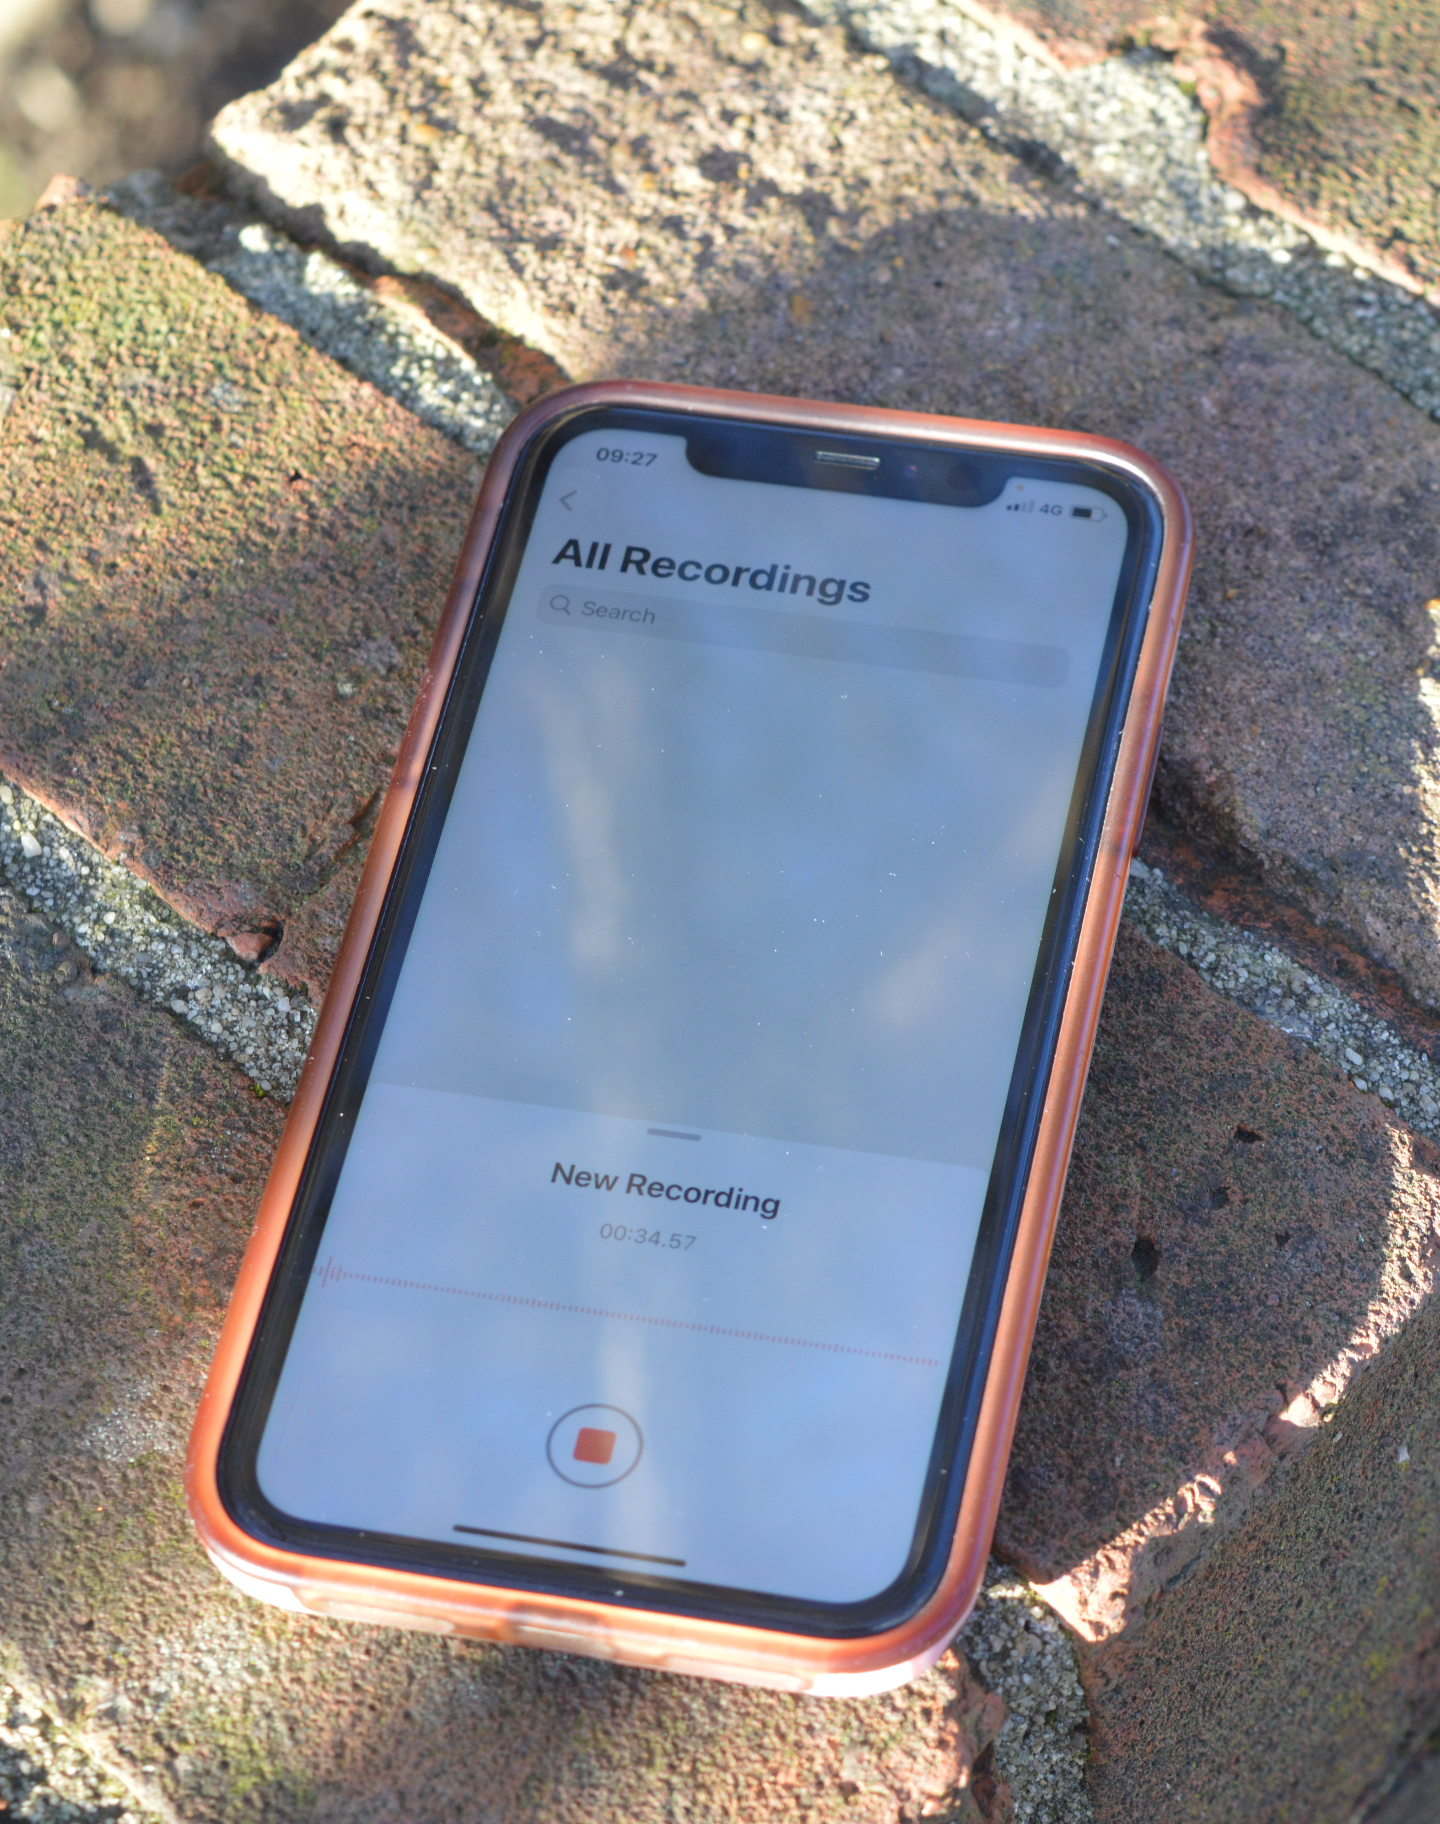
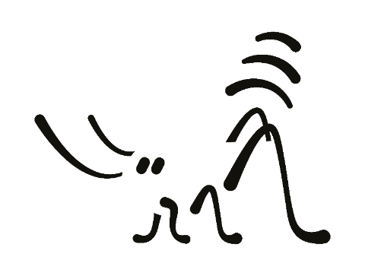
Nature Overheard
Co-created citizen science
nhm.ac.uk/natureoverheard

Slide 26
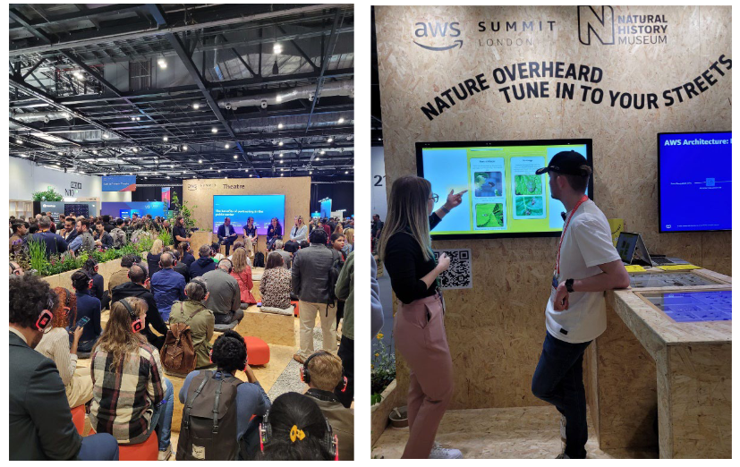
Urban Nature Hub at AWS Summit

Slide 27
Random data points Phones / tablets / mysterious

Slide 28
Integration

Slide 29
The Museum’s approach
BIOACOUSTICS
ECOACOUSTICS
Single species
Ecosystems
Species descriptions
Behavioural studies
Statistical analyses
Machine Learning
Curated reference sound collections
Soundscape collections
Single microphone devices
Connected sensor networks

Slide 30
What we can offer
Secure (accessible) location with power and data connectivity for development/testing of devices
Intensively studied urban site
(soon) large urban dataset for testing models / algorithms

Slide 31
Thank you!
edward.baker@nhm.ac.uk
@edwbaker

