Slide 1

Introduction to bioacoustics and ecoacoustics
Ed Baker

Slide 2
Interdisciplinary

Slide 3
Interdisciplinary
No one correct way through this

Slide 4
Interdisciplinary
No one correct way through this
Try and develop an intuition by approaching it from several different directions

Slide 5
Interdisciplinary
No one correct way through this
Try and develop an intuition by approaching it from several different directions
  What sounds?
  Why sounds?
  Just what IS noise?

Slide 6
Interdisciplinary
No one correct way through this
Try and develop an intuition by approaching it from several different directions
  What sounds?
  Why sounds?
  Just what IS noise?
  … what IS sound?

Slide 7
Interdisciplinary
No one correct way through this
Try and develop an intuition by approaching it from several different directions
  What sounds?
  Why sounds?
  Just what IS noise?
  … what IS sound?
  Recording
  Analysis

Slide 8
Interdisciplinary
No one correct way through this
Feel free to ask questions, interrupt, take over…

Slide 9
Interactive
Starting at the analogue end

Slide 10
Interactive
Starting at the analogue end
Notebook. Pencil.

Slide 11
Interactive
Starting at the analogue end
Notebook. Pencil.
Go out into gardens (or Museum) for five minutes. Don’t stay close to anyone else here. Write down everything you hear. Come back.

Slide 12
Interactive
Starting at the analogue end
Notebook. Pencil.
Go out into gardens (or Museum) for five minutes. Don’t stay close to anyone else here. Write down everything you hear. Come back.
Let’s make a list.

Slide 13
Let’s do some classification

Slide 14
Let’s do some classification
You’re at the Natural History Museum – we ARE going to do some taxonomy.
How would you classify these? Have a go yourself, then compare with your neighbours.

Slide 15
Let’s do some classification
You’re at the Natural History Museum – we ARE going to do some taxonomy.
How would you classify these? Have a go yourself, then compare with your neighbours.
Can you guess how I’m doing it?

Slide 16
Discussion

Slide 17
… another way (bottom up not top down)

Slide 18
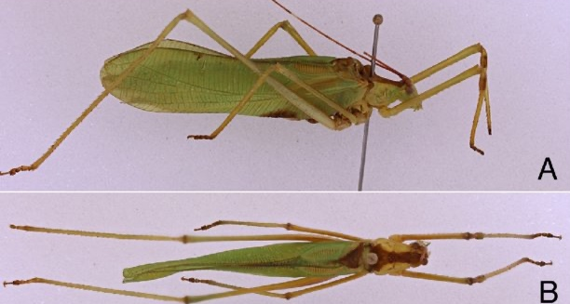
Orthoptera: Bush Crickets

Slide 19
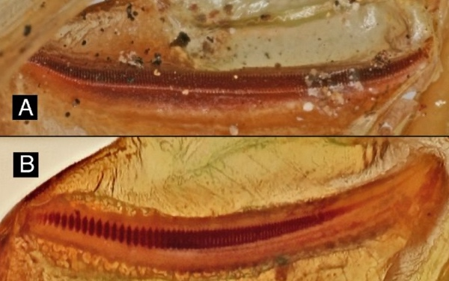
Orthoptera: Bush Crickets

Slide 20
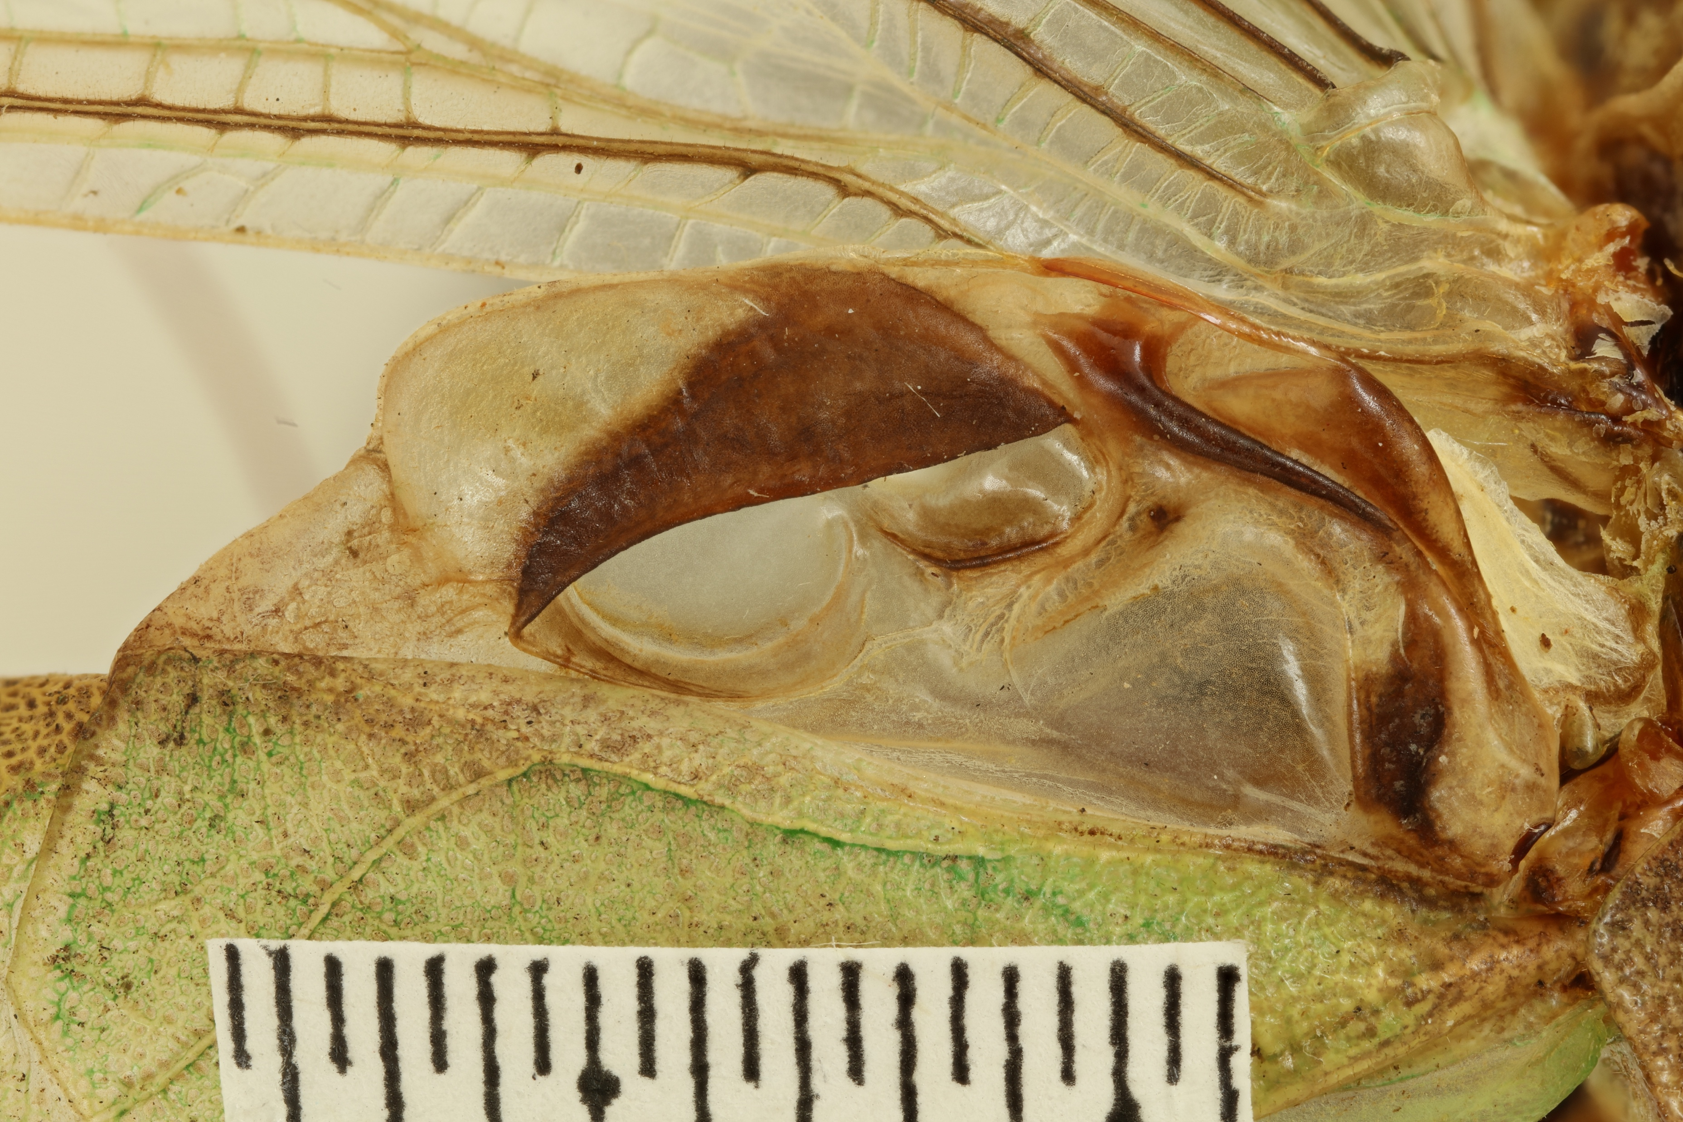
Orthoptera: Bush Crickets

Slide 21
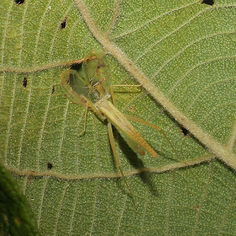

Slide 22
Orthoptera: MOLE Crickets

Slide 23
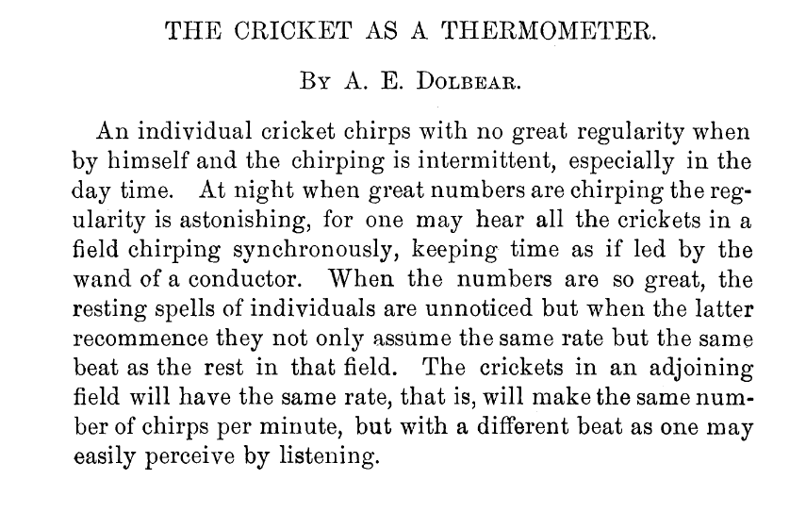

Slide 24
LEPIDOPTERA

Slide 25
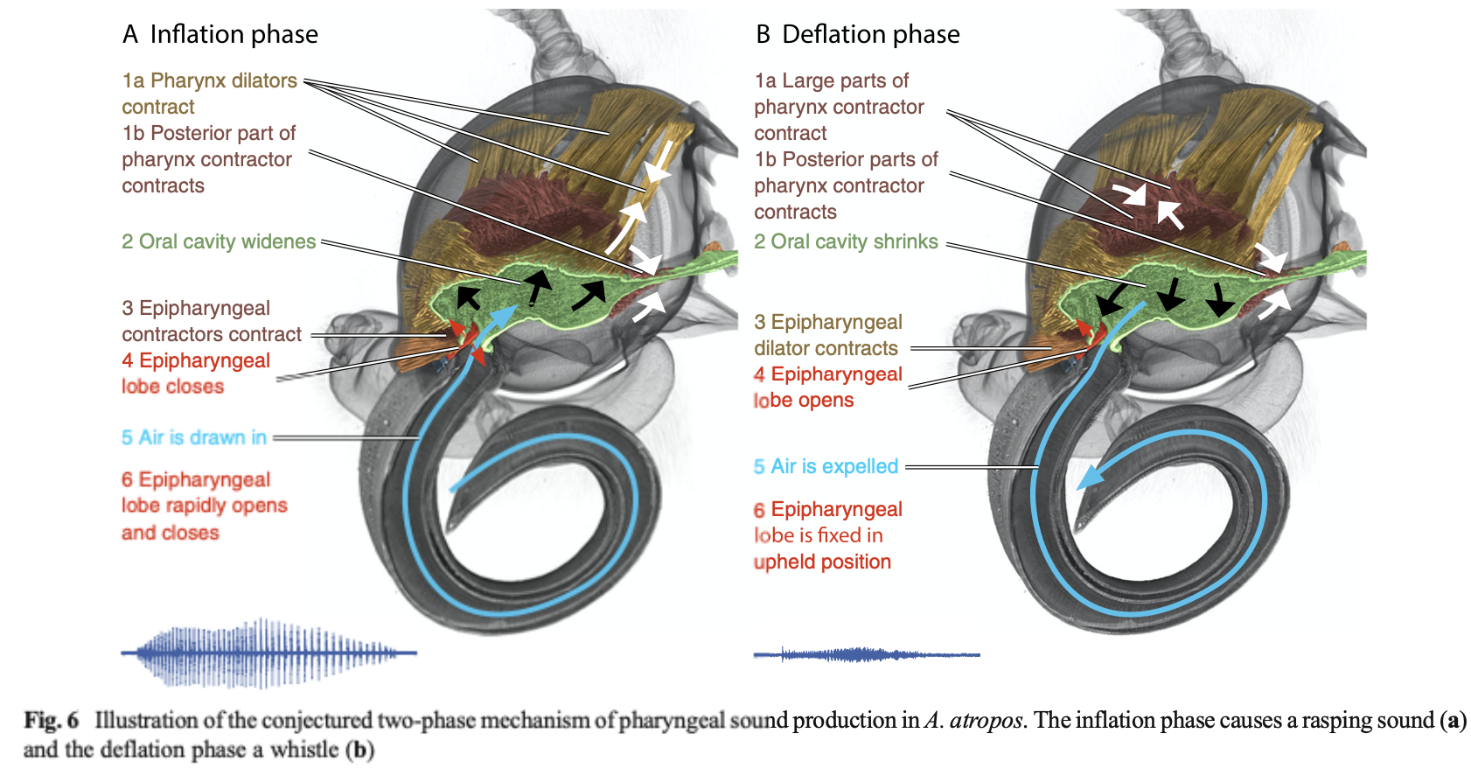
LEPIDOPTERA

Slide 26
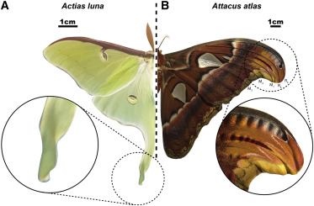
https://doi.org/10.1016/j.cub.2021.08.038

Slide 27
BLATTODEA

Slide 28
HEMIPTERA: CICADAS

Slide 29
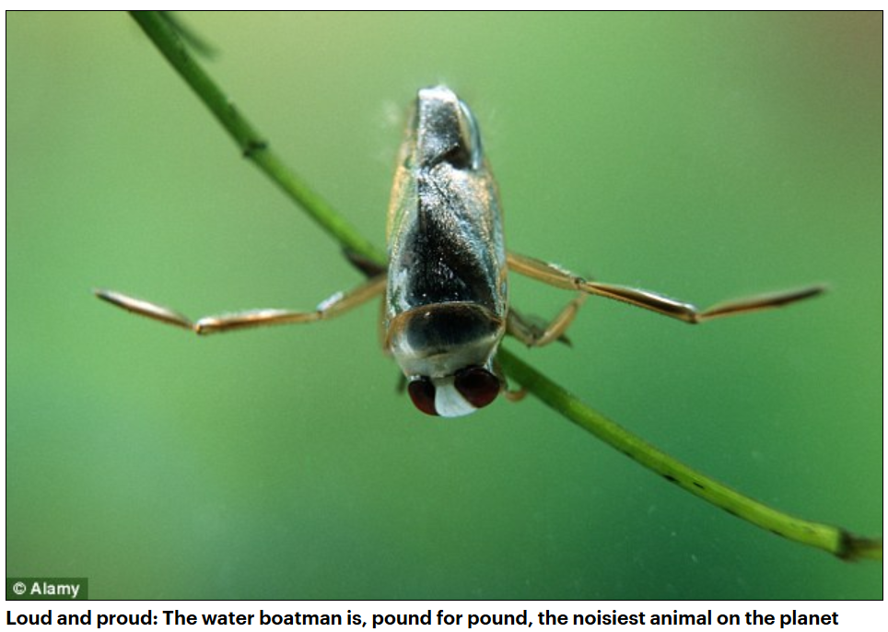

Slide 30
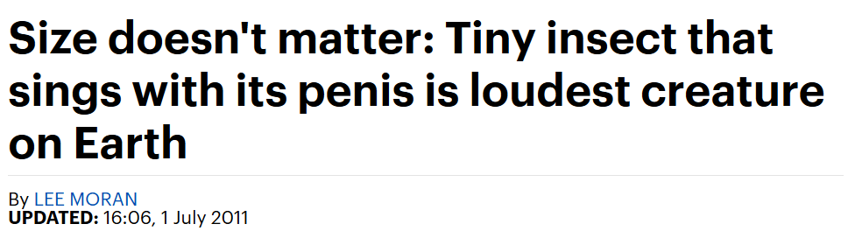

Slide 31
Incidental Noises

Slide 32
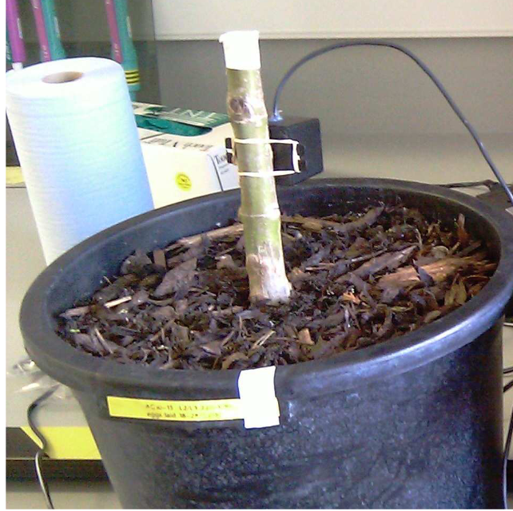

Slide 33
Incidental Noises

Slide 35
What is noise?

Slide 36
Unwanted sound?

Slide 37
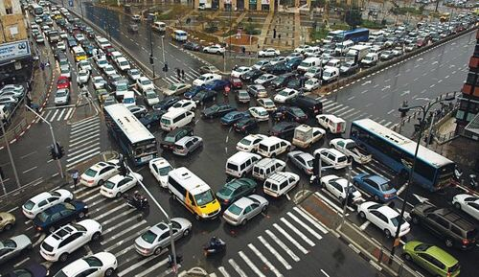

Slide 38
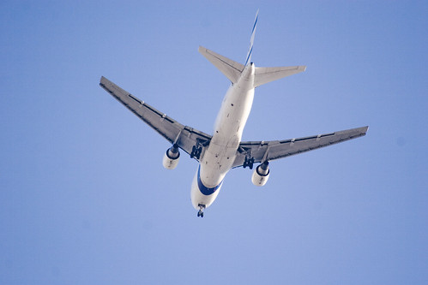
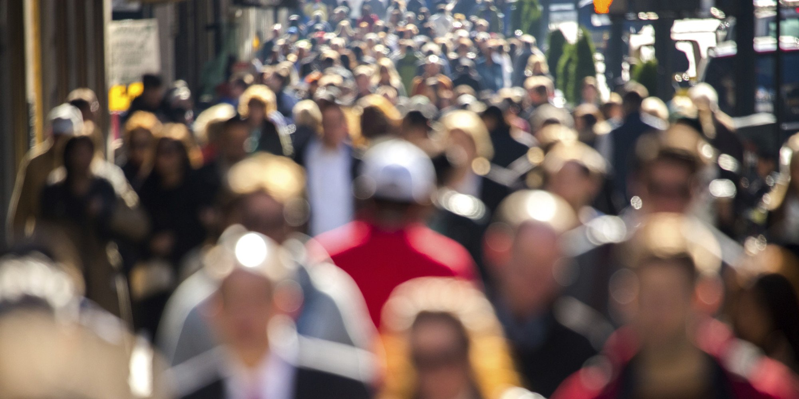
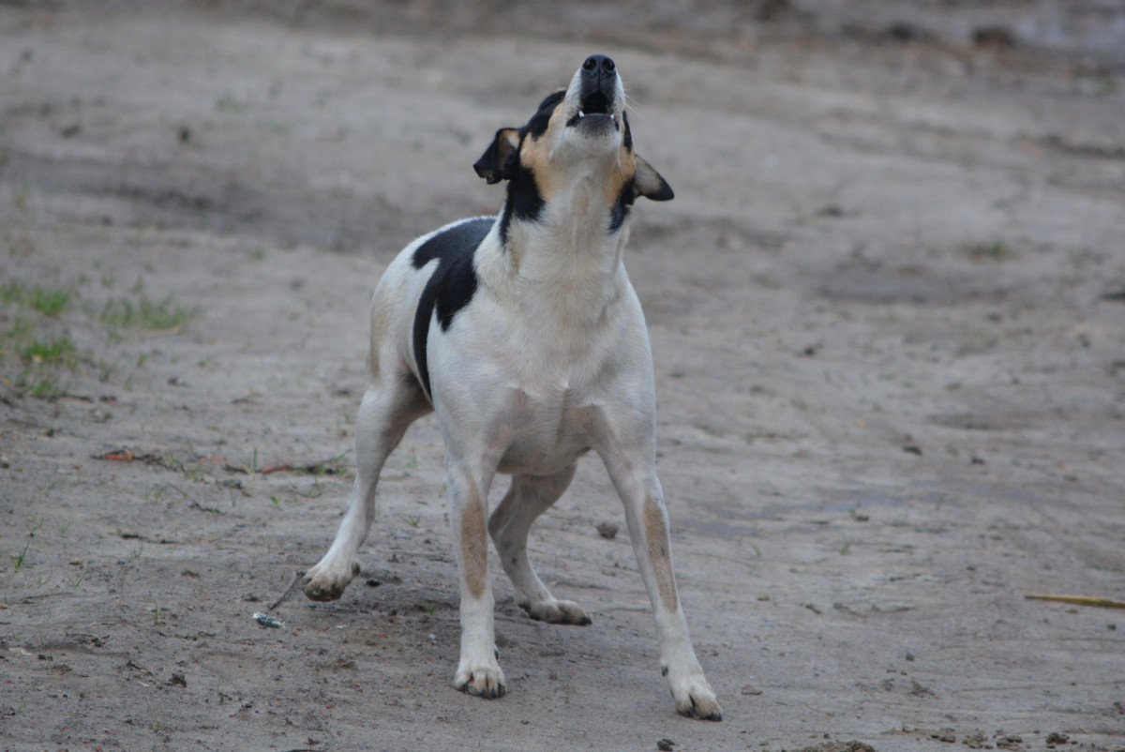
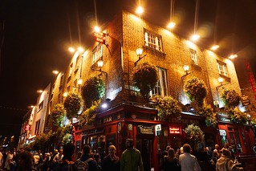

Slide 39
A working definition
Sound that is:
Unwanted
Unpleasant

Slide 40
Context dependant?

Slide 41
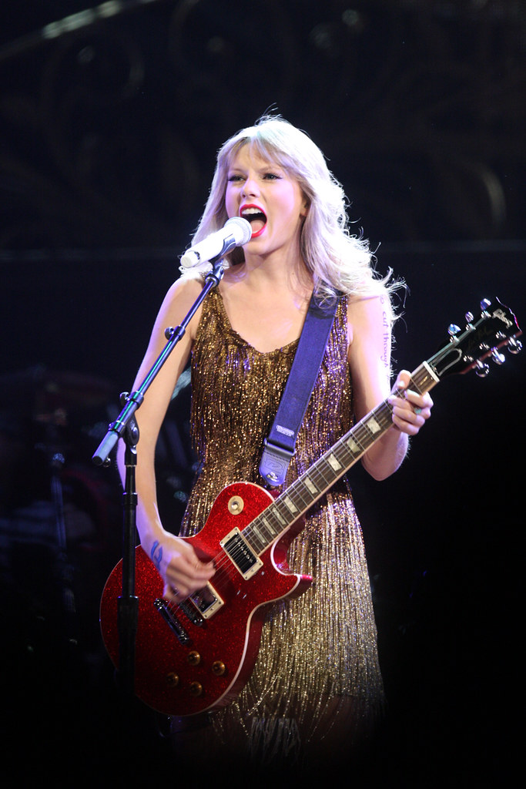
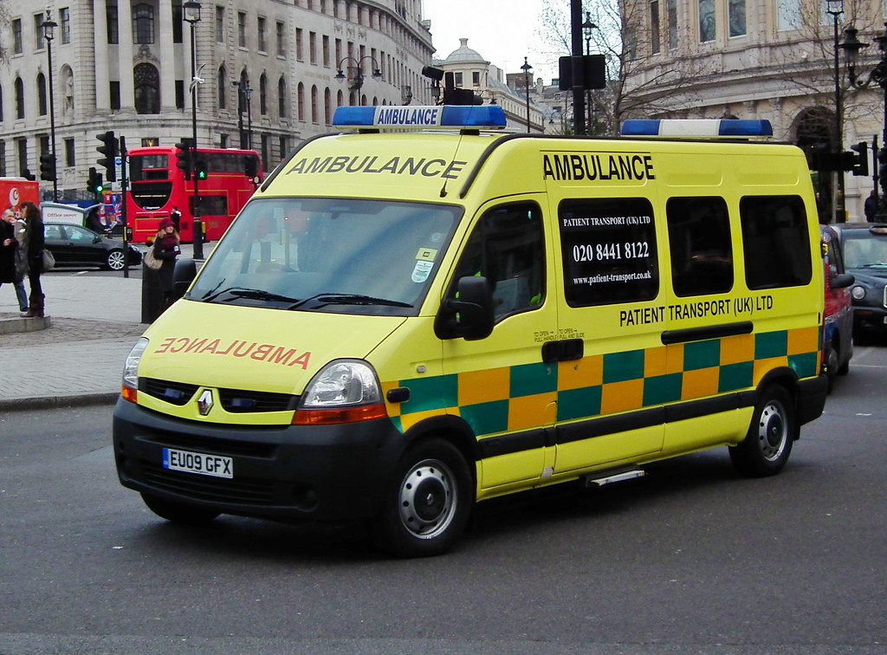

Slide 42
Not always awful?

Slide 43
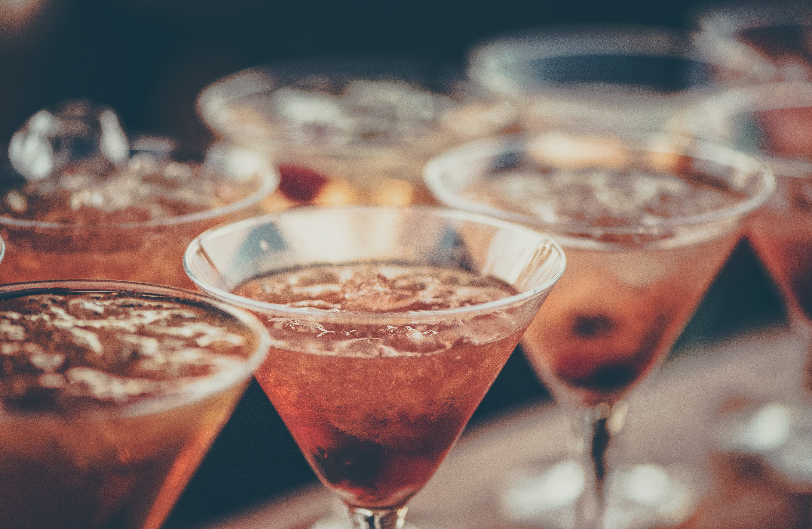

Slide 44
Human centred

Slide 45
An alternative, precise definition
Data Source
Transmitter
Receiver
Data Destination
Noise Source

Slide 46

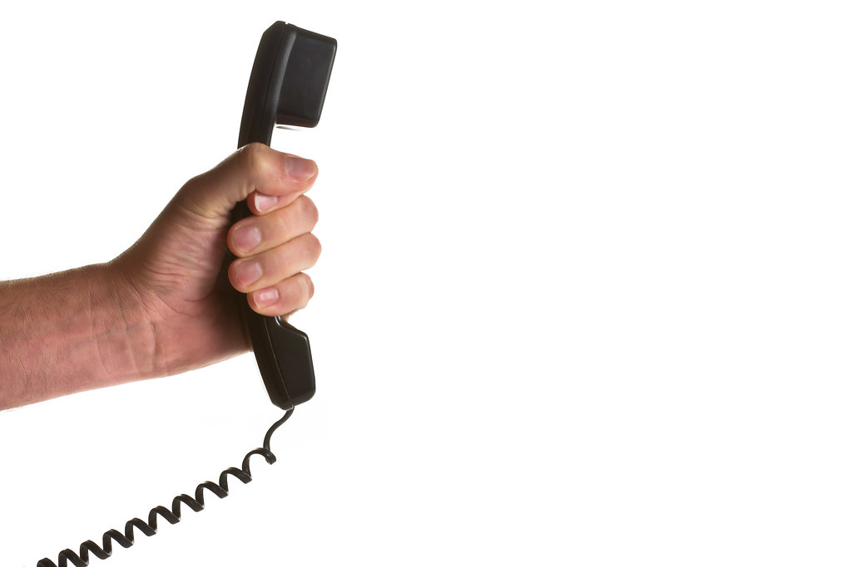
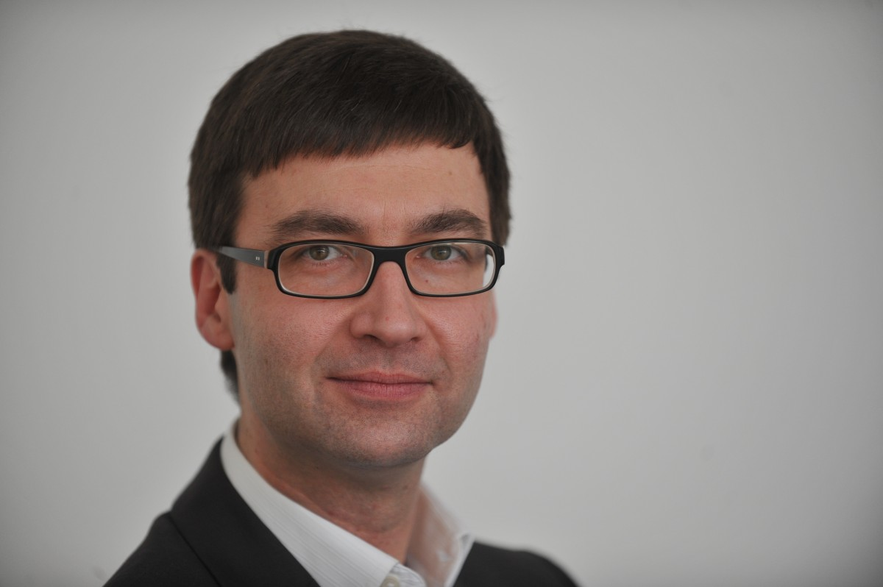
An alternative, precise definition
Data Source
Transmitter
Receiver
Data Destination
Signal
Received Signal
Noise Source
Attenuation
Interference

Slide 47
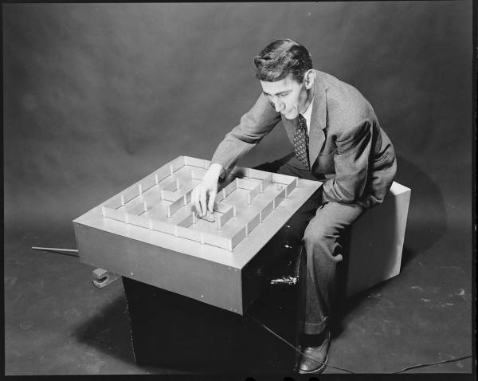
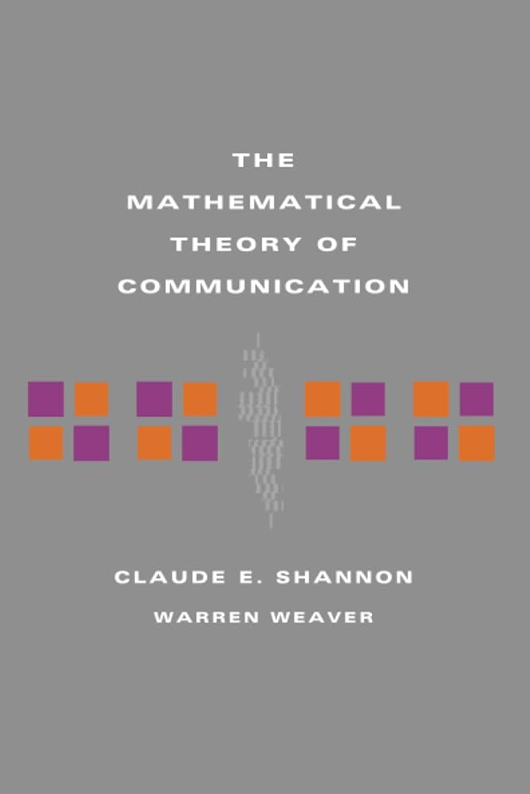
Information theory

Slide 48
“The word communication will be used here in a very broad sense to include all of the procedures by which one mind may affect another.”
– Warren Weaver

Slide 49
A working definition
Sound that is:
Unwanted
Unpleasant
Disruptive

Slide 50
What are the effects of noise?

Slide 51
On people
It is estimated that the annual social cost of urban road noise in England is £7 billion to £10 billion.
https://www.gov.uk/guidance/noise-pollution-economic-analysis

Slide 52
On people
It is estimated that the annual social cost of urban road noise in England is £7 billion to £10 billion.
sleep disturbance
annoyance
Acute Myocardial Infarction
hypertension
https://www.gov.uk/guidance/noise-pollution-economic-analysis

Slide 53
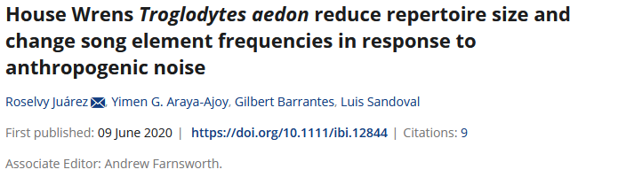
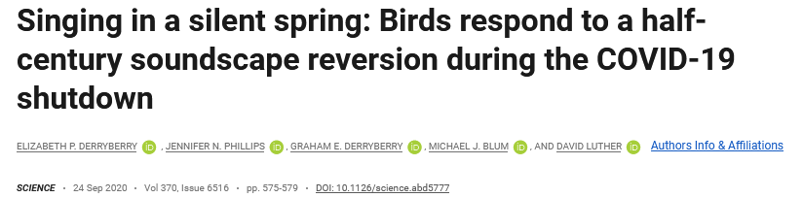
On wildlife
“This shift was especially notable because the frequency of human-produced traffic noise occurs within a range that interferes with the highest performance and most effective song. Thus, our “quiet” allowed the birds to quickly fill the most effective song space.”

Slide 54
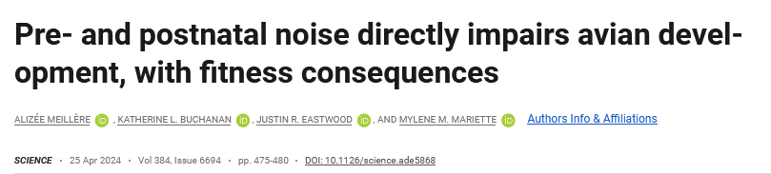
On wildlife
“… birds exposed to traffic sounds in the egg had impaired growth, shorter telomeres, and reduced production as adults. Such effects may be pervasive given the ever-present background drone of our traffic noise.”

Slide 56
Bioacoustics and ecoacoustics

Slide 57
The Museum’s approach
BIOACOUSTICS
ECOACOUSTICS
Single species
Ecosystems
Species descriptions
Behavioural studies
Statistical analyses
Machine Learning
Curated reference sound collections
Soundscape collections
Single microphone devices
Connected sensor networks

Slide 58
We haven’t even talked about sound.

Slide 59
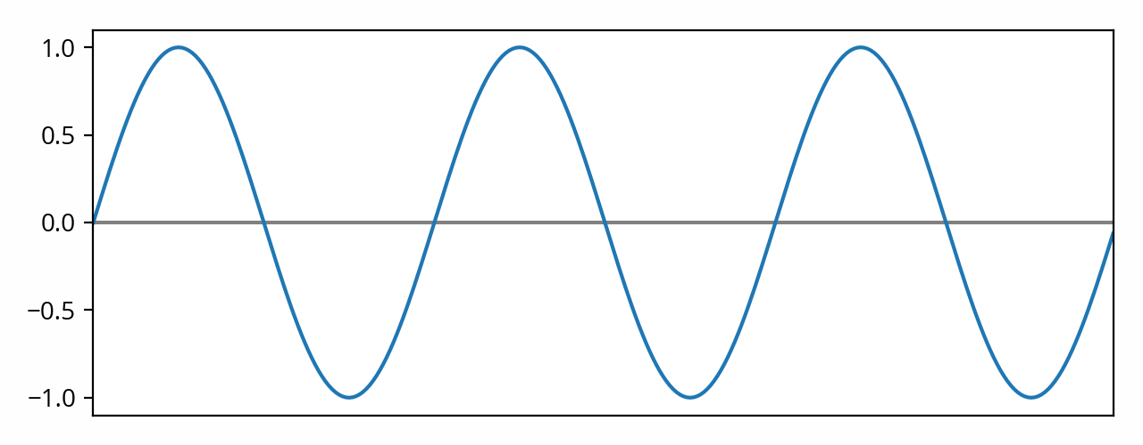
Deceptively simple?
Frequency
Amplitude/pressure

Slide 60


Slide 61
Inverse-square law
Source

Slide 62
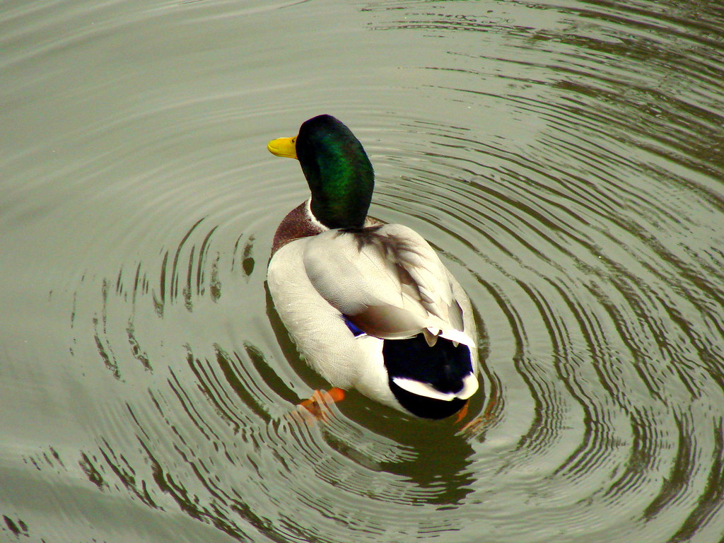
Inverse-square law
Source

