Slide 1
Urban Noise
Ed Baker
Acoustic Biology Researcher Natural History Museum, London

Slide 2
What is noise?

Slide 3
Unwanted sound?

Slide 4
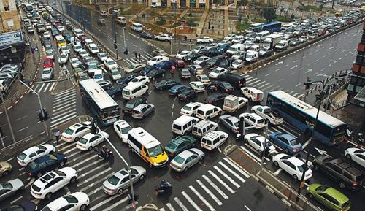

Slide 5
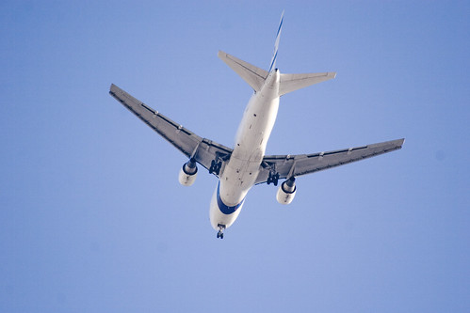
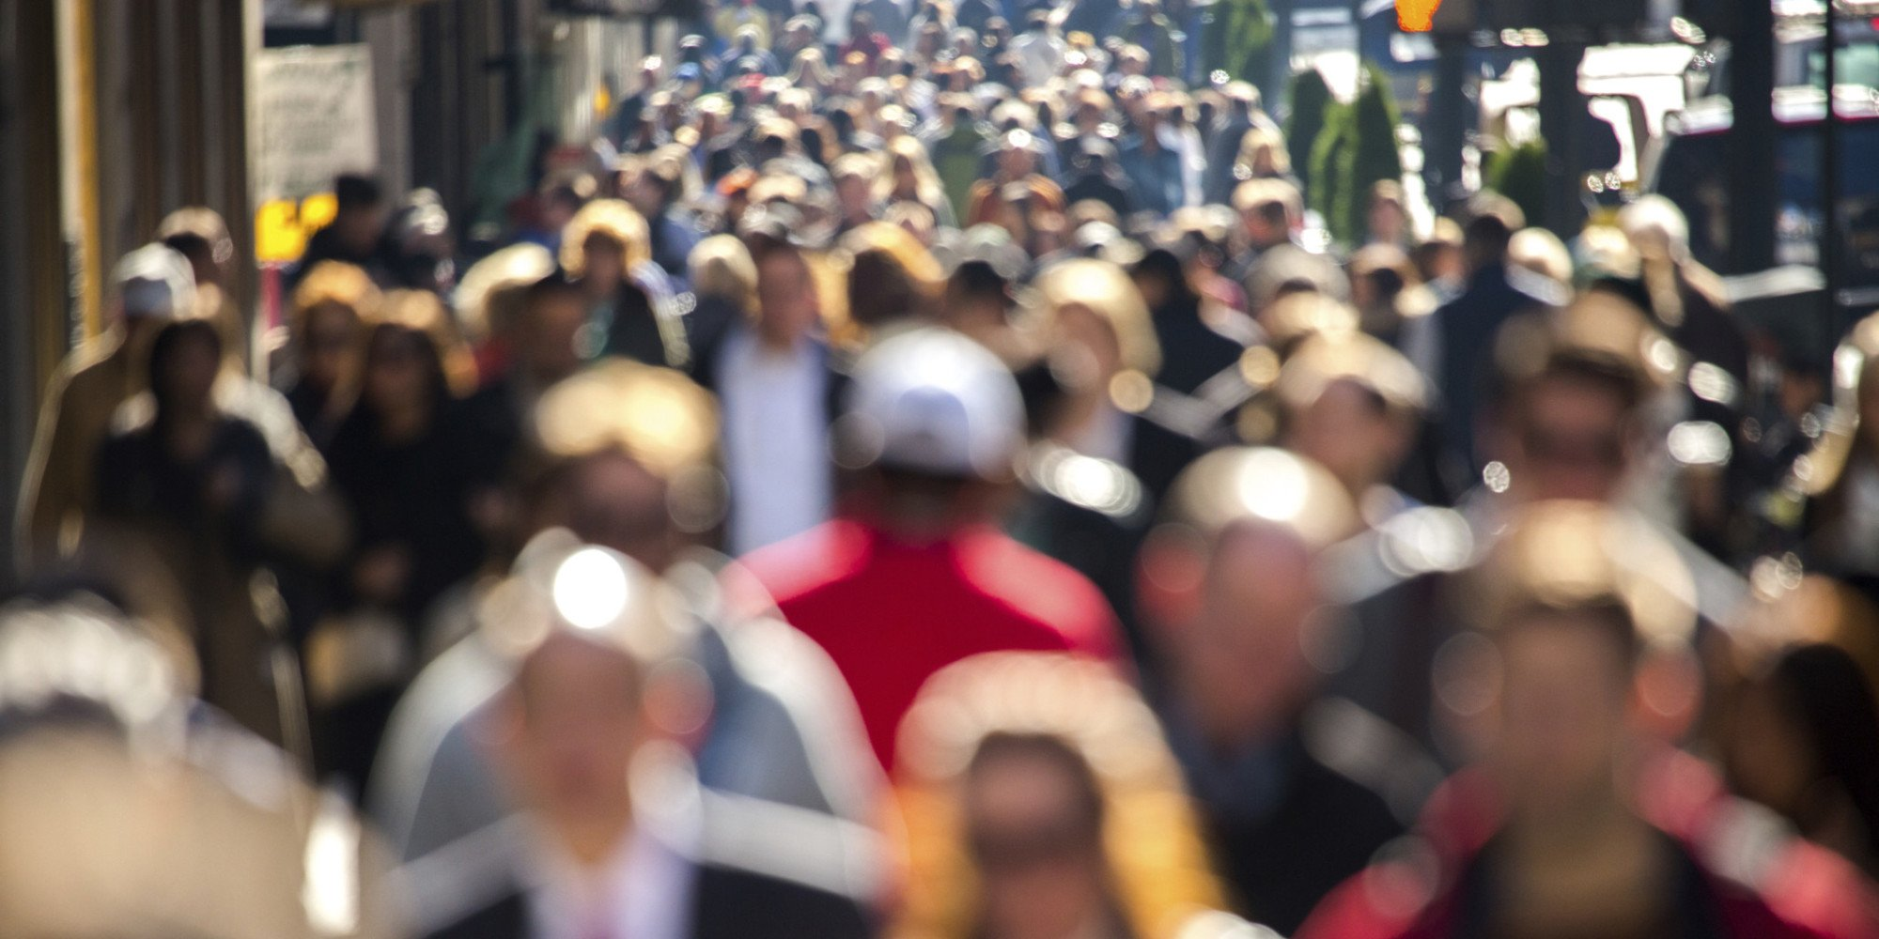
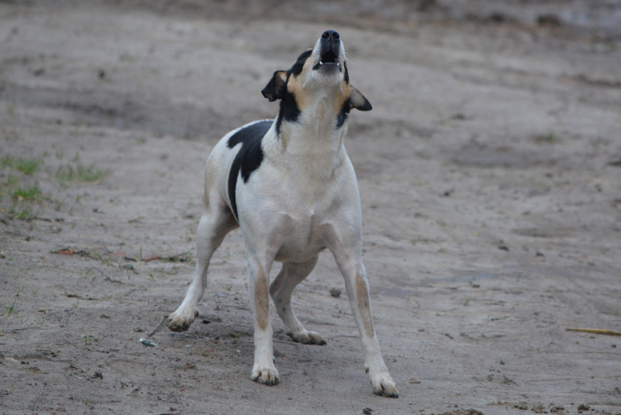
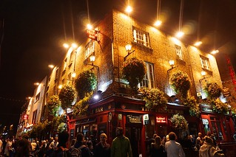

Slide 6
A working definition
Sound that is:
Unwanted
Unpleasant

Slide 7
Context dependant?

Slide 8
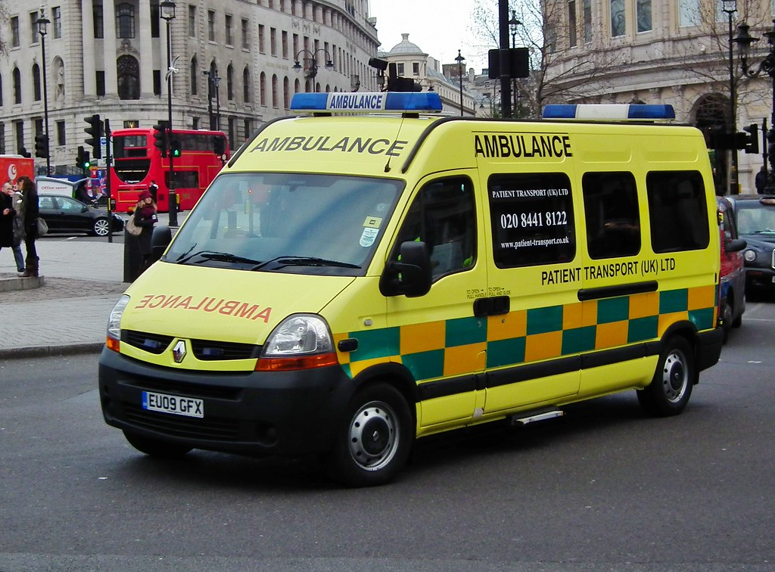

Slide 9
Not always awful?

Slide 10
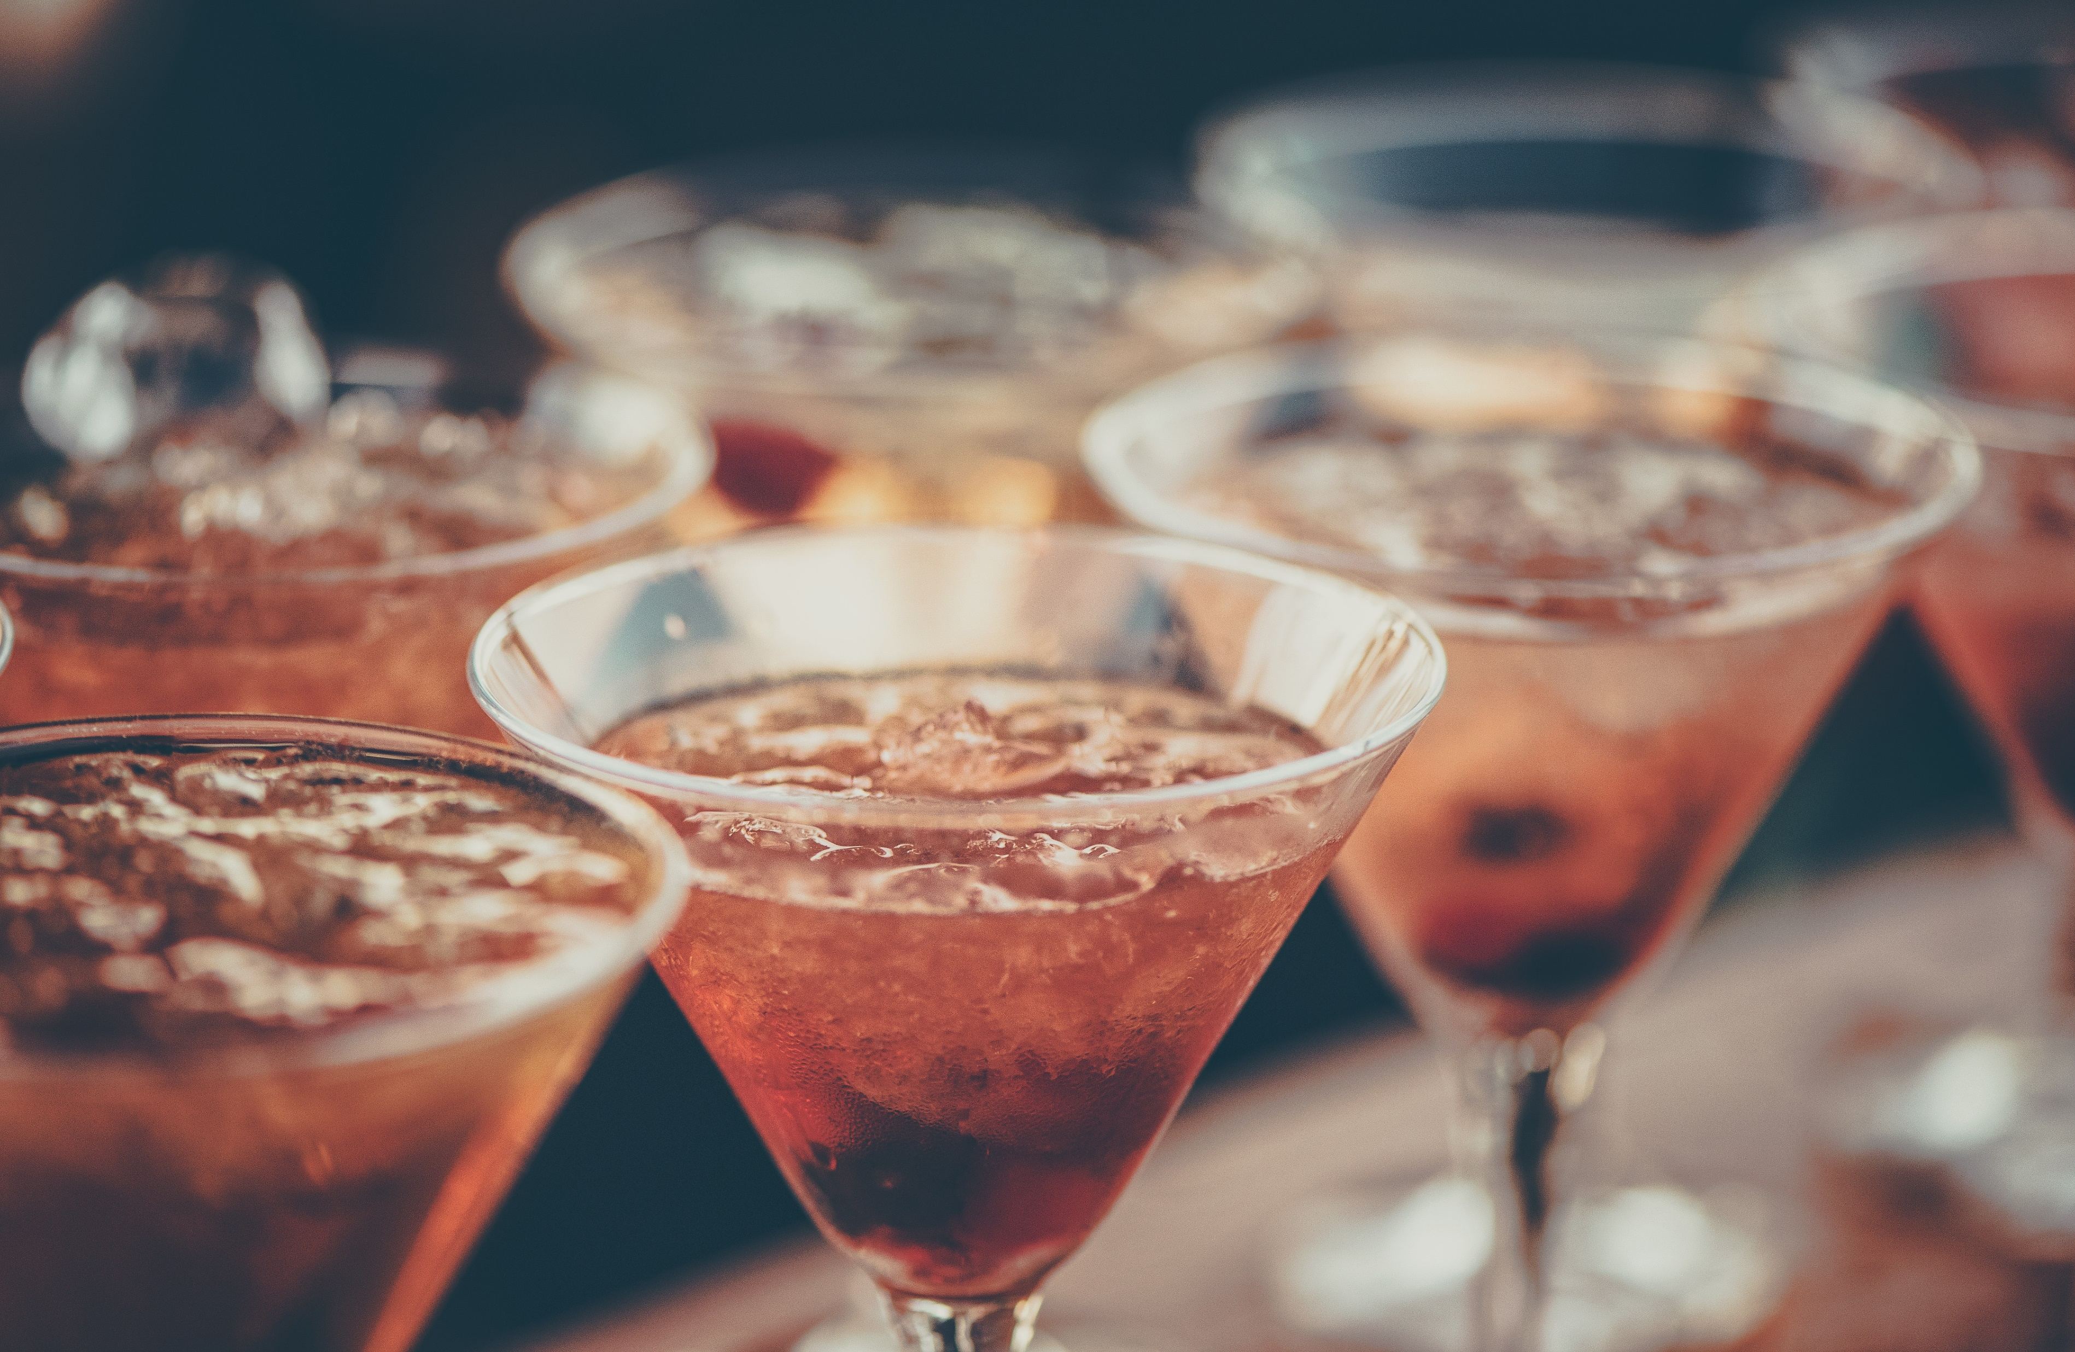

Slide 11
Human centred

Slide 12
An alternative, precise definition
Data Source
Transmitter
Receiver
Data Destination
Noise Source

Slide 13
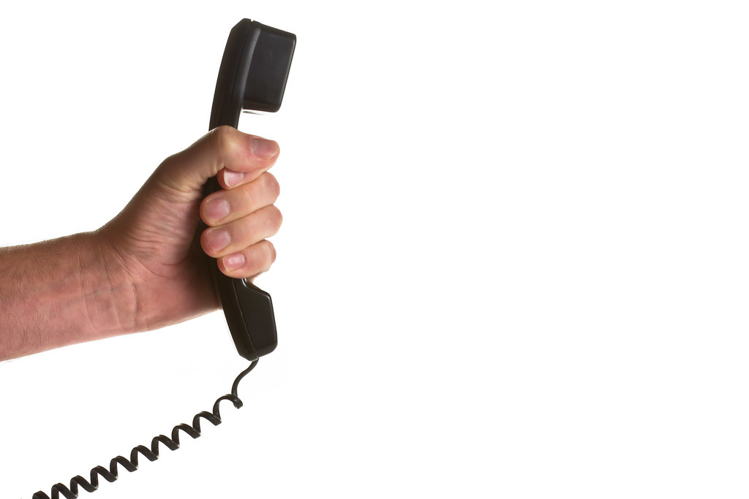
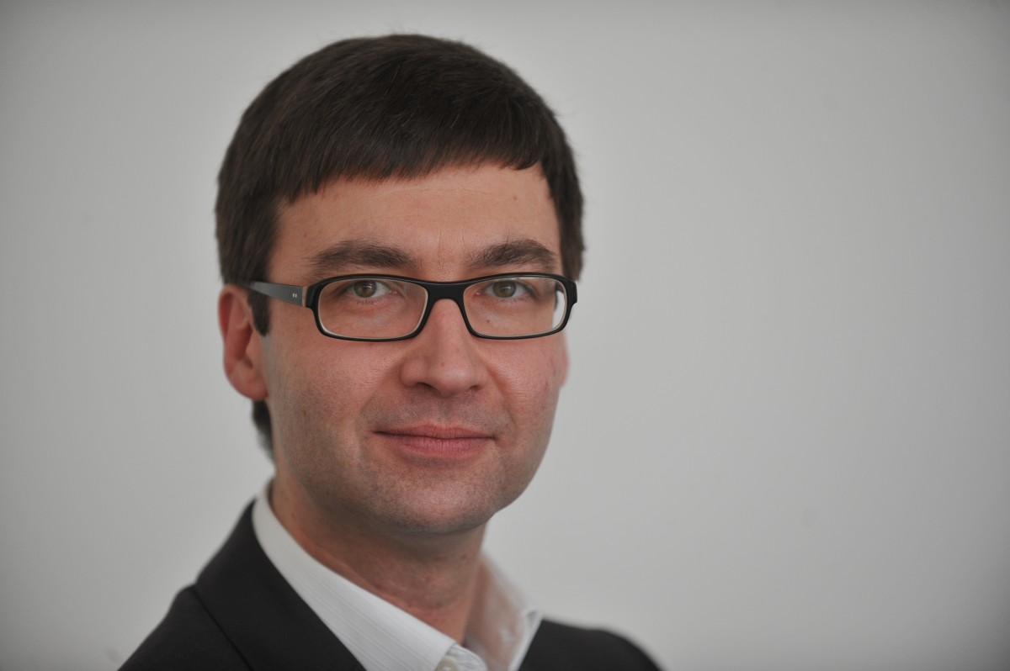
An alternative, precise definition
Data Source
Transmitter
Receiver
Data Destination
Signal
Received Signal
Noise Source
Attenuation
Interference

Slide 14
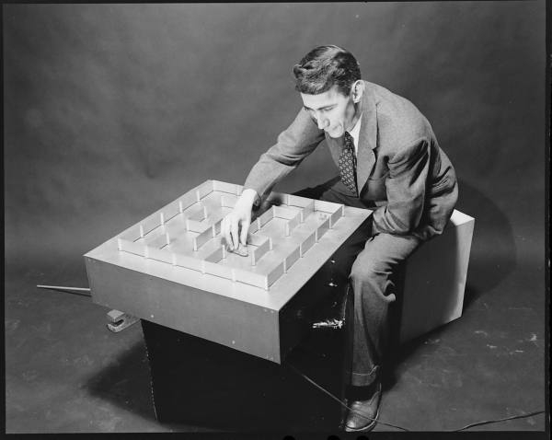
Information theory

Slide 15
An alternative, precise definition
Data Source
Transmitter
Receiver
Data Destination
Signal
Received Signal
Noise Source
Attenuation
Interference

Slide 16
“The word communication will be used here in a very broad sense to include all of the procedures by which one mind may affect another.” – Warren Weaver

Slide 17
An alternative, precise definition
Brain
Sound Proudction
Ear
Brain
Noise Source

Slide 18
A working definition
Sound that is:
Unwanted
Unpleasant
Disruptive

Slide 19
We haven’t even talked about sound.

Slide 20
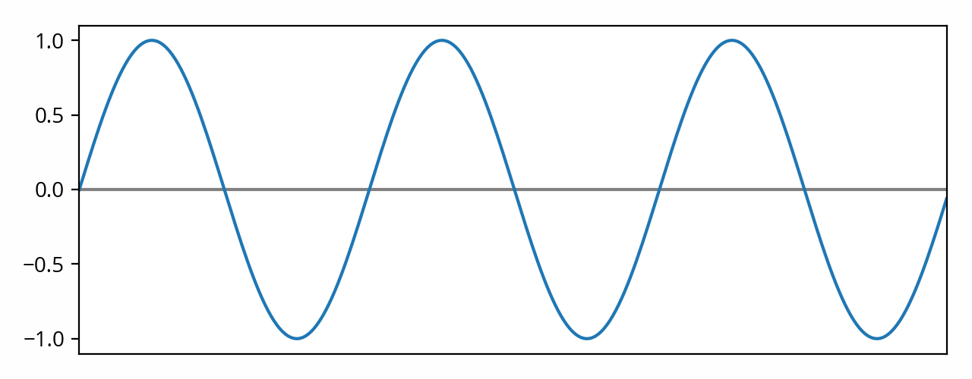
Deceptively simple?
Frequency
Amplitude/pressure

Slide 22
Inverse-square law
Source

Slide 23
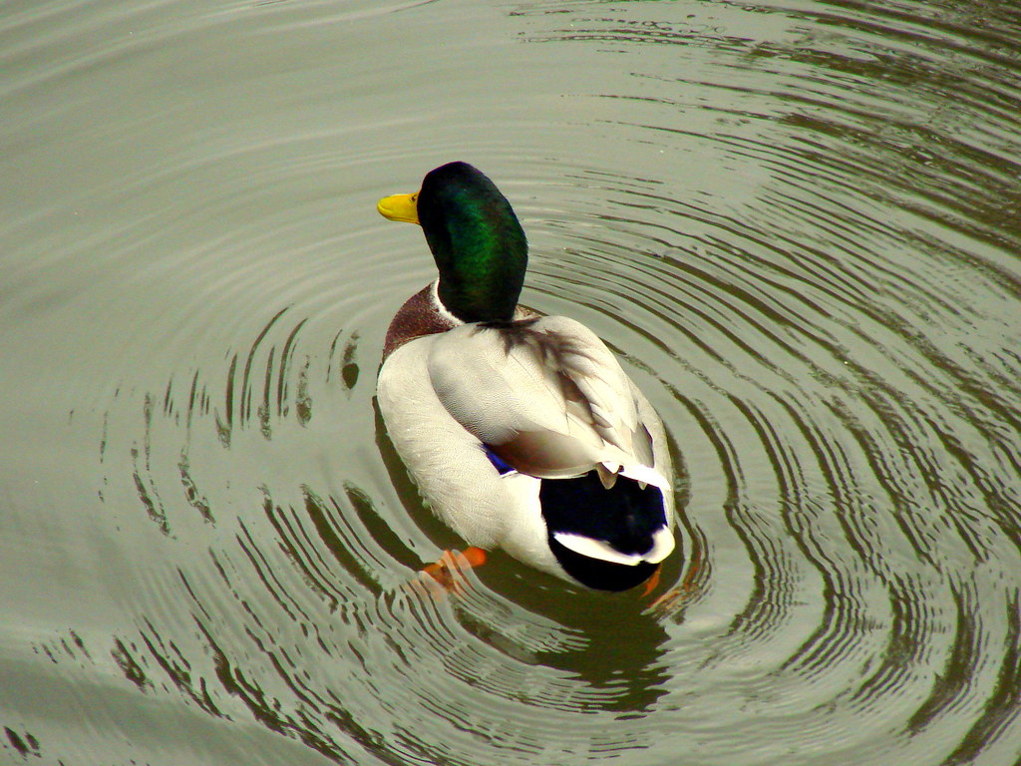
Inverse-square law
Source

Slide 24
What are the effects of noise?

Slide 25
On people
It is estimated that the annual social cost of urban road noise in England is £7 billion to £10 billion.
https://www.gov.uk/guidance/noise-pollution-economic-analysis

Slide 26
On people
It is estimated that the annual social cost of urban road noise in England is £7 billion to £10 billion.
sleep disturbance
annoyance
Acute Myocardial Infarction
hypertension
https://www.gov.uk/guidance/noise-pollution-economic-analysis

Slide 27
On wildlife
“This shift was especially notable because the frequency of human-produced traffic noise occurs within a range that interferes with the highest performance and most effective song. Thus, our “quiet” allowed the birds to quickly fill the most effective song space.”

Slide 28
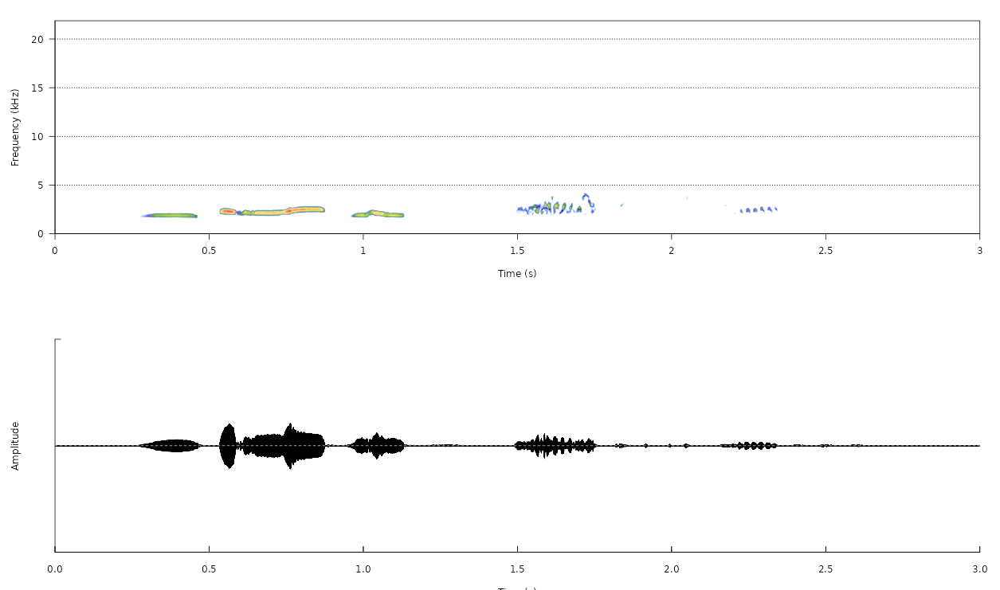
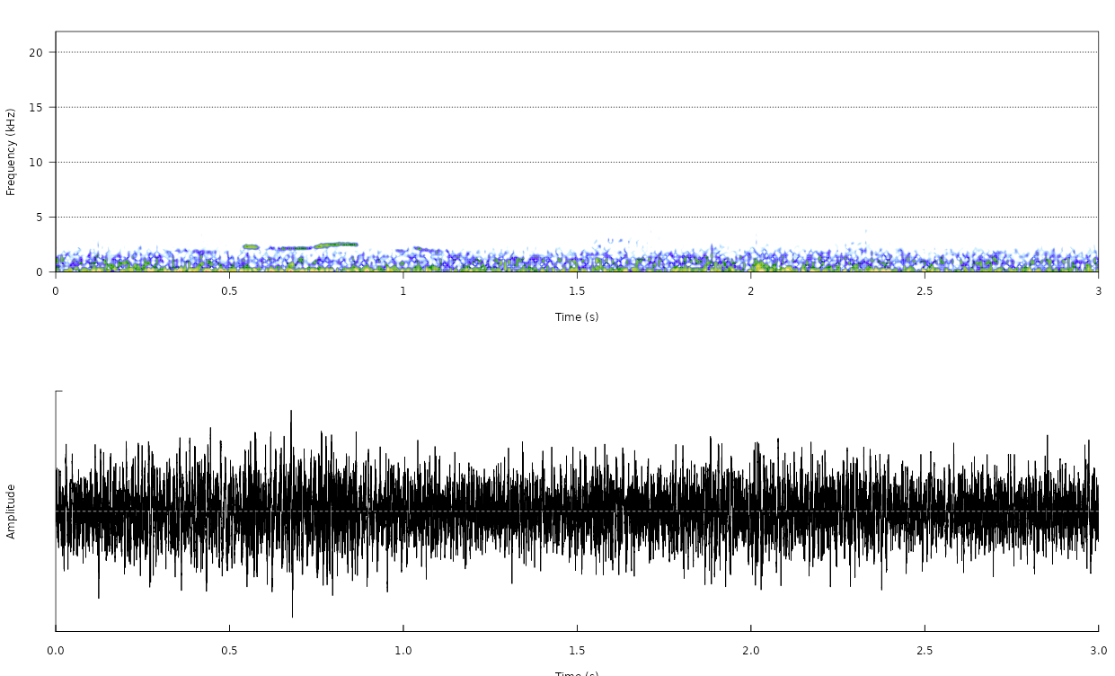
On wildlife
https://shiny.ebaker.me.uk/noise_wildlife/

Slide 29
On wildlife
“… birds exposed to traffic sounds in the egg had impaired growth, shorter telomeres, and reduced production as adults. Such effects may be pervasive given the ever-present background drone of our traffic noise.”

Slide 30
What do we do about it?

Slide 31
Abatement
Noise reduction
Noise buffers

Slide 32
Some standard things
Soundproof homes
Sound insulation, e.g. Double/triple glazing
Also increases thermal efficiency
Has to be replicated in every home
No wider benefit to people outside and other species

Slide 33
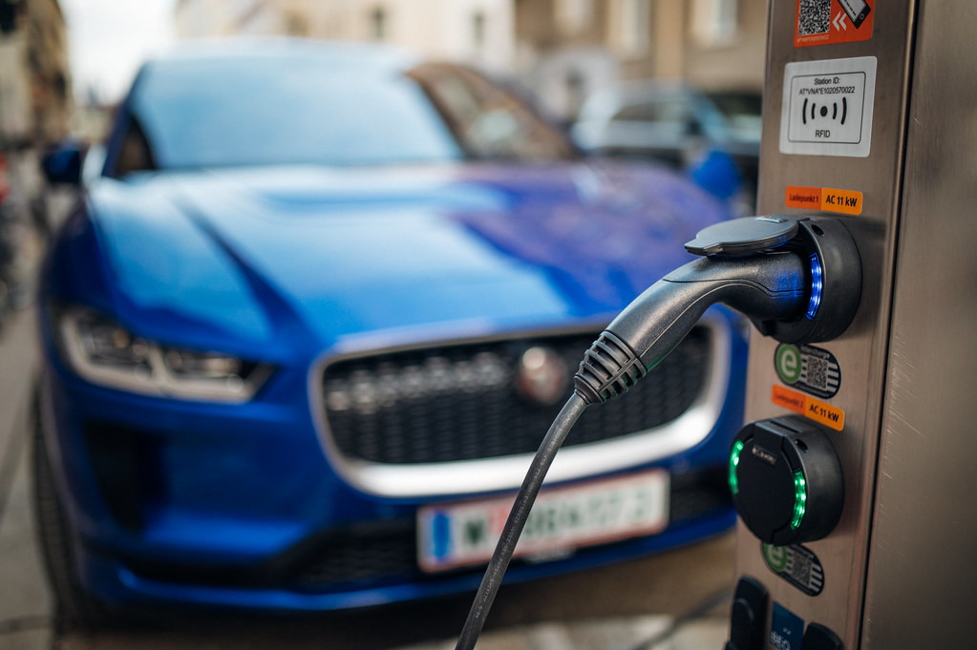
Noise reduction
Electric cars
But noise has information content
https://www.gov.uk/government/news/new-noise-systems-to-stop-silent-electric-cars-and-improve-safety

Slide 34
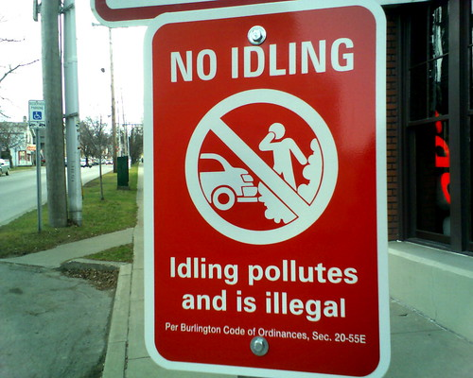
Quiet times / neighbourhoods
No night flights
No engine idling

Slide 35
Noise buffers (sound isolation)
Vegetation
5-10 dB per 30m (50% perceived volume, psychoacoustics)
Dense foliage (seasonal effects if deciduous)
Buffer close to source
Potential for other gains (biodiversity, urban heat islands)

Slide 36
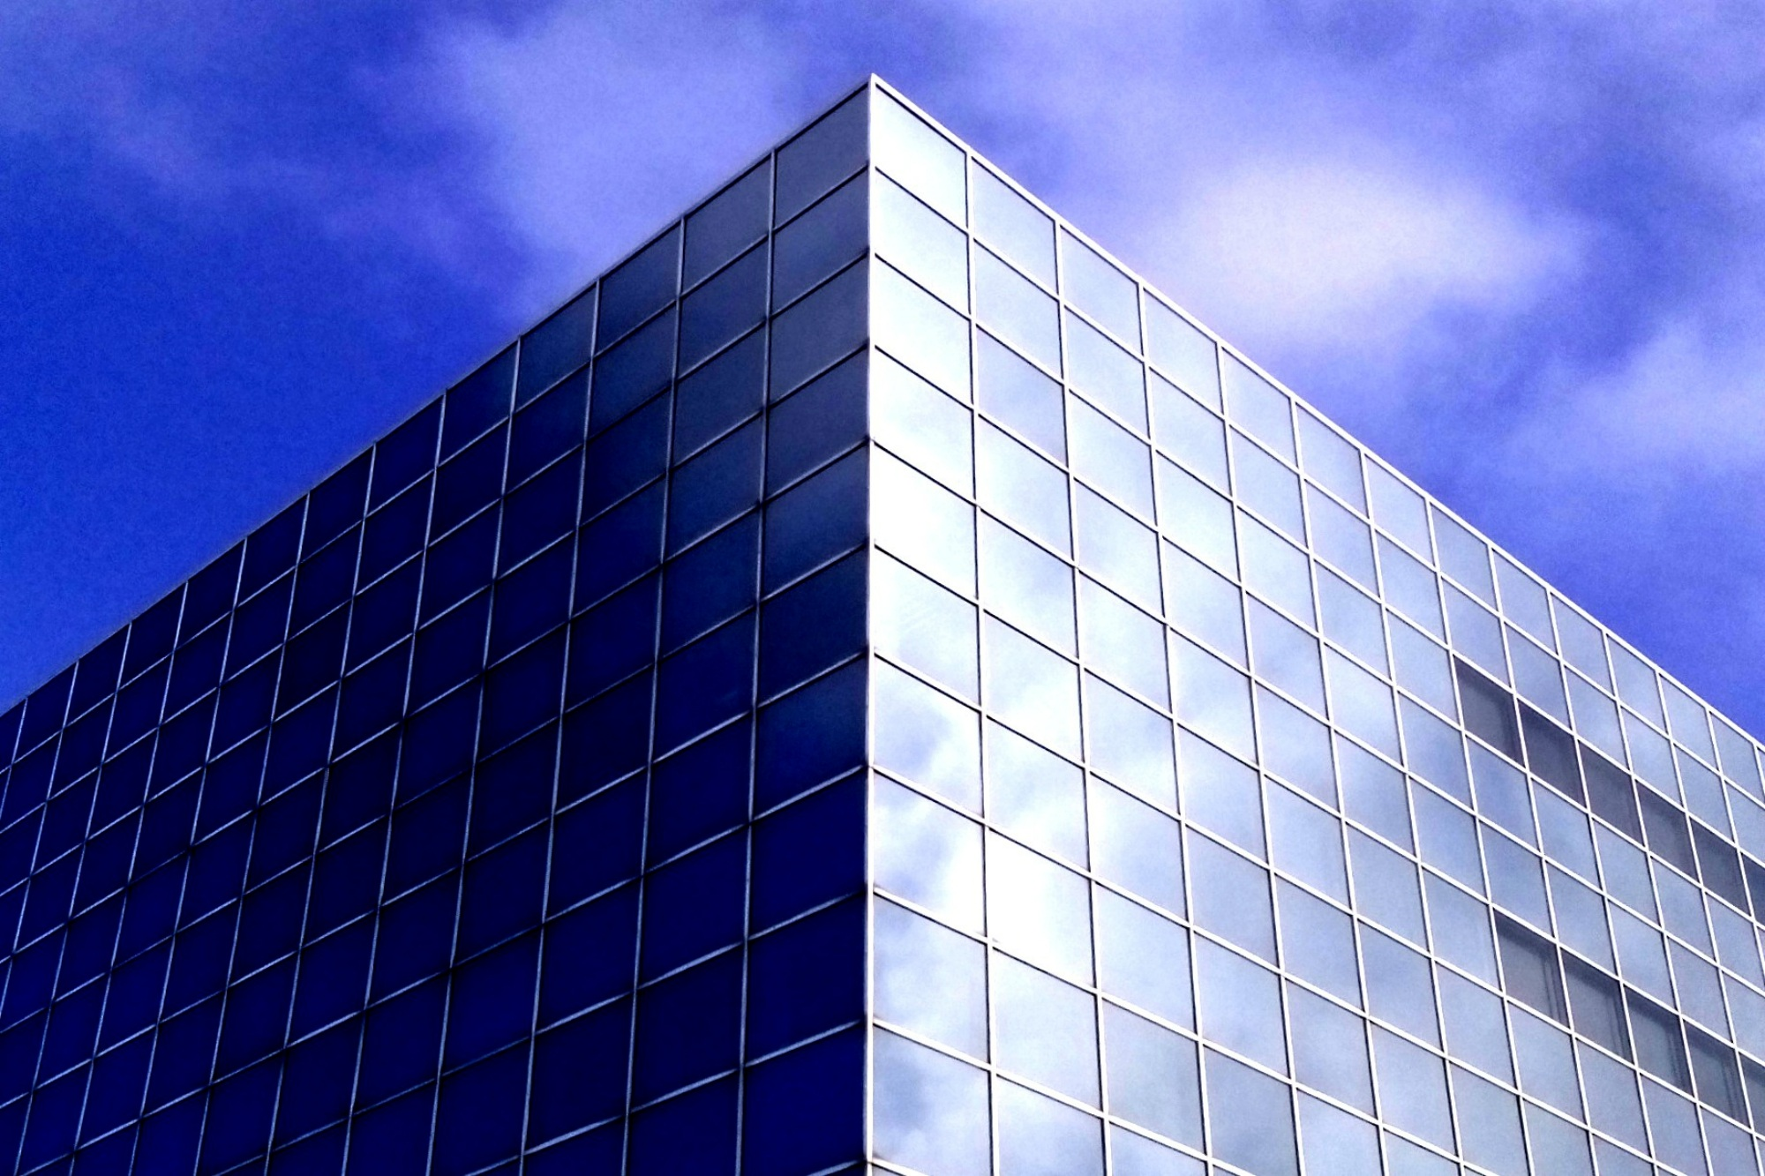
Noise buffers (sound reduction)
Sound reflects off flat surfaces
Urban planning
Green walls
Meta-materials

Slide 37
What’s missing?

Slide 38
What’s missing?
More-than-human
Non-airborne sounds
Several problems – one solution

Slide 39
Questions?
edward.baker@nhm.ac.uk

